Slide 1
Using Selection Criteria to Optimize Analysis in High Energy Physics
Comparing Methods to Find New Particles
Chris Davis*, Dr. David Toback, Daniel Cruz
Texas A&M University
Dr. Joel Walker, Jacob Hill
Sam Houston State University

Slide 2
Outline
Overview
Motivation for using selection criteria to find new particles
Using Selection Criteria (Cuts)
Comparing Different Approaches
Single Criterion
Two Criteria
Results

Slide 3
Motivation
We want to be more sensitive to new particles in High Energy Physics
Huge amount of collisions at colliders such as LHC means lots of data to look through
Many ways to look for new particles
However, most are dominated by Standard Model particle “Backgrounds”
In some places, new particle “Signal” dominates the Background
Higher sensitivity means we can better distinguish between Signal and Background, giving stronger results
Using selection criteria allows us to be the most sensitive to new particles in these regions

Slide 4
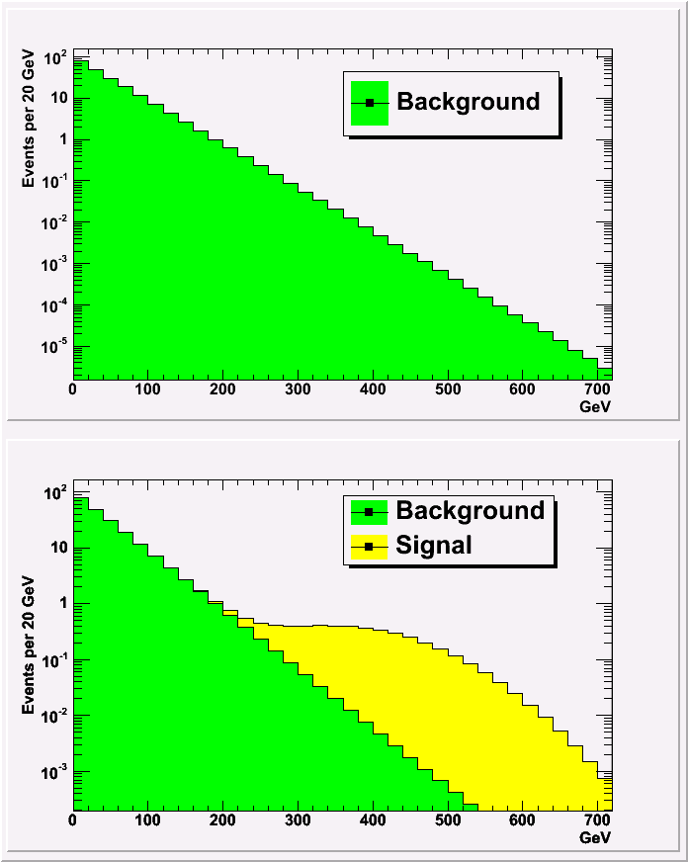
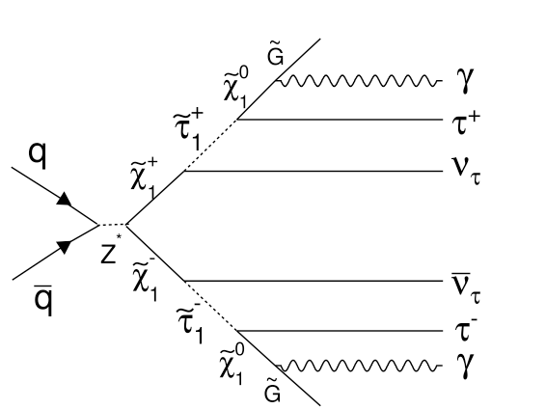
The Data We Used
Hypothesis 1
Data is from a diphoton search for supersymmetry at Fermilab¹
A typical, simple search involves counting
Number of Background events expected
Number of Signal events expected
How many events are observed in the experiment
Add up observed events to determine which hypothesis is more consistent with data
Hypothesis 2
1. Eunsin Lee, TAMU Ph.D. Thesis (2010), PRL 104

Slide 5
Using Selection Criteria (Cuts)

Slide 6
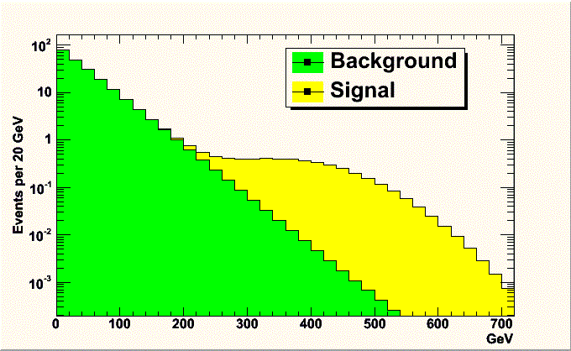
Selection Criteria
Selection criteria are used to optimize searches
Select only events that pass certain criteria
New particles easily pass them
Few Background events also pass
Thrown out

Slide 7
Single Selection Criterion
Creates a single set of data starting at A
Throw out all events that do not pass our criterion, count events from A→∞
Lowering the value of A adds in more background, more signal
Raising value of A takes out background, but also signal
We look at data that is most sensitive to signal
A
Thrown out

Slide 8
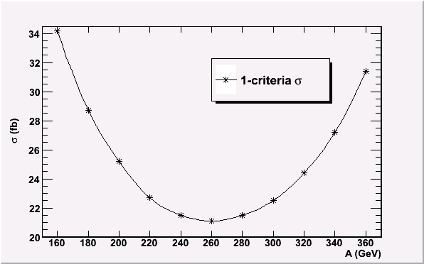
Single Criterion in Experiment
Cross section, σ, is a quantitative measure of sensitivity
Lower σ, better sensitivity
Higher σ, worse sensitivity
Vary A to optimize sensitivity
Can we get better sensitivity by doing a more sophisticated analysis?
8

Slide 9
Two Selection Criteria
Data is placed into two sets
Count events from A→B and B→∞
This is a more sophisticated analysis
Does being more sophisticated translate to being more sensitive?
Systematic errors can be introduced, we’ll deal with the simplest case without them in this talk
A
B
Thrown out

Slide 10
Main Question
Is it better to do one or two separate sets of independent criteria?
If we use two selection criteria, can we become more sensitive to new particles?.....Yes, will show!
Is using two selection criteria always more sensitive than using a single selection criterion?.....Surprisingly no, will show!
OR

Slide 11
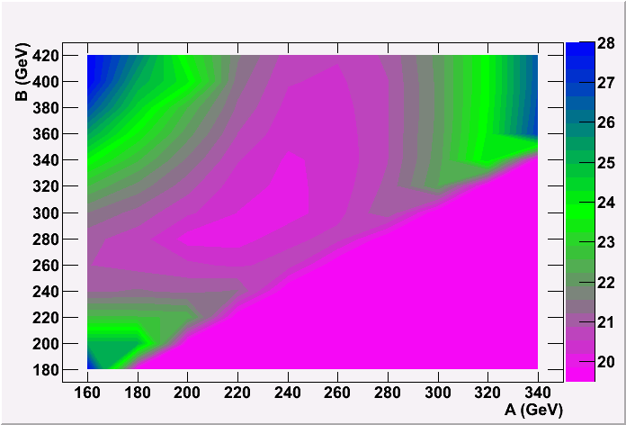
Two Selection Criteria in Experiment
Optimal criteria give lower σ than the optimal single criterion
≈5% less in this particular experiment
More sensitive!
Varying A and B to optimize sensitivity
Minimum
A≥B

Slide 12
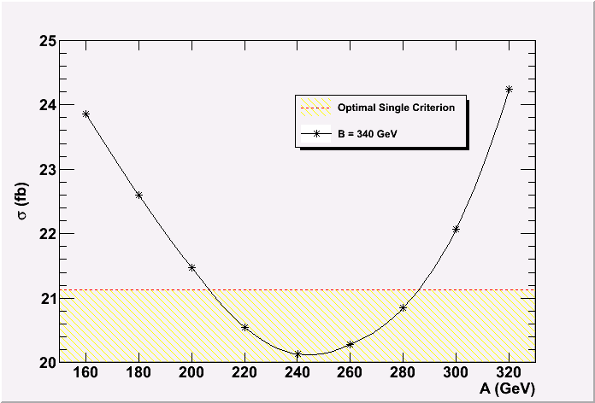
Can it be Worse?
A Varied
B Fixed
Look at two criteria in one dimension to compare with an optimal single criterion
There is a region where two criteria are better
However, also regions where two criteria are worse!
Worse!
Better!

Slide 13
Conclusions
Our sensitivity to new particles is improved when we use selection criteria
We have determined that
Two criteria CAN be better than a single, optimized criterion
Need to look for a minimum!
Two criteria CAN ALSO give a worse result if used incorrectly

Slide 14
BACKUP SLIDES

Slide 15
Signal Events

Slide 16
Limit Calculator
Example One-Cut input
160
1
-1 2.59 .0790 .1218 4.251 .3188
0
Example Two-Cut Input
360
2
-1 2.59 .0399 .1218 4.218 .3188
-1 2.59 .0391 .1218 .0326 .3188
0

Slide 17

Expected Cross Sections
N_{events} = Luminosity * σ_{production} * Acceptance
Find 95% confidence limits on σ_{production}
Taking cuts allows us to optimize expected σ
Used improved Limit Calculating program¹
1. Developed by Dr. Joel Walker, Sam Houston State University

Slide 18
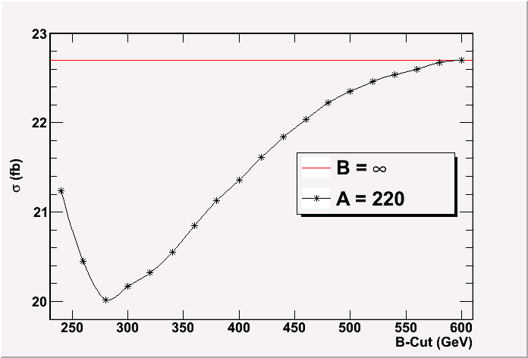
Splitting Single Cut into Two
If you take a single cut and place a B cut in it, you will always improve your sensitivity
Possibly not much better, but never worse

Slide 19
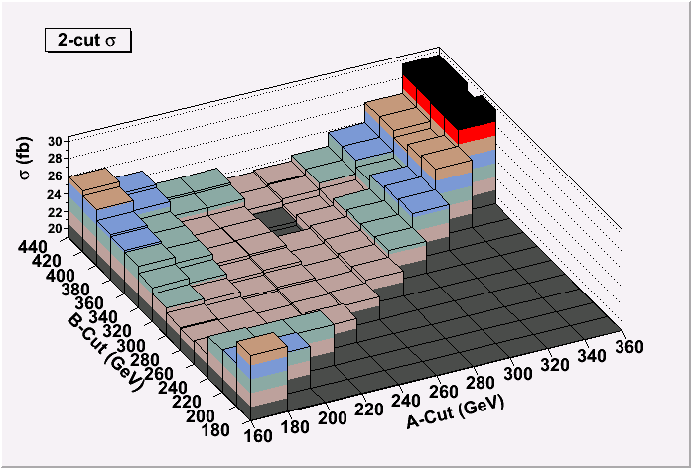
Binned Value Two-Cut
The optimal cuts give 20.1 fb at A:240 B:360

Slide 20
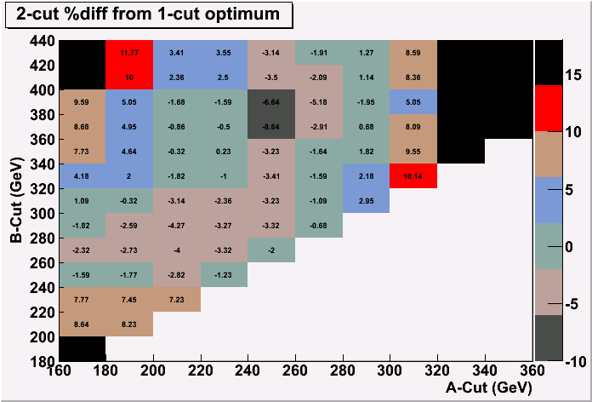
Percentage Decrease
Two cuts can be used to improve the optimal expected limit
Able to achieve slightly under 10% decrease (8.64%)

Slide 21

Acceptance
Related to signal by a scaling factor

