Slide 1

Studying top quarks at the Fermilab Tevatron
Presented by Sarah Henry for the CDF collaboration
Texas APS, Texas A&M University
October 18th-19th

Slide 2
Overview
Top quark production
Predictions from the Standard Model
Predictions in the case of a new particle
Results
Notes:
Top quark production – a little about the Fermilab Tevarton. , predictions for this top quark production that stems from the SM but also in the case that there is a new particle out there. Then the actual results from Fermilab

Slide 3
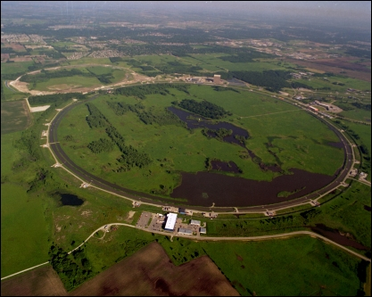
Collider Physics
We collide particles (protons and anti-protons) at very high speeds and when they collide sometimes top quarks are produced
This experiment was done at the Fermilab Tevatron (shown above)
Notes:
There are only two places in the world where a particle accelerator is able to create top quarks. One is the lhc and the other is fermilab. At fermilab we collide protons and anti protons

Slide 4
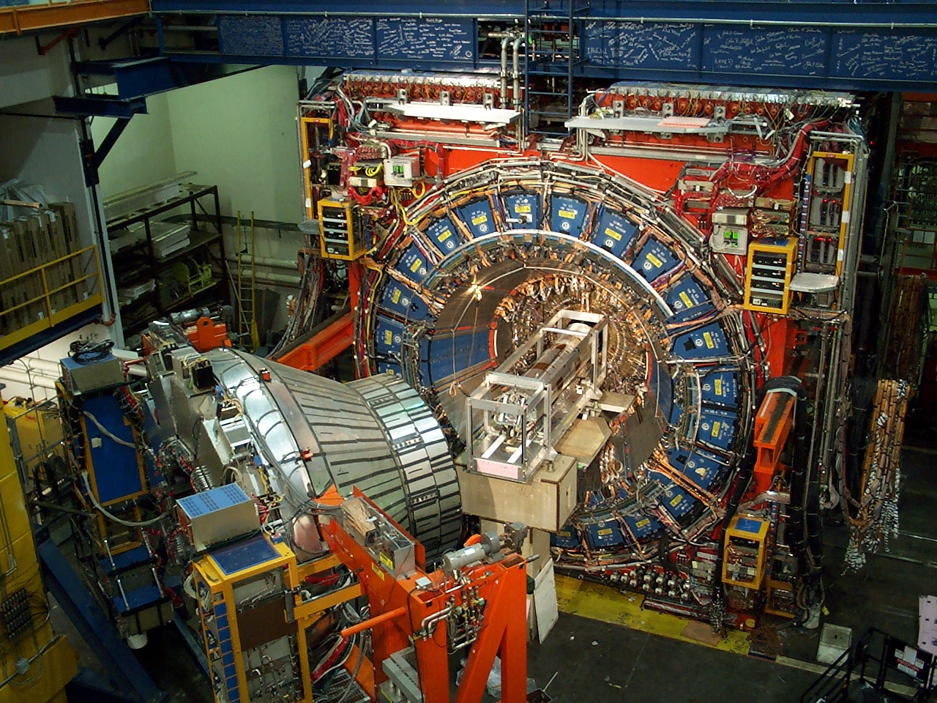
Collider Physics
With special detectors, we can identify top quarks and measure what direction they go.
CDF detector (shown above)

Slide 5
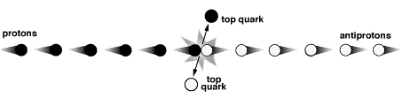
Particle Physics
Using the detector, we can count the number of times a top quark goes along the same direction as the proton (call this “forward”) and when it goes the other way (call this “backward”). A calculation can be done, based on the known laws of physics (the standard model of particle physics), that predicts the number of forward vs. the number going backward
Backward
(-)
Forward
(+)

Slide 6
Theory of particle physics
If you look at a lot of collisions, slightly more top quarks will be produced “forward” than “backward”
But not by much – not more than a few %

Slide 7
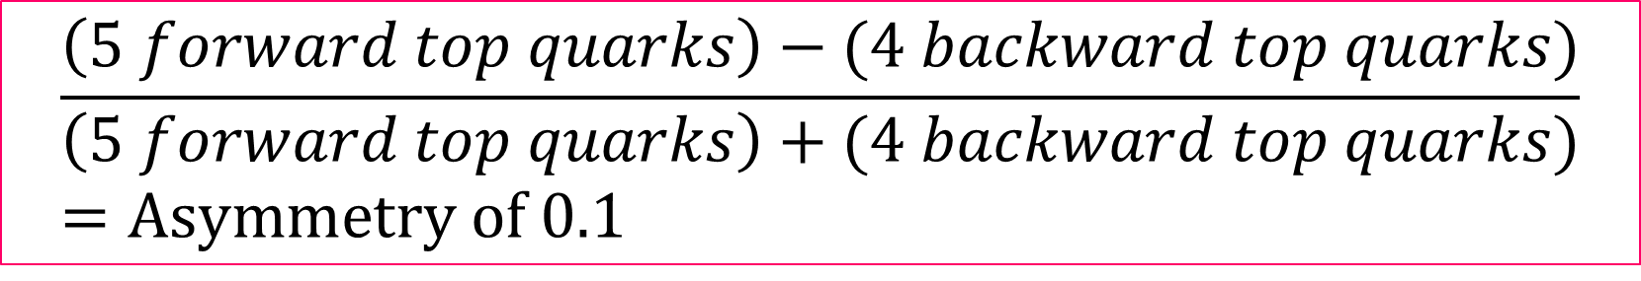
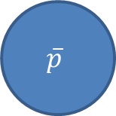
BACKWARD
FORWARD
p
t
$$\overline{p}$$
t
t
t
t
t
t
t
t
$$\frac{\left(5 forward top quarks\right)−(4 backward top quarks)}{\left(5 forward top quarks\right)+(4 backward top quarks)}=Asymmetry of 0.1$$

Slide 8
Predictions
Imagine there exists another particle. What would happen in that experiment when we count the number of top quarks that go forward and the number that go backward?
An example of a new particle would be the axigluon, which is a heavy partner of the gluon
New particle
We make measurements to compare different predictions of new particles.
The existence of this particle could create many more OR many fewer forward-going particles than backward-going particles.

Slide 9
Results with the error bar
(1) Standard Model prediction: 0.038±0.003
Prediction of a new particle of type “A”
Prediction of a new particle of type “B”
0
(1) W. Bernreuther and Z.-G. Si, Phys. Rev. D 86, 034026
(2012).

Slide 10
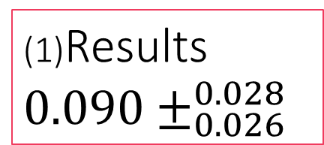
Results with the error bar
Standard Model prediction: 0.038±0.003
(1)Results ${0.090±}_{0.026}^{0.028}$
Prediction of a new particle of type “A”
Prediction of a new particle of type “B”
0
(1) Measurement of the Inclusive Leptonic Asymmetry in Top-Quark Pairs
that Decay to Two Charged Leptons at CDF. Phys. Rev. Lett. 113, 042001.
T. Aaltonen et al. (CDF Collaboration)

Slide 11
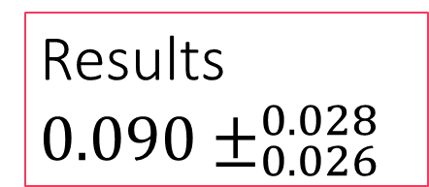
Results with the error bar
Standard Model prediction: 0.038±0.003
Results ${0.090±}_{0.026}^{0.028}$
Prediction of a new particle of type “A”
Prediction of a new particle of type “B”
0

Slide 12
Conclusion
We have measured the forward-backward asymmetry of top quarks produced at the Fermilab Tevatron using the CDF detector.
The results are not completely consistent with the expectations of the Standard Model of particle physics but they are not far enough away to indicate evidence of a new particle.
We have published these results and are looking at the rest of the data for other information that might be helpful for us to resolve this puzzle one way or another.
Stay Tuned!

Slide 13
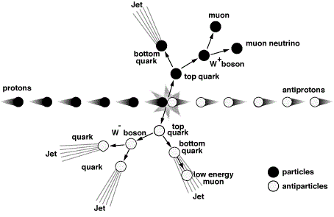
Proton antiproton collision diagram
Notes:
Collision at 1.96 Tev

Slide 14
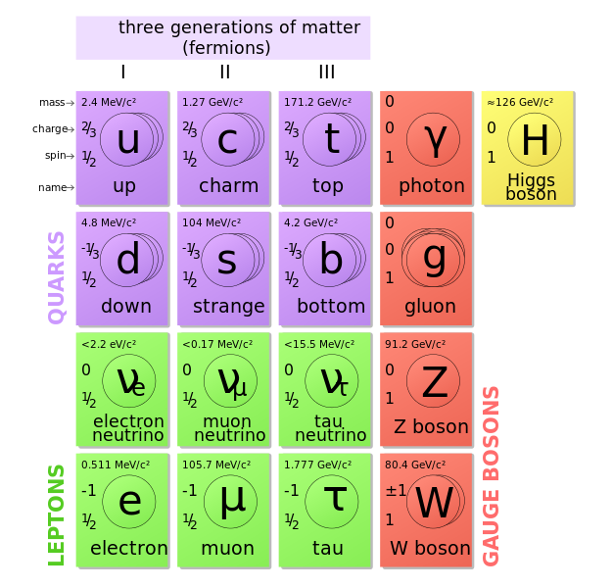
Top Quark
The top quark is short lived and massive
Mass of 173 GeV
Lifetime of 10^-24 seconds
Notes:
It has the shortest lifetime of all six quarks

Slide 15
Particle Physics
The Fermilab Tevatron is one of only two places in the world where a particle accelerator was able to create top quarks via collision and study their properties.
The other collider is the Large Hadron Collider (LHC)
The difference between the two
Fermilab studies top quark pair production from proton antiproton
The LHC studies from proton proton collisions
Notes:
Fermilab is 6.3 km, 3.9 miles in circumference.
LHC is 27 km in circumference
The discovery of the top quark was from Fermilab in 1995 by D0 and CDF

Slide 16
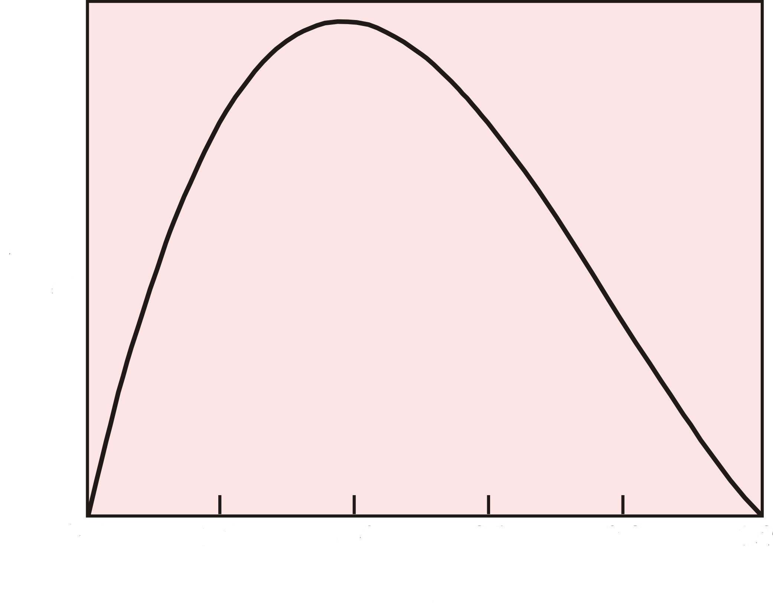
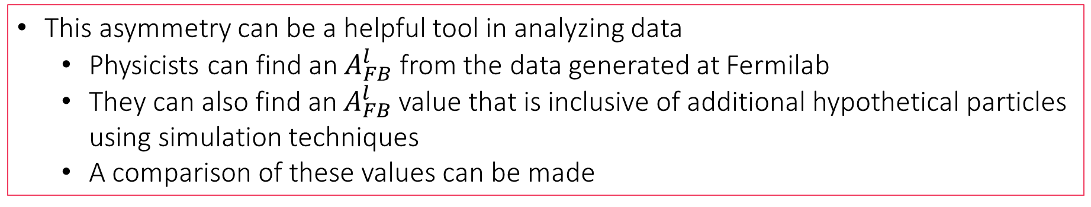
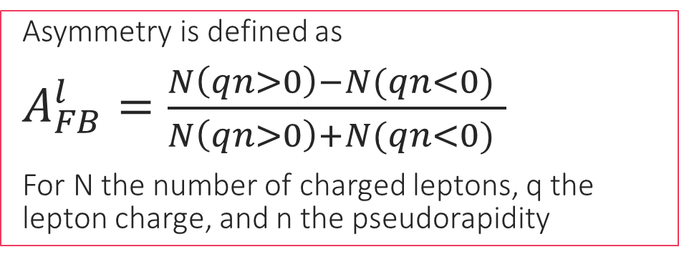
Asymmetry
Asymmetry is defined as
$A_{FB}^{l}=\frac{N\left(qn>0\right)−N(qn<0) }{N\left(qn>0\right)+N(qn<0) }$
For N the number of charged leptons, q the lepton charge, and n the pseudorapidity
This asymmetry can be a helpful tool in analyzing data
Physicists can find an $A_{FB}^{l}$ from the data generated at Fermilab
They can also find an $A_{FB}^{l}$ value that is inclusive of additional hypothetical particles using simulation techniques
A comparison of these values can be made

Slide 17
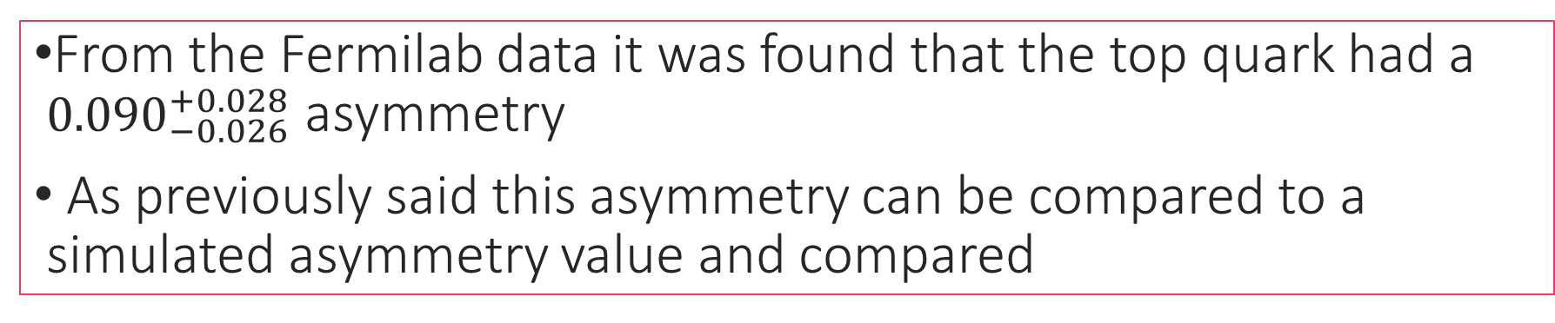
Results
From the Fermilab data it was found that the top quark had a ${0.090}_{−0.026}^{+0.028}$ asymmetry
As previously said this asymmetry can be compared to a simulated asymmetry value and compared
Theoretical physicists have come up with a particle called an axigluon. Though we may not know much about this particle we can give feedback on whether their axigluon model holds a possibility of existing
200 GeV AxiL -0.063 (left handed axigluon)
200 GeV AxiF – 0.151 (right handed axigluon)
200 GeV Axi0 – 0.050 (pure axigluon)

