Slide 1



CDF Legacy
Results
2014 and Future
Fermilab Wine & Cheese
David Toback
Texas A&M University
December 2014

Slide 2
Prelude
The CDF collaboration continues to do exciting physics and publish at a strong rate
Focusing on legacy results that are competitive and complementary to the LHC
In a phrase, our motto is “Get the papers out!”

Slide 3
Overview
Big picture of the science in 2014, and CDF’s role in it
Some fun numbers for those keeping track
The CDF Legacy Program
  Higgs
  Searches
  Top
  Heavy Flavor
  QCD
  EWK
Looking Forward & Conclusions

Slide 4
The Big Picture in 2014
There are many BIG questions in 2014, many of which were not on our radar screen in the early 1980’s when CDF started
Why is the top mass so much bigger than all the others?
  Why is the top coupling to the Higgs so large?
What protects the Higgs mass?
Is Supersymmetry a correct description of nature?
Are there extra dimensions of nature?
What is the mechanism that gives neutrinos mass?
What is the dark matter that fills the universe?
What is the dark energy that is causing the universe to accelerate?
Why so much matter in the universe and so little anti-matter?
What bigger theory does the SM approximate so well?

Slide 5
The Collider Program
The Collider Program, Tevatron and LHC, try to address many of these questions
LHC has taken over in many ways, especially for interactions which are only probed at the highest energies
Tevatron is completing its studies in a number of competitive areas
  Typically complementary to the LHC and other experiments

Slide 6
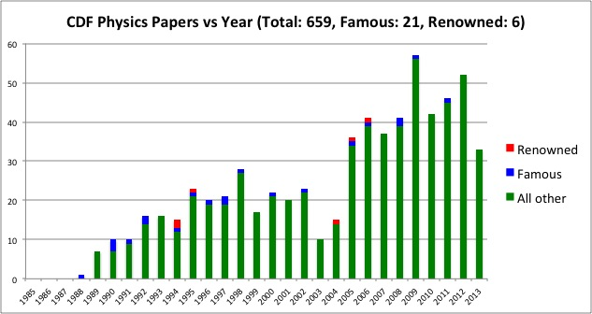
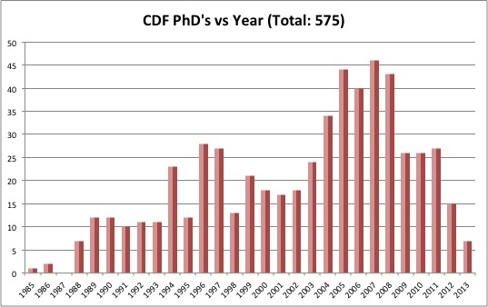
History
The numbers leading up to 2014 were large and impressive
  Continue to have excellent results in all physics groups
  Already have 20 papers this year

Slide 7
Tevatron Legacy
Review Papers
CDF and Dzero Recently came together to do a set of Review Papers that nicely summarize both Run I and Run II results
Overview: 1409.4861
Higgs: 1409.5043
New particles: 1409.4910
Top: 1409.5038
Heavy Flavor: 1412.5211
QCD: 1409.5639
EWK: 1409.5163

Slide 8
Higgs Physics
Tevatron has the advantage in the Higgs → bb final state
LHC has done an excellent job in the other modes, giving strong evidence that it behaves like a SM Higgs
CDF Legacy program is about finishing our statements about the bb final state, and contributing to the understanding of the story by testing the spin/parity of the Higgs

Slide 9
Final Higgs Combination
Both CDF and DZero have completed their searches
Powerful results in bb are complementary to the final states from the LHC
Observed significance is 3.0σ at a Higgs mass of 125 GeV
Tevatron combination published in PRD 88, 052014 (2013)

Slide 10
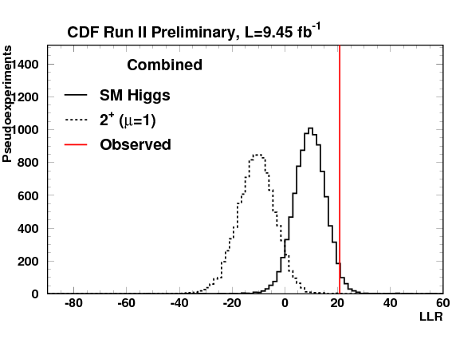

Higgs Couplings
Emphasis has shifted to property measurements
Compare data in VX with X→bb to predictions of exotic Spin and Parity combinations
    Pseudoscalar Higgs with J^{P}=0⁻
    Graviton-like state with J^{P}=2⁺
    Kinematics are very different than in SM (which has J^{P}=0⁺)
Data is much more like SM than either of the two other hypotheses (exclude at better than 95% C.L.)

Slide 11
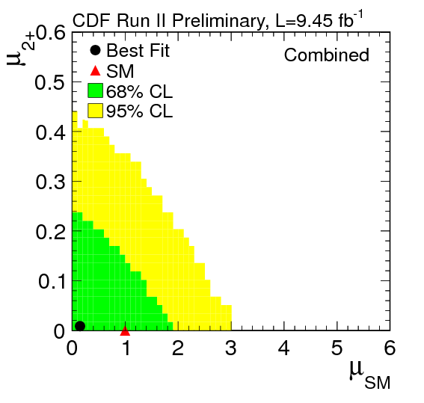
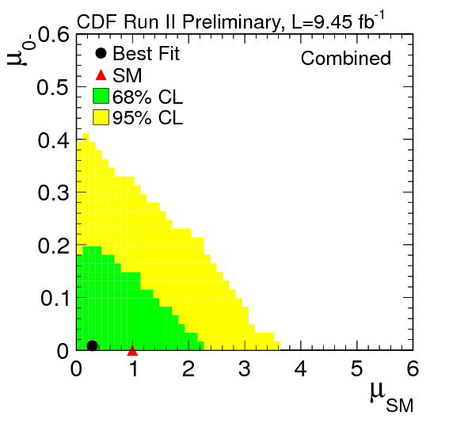
Higgs Couplings Continued
Can also test the amount of strength of the two hypotheses simultaneously
Data favors SM at its expected rate and no contribution from exotic states

Slide 12
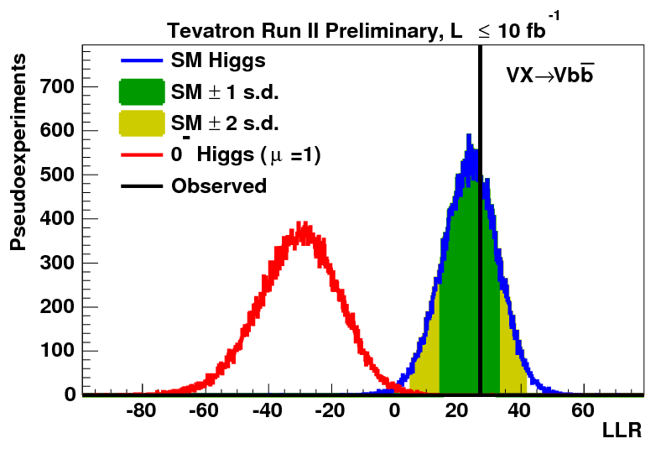
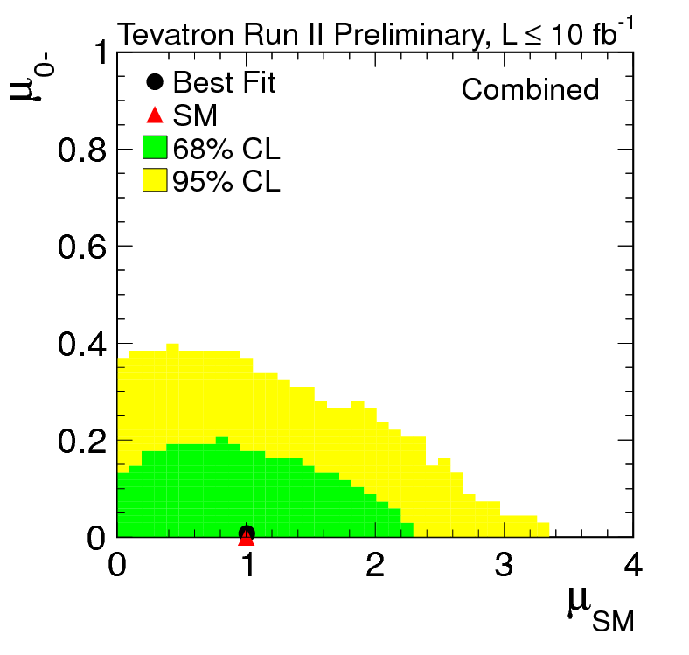
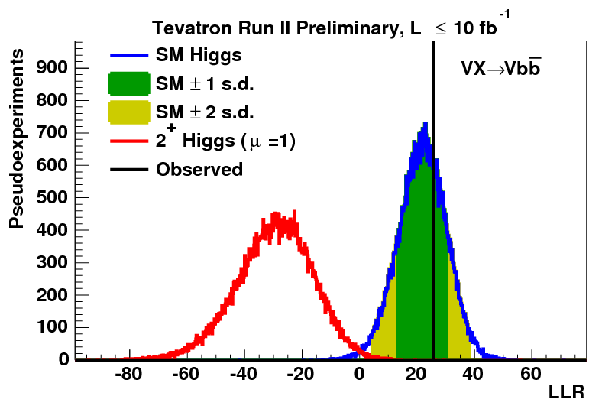
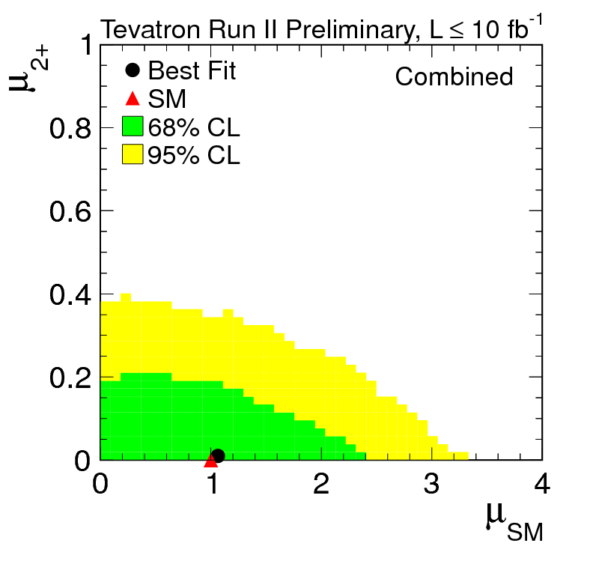
Tevatron Combination to be Submitted by the End of the Year

Slide 13
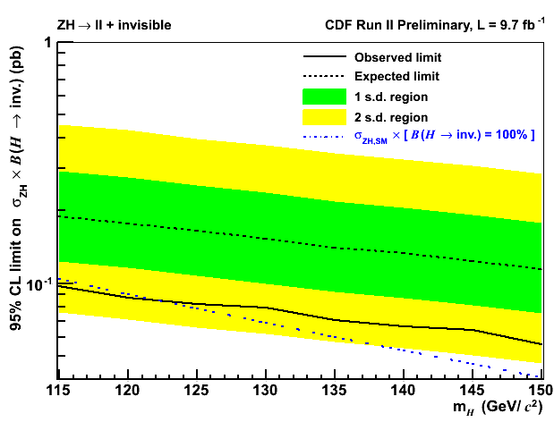
Invisible Higgs
Search for ZH→ll+Invisible is recently completed
  CDFNote 11068
Working on new interpretation of this result in dark matter scenarios

Slide 14
New Particle Searches
Long history of searches at CDF for established models like Supersymmetry, heavy vector bosons, or extra dimensions
Try different models of each, but also in many different variations
Any indication of a deviation from the SM could help point the way to an understanding of what protects the Higgs mechanism, gives neutrinos their mass, tell us if the world is Supersymmetric in nature, or perhaps even give us a dark matter candidate

Slide 15
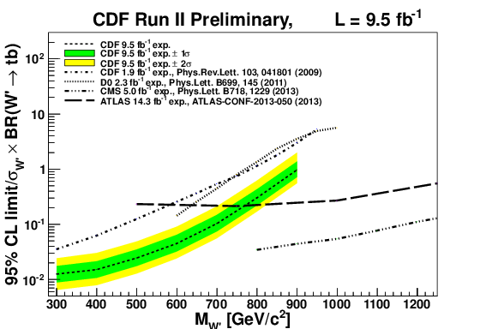
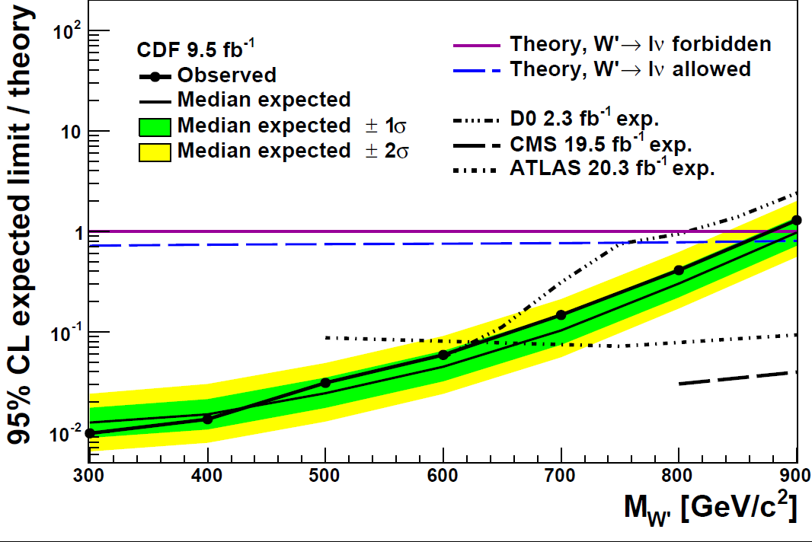
Search for Heavy Vector Bosons
Tevatron still has advantages for intermediate-mass searches
    PPbar vs. PP (backgrounds)
    Low number of interactions per crossing (triggers)
Recent limits on W’→tb are the world’s best at intermediate masses
    Same for Z’ → tt

Slide 16
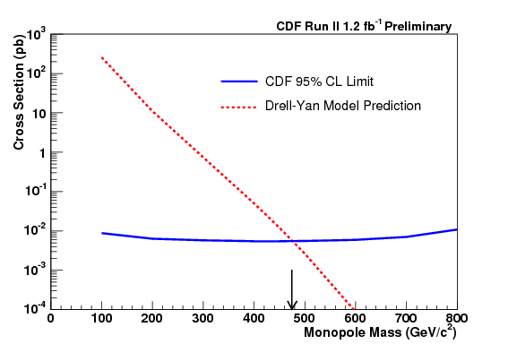
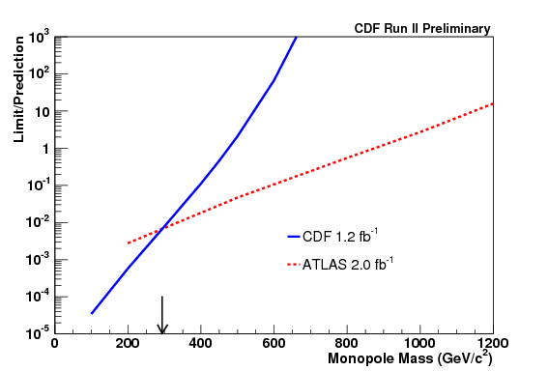
Monopoles
Use the detector in fun new ways (straight tracks, very high ionization, time-of-flight) to expand our sensitivity to magnetic monopoles
World’s most sensitive limits for intermediate masses
  Public Note 11102

Slide 17
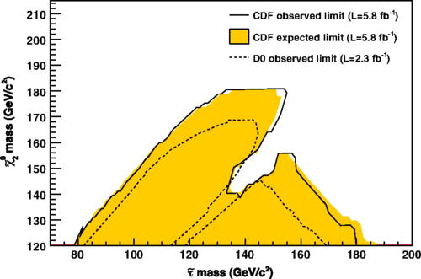
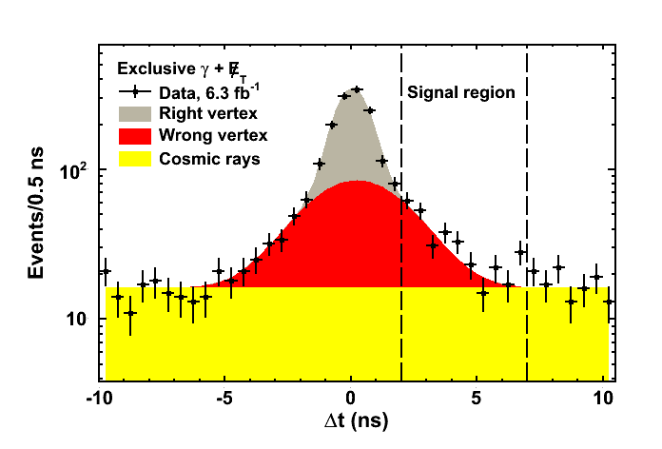
Supersymmetry
Long history of searches for SUSY, including models with mSUGRA, GMSB, and Large tanBeta versions of both
Important results in τ and photon final states, including the EMTiming system to search for Delayed Photons
  mSUGRA program finished
  Last GMSB results with delayed photons expected soon

Slide 18
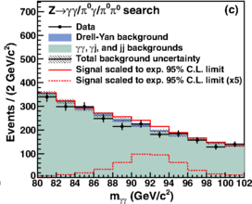
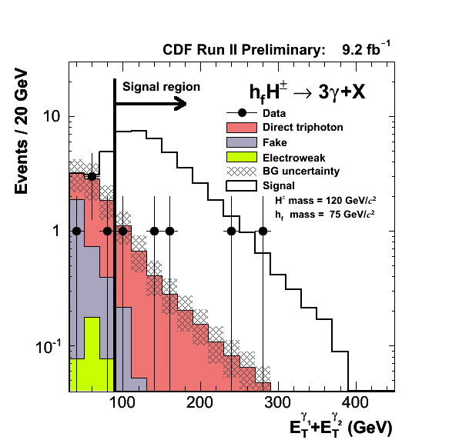
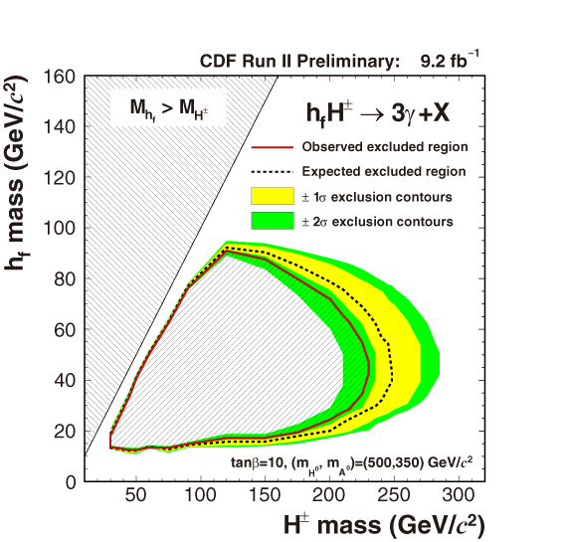
Diphotons and Triphotons
Search for forbidden Z→γγ decay (PRL 112, 111803 (2014))
First tri-photon results which can be interpreted in Higgs models (CDFNote 11116)

Slide 19
Top Quarks
Top quark is a unique probe of particles and their interactions
Precision measurements are important in their own right, as well as completing the EWK model with the Higgs
Cross sections (single top and pair production) are the last of their kind for the foreseeable future
Property measurements are still competitive with LHC
The forward-backward asymmetry has been anomalous for years, and it may well be that it tells us that NNLO understanding of top quark production is necessary

Slide 20
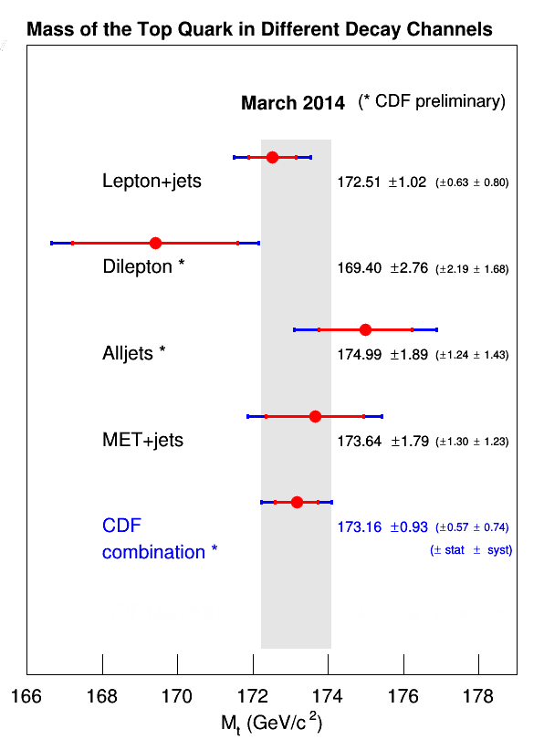
Top Mass
CDF Combination now complete in all channels
  Public Note 11080
Updating Lepton+Jets analysis for Matrix Element Methods

Slide 21
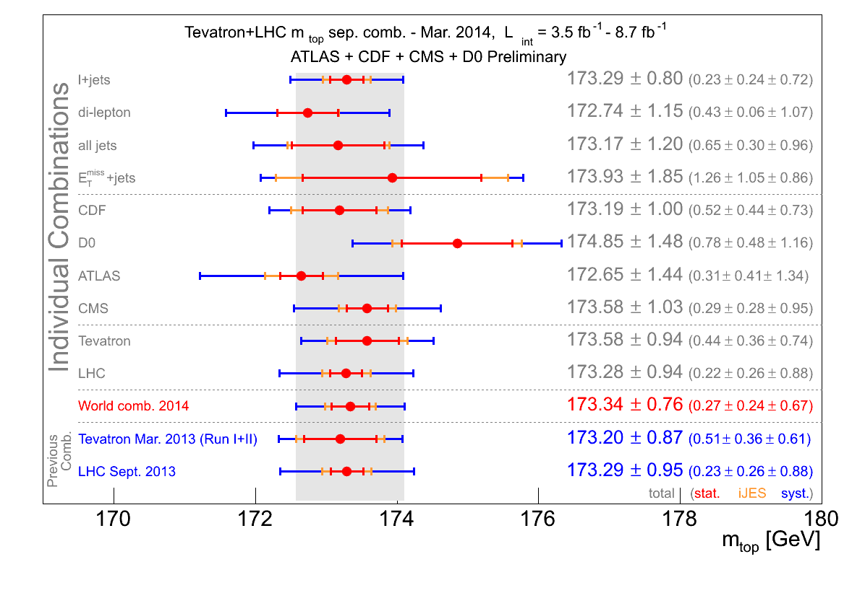
Top Mass Combinations
Tevatron Combination
  arXiv:1305.3939
World combination
  arXiv:1403.4427

Slide 22
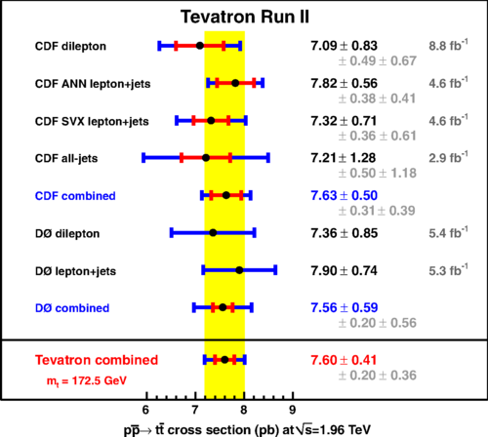
Top Pair-Production Cross Section
Combination from ~8.8 fb⁻¹ published
  Phys. Rev. D 89, 072001 (2014)
  7.60±0.41 pb
CDF version in lep+jets with the full dataset in progress

Slide 23
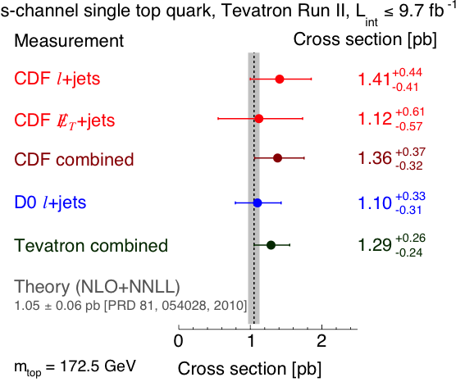
Observation of Single Top in the s-Channel
CDF 4.2σ evidence in the combined Met+Jets and Lepton+Jets
  PRL 112, 231803 (2014)
  PRL 112, 231805 (2014)
Tevatron Combination at 6.3σ
  PRL 112, 231802 (2014)

Slide 24
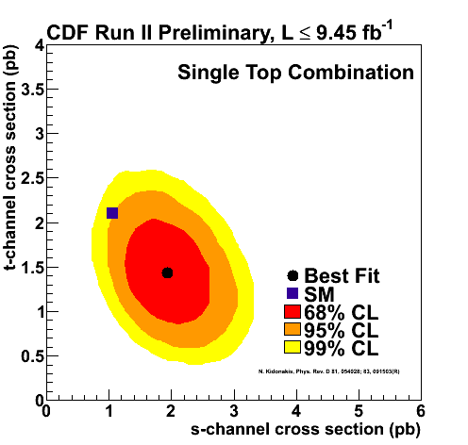
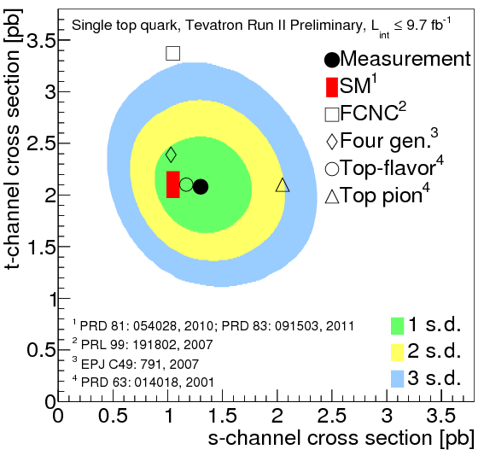
Single Top: s vs. t
CDF Result and Tevatron combination for s and t channels separately are complete
Nearing publication

Slide 25
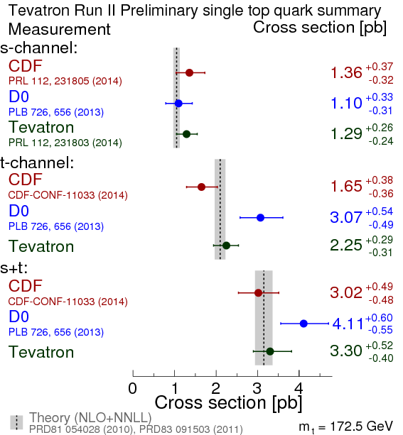
Cross Sections and Extracting |V_{tb}|
All single-top cross sections are consistent with SM
CDF Combined
  |V_{tb}|>0.84
Tevatron
  |V_{tb}|>0.92

Slide 26

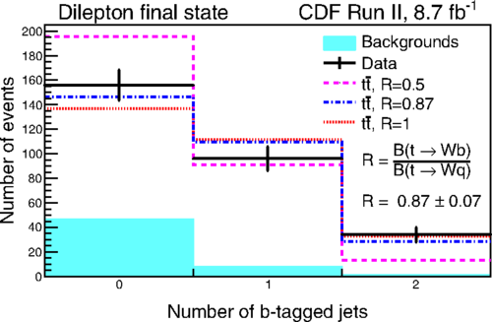
|V_{tb}| from Top Branching Fractions
Can also measure |V_{tb}| from the ratio of t→Wb to t→Wq
  Use Lepton+Jets and Dilepton final state
Measure:
  R=0.87±0.07
  |V_{tb}|=0.93±0.04
  |V_{tb}|>0.85 at 95% CL
Phys. Rev. Lett. 112, 221801 (2014)

Slide 27
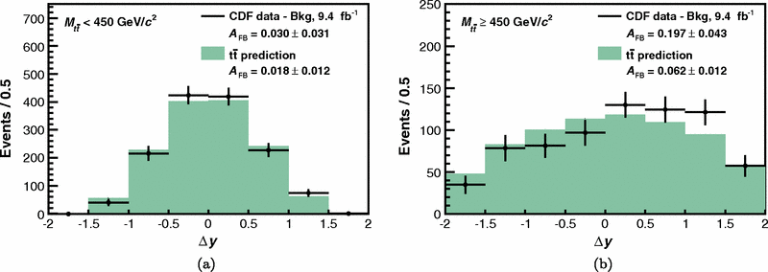
Forward-Backward
Asymmetry in ttbar
Hot topic for a number of years/Theory-Experiment doesn’t hang together well
    Focus on gathering facts to improve methods and theory
    CDF Lep+Jets results shows many more forward events than backward events (when compared to predictions) at large m_{tt}
    Large amounts of follow up
      Lepton+Jets and Dilepton
      Both Full-reconstruction asymmetry and the leptonic-asymmetry
      NLO simulations and recently a NNLO calculation

Slide 28
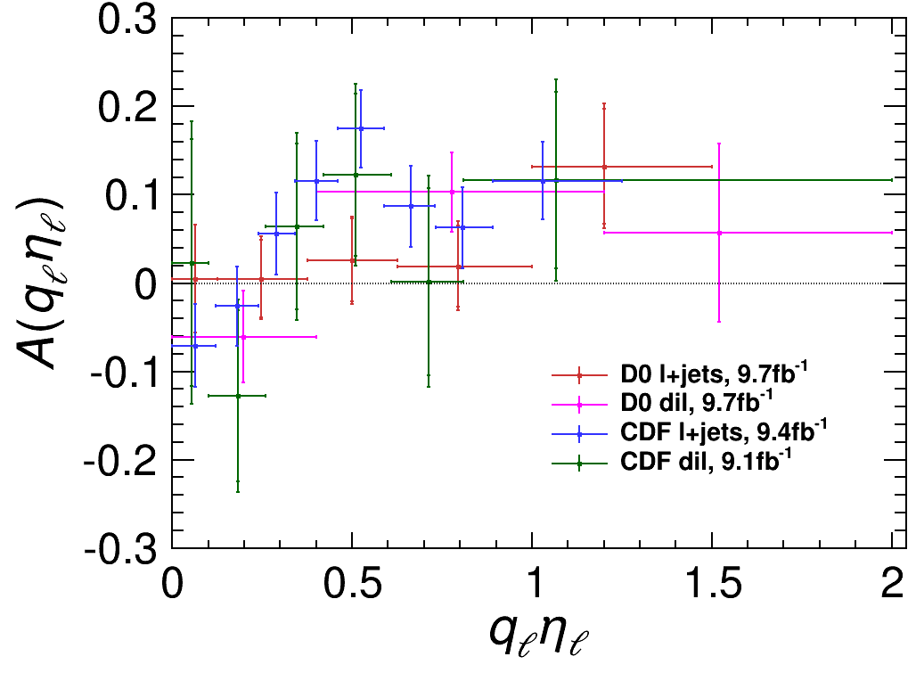
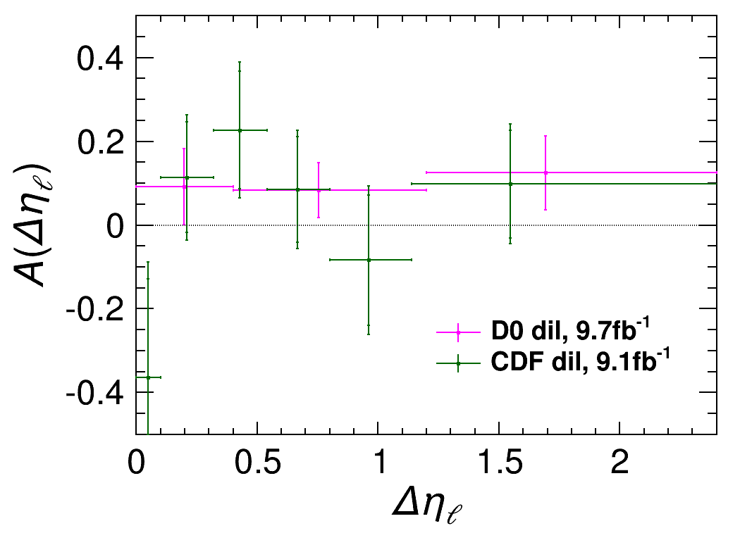
Differential Asymmetries
Get leptonic asymmetries with negligible reconstruction uncertainties
Extrapolate the inclusive asymmetry from the differential distributions
For dilepton events, can get the Δη asymmetry
Individual results published, Tevatron combination results in progress

Slide 29
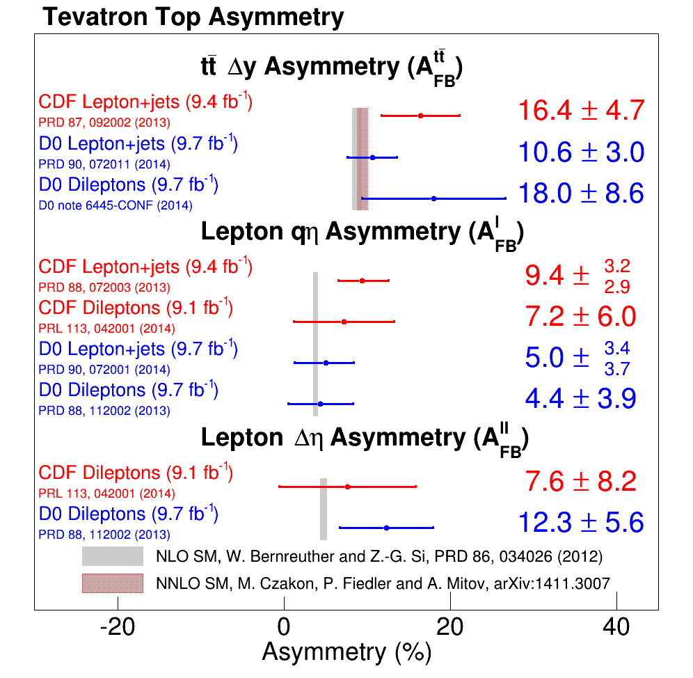
Integrated Asymmetries
New NNLO measurement for tt asymmetry (slight increase)
The “by eye” χ² is small, but 9 out of 9 are above predictions
CDF full reconstruction in dileptons nearing completion, final combination in progress

Slide 30
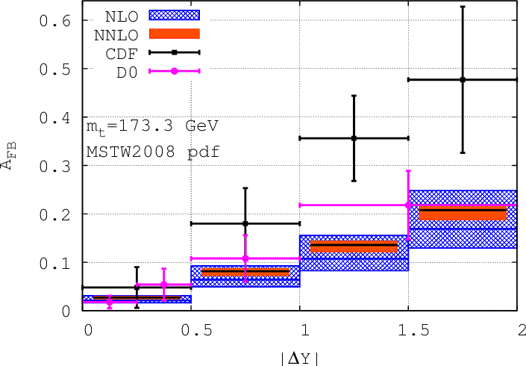
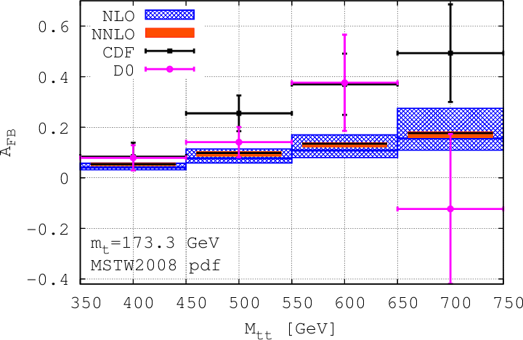
What remains?
Differential Distributions
Differential distributions agree with NNLO? Not as clear at large ΔY and M_{tt}
Modest discrepancies between CDF and Dzero at large ΔY and M_{tt}
Working on combination for final Tevatron Legacy numbers

Slide 31
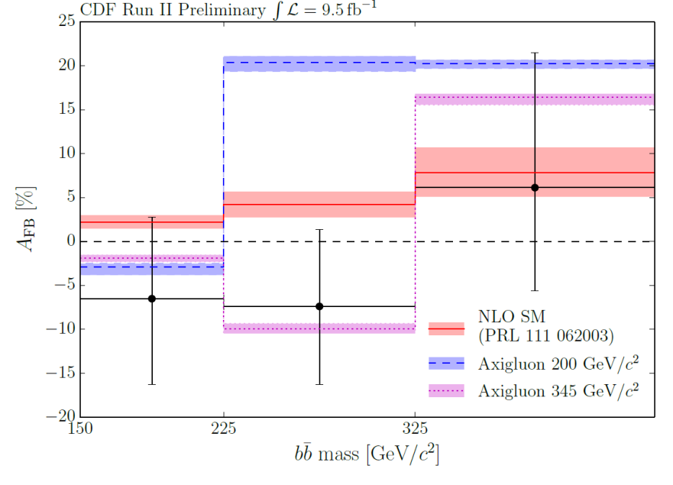
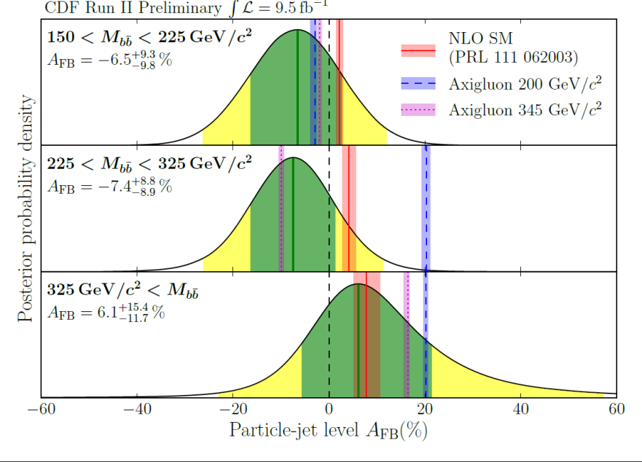
A_{FB} in bb
The A_{FB} in tt makes it compelling to look at the same measurement in the bb final state
New results consistent with SM
  Public note 11092
Measurement at lower masses of bb in the works

Slide 32
Heavy Flavor
The CDF Heavy Flavor program has been powerful for many years and is rich and broad in measurements and searches for both bottom and charm states
Probe of strong production, meson and baryon states, and EWK decays
CP violation could tell us about the matter anti-matter asymmetry in the universe

Slide 33
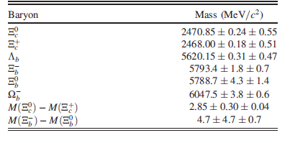
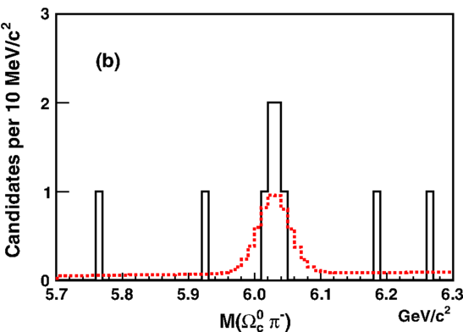
b-Baryon Properties
Full dataset measurement of the masses and lifetimes of Ξ_{c} and b-baryons
First observations of Ω_{b}⁻→Ω_{c}⁰π⁻ and Ξ_{b}⁰ → Ξ_{c}⁺ π⁻
  PRD 89, 072014 (2014)

Slide 34
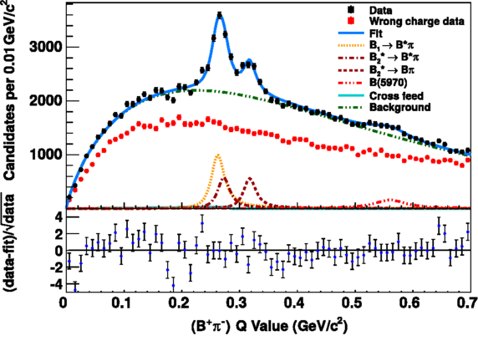
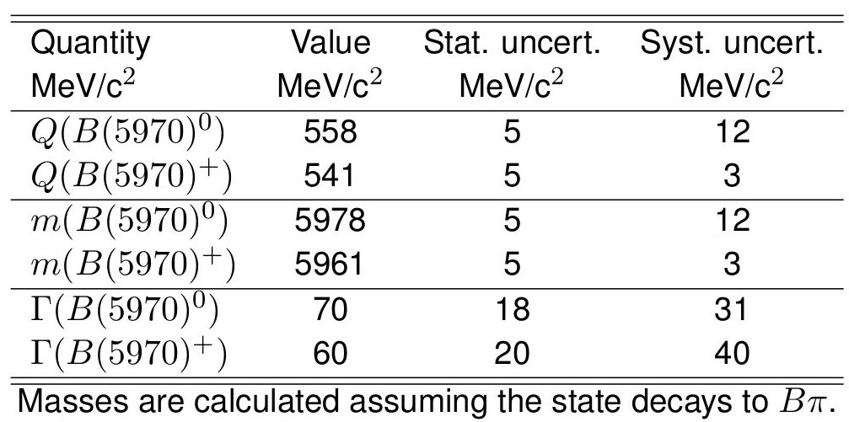
Excited B-mesons
First evidence of resonances (4.4σ) consistent with two states of orbitally excited (L=1) B⁺-mesons
  In both B⁰π⁺ and a B⁺π samples
Measured masses and widths of all states, as well as the relative production rates
  PRD 90, 012013 (2014)

Slide 35
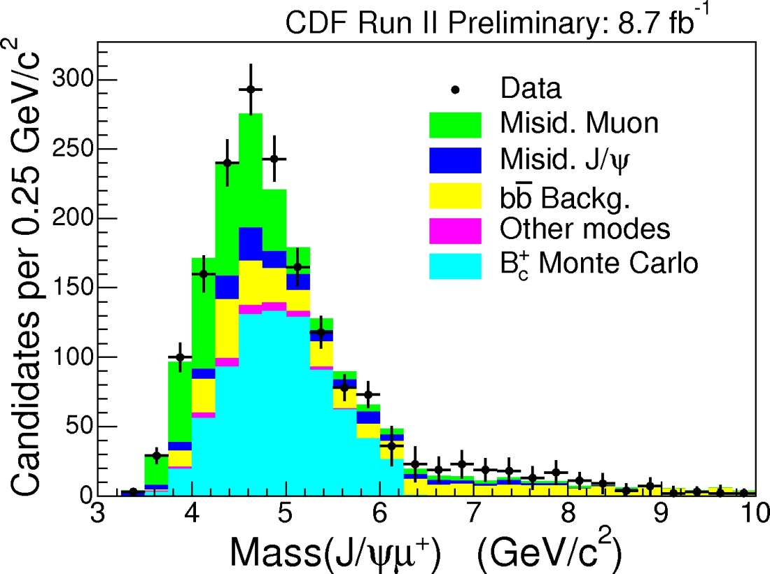
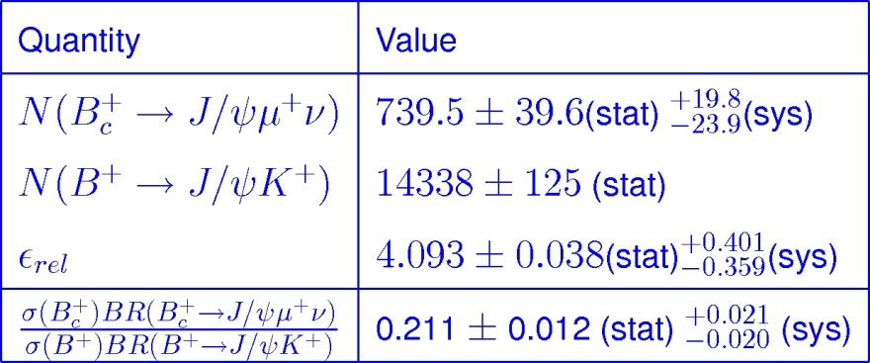
Measurement of B_{c} Production
Important to learn more about B_{c}, do what we can at the Tevatron
Measure the ratio of the production cross section times branching fraction of B_{c}⁺→J/ψ μ⁺ν relative to B⁺→J/ψK⁺
CDFNote 11083

Slide 36
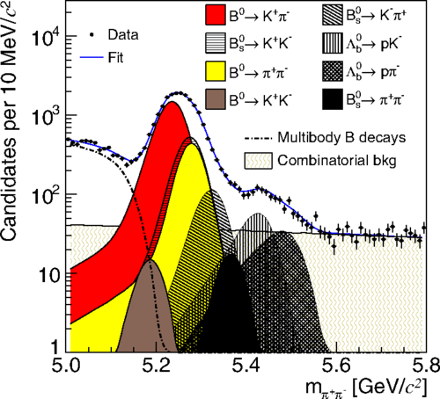
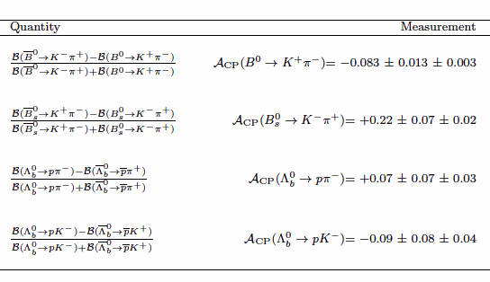
Direct CP Violating Asymmetries in Charmless Decays of Strange Bottom Mesons and Bottom Baryons
Direct CP violation in charmless decays of B mesons have shown discrepancies from expectations
Follow up on with B⁰→K⁺ π⁻, B⁰_{s}→π⁺ K⁻ as well as Lambdas
Results are compatible with and have comparable accuracy with current results from B-Factories and LHCb
  PRL 113, 242001 (2014)

Slide 37
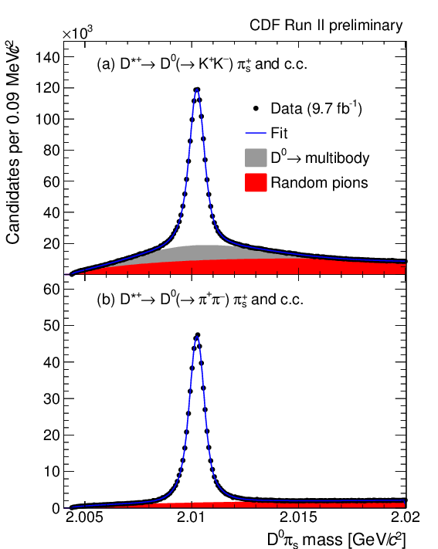
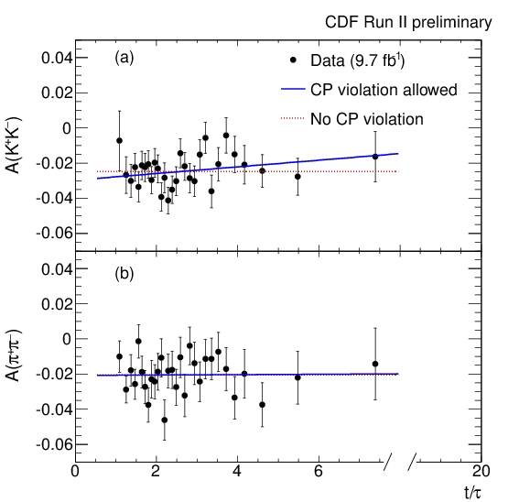
Indirect CP-violating asymmetries in D⁰ → K⁺K⁻ and D⁰ → π⁺π⁻ decays
Use D^{*+} →D⁰ π⁺ decays to identify the flavor of the neutral charmed meson at production
Allows a measurement of the effective-lifetime asymmetry, A_{Γ}
  A_{Γ} (π⁺π⁻) = [-0.1 ± 1.8 (stat.) ± 0.3 (syst.)] × 10⁻³
  A_{Γ}(K⁺K⁻) = [-1.9 ± 1.5 (stat.) ± 0.4 (syst.)] × 10⁻³
CDF Public Note 11117, accepted for publication in PRD-RC

Slide 38
QCD
The strong interaction is one of the most difficult to probe in any experiment
Many studies which look for deviations of the Standard Model as well as to improve future experiments

Slide 39
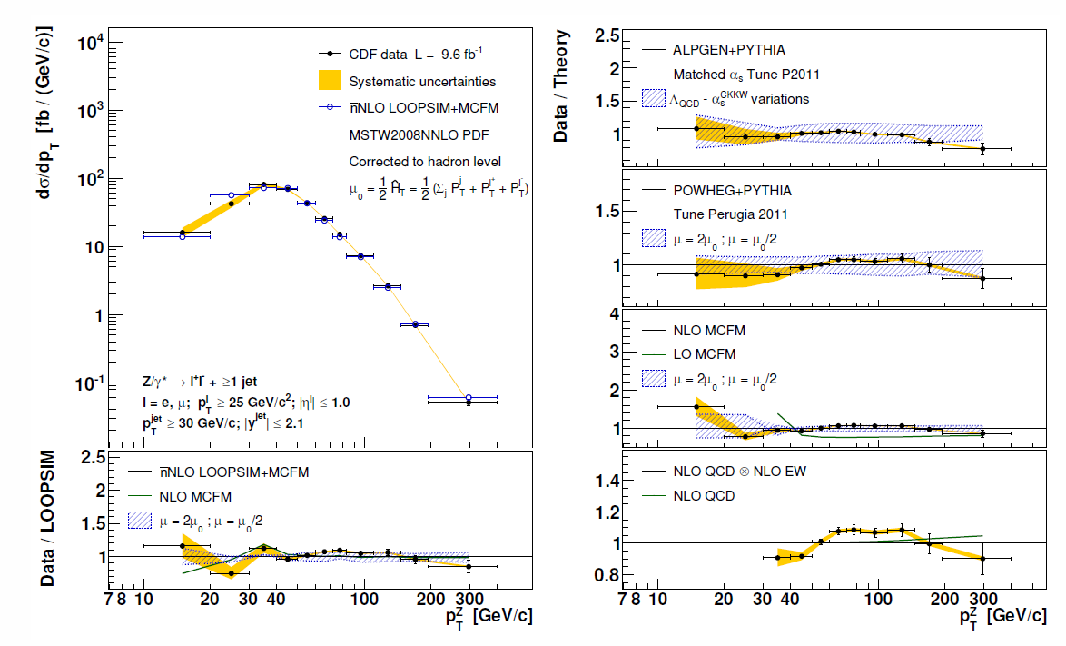
W/Z+Jets
Z+jets Production well described by QCD@NLO
  arXiv:1409.4359, Accepted to PRD
W+Jets coming soon

Slide 40
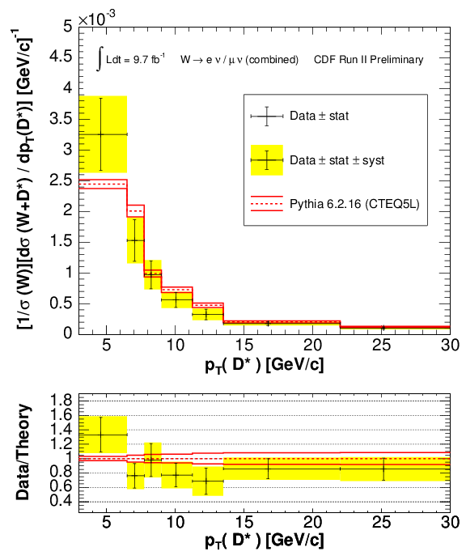
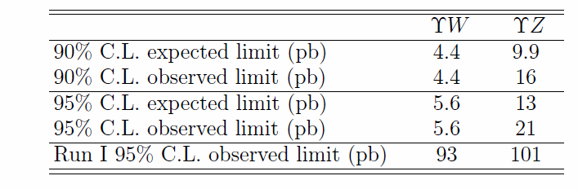
Vector Boson + Heavy Flavor Production
Measurements of σ(W+D*)/σ(W) and σ(Z+D*)/σ(Z) in the W/Z leptonic decay channels using full D* reconstruction
  First measurement of W/Z+D* production with p_{T}(c) < 15 GeV at the Tevatron
  CDF Public Note 11087
W/Z+Upsilon
  No observation, new limits
  arXiv:1412.4827 Submitted to PRD

Slide 41
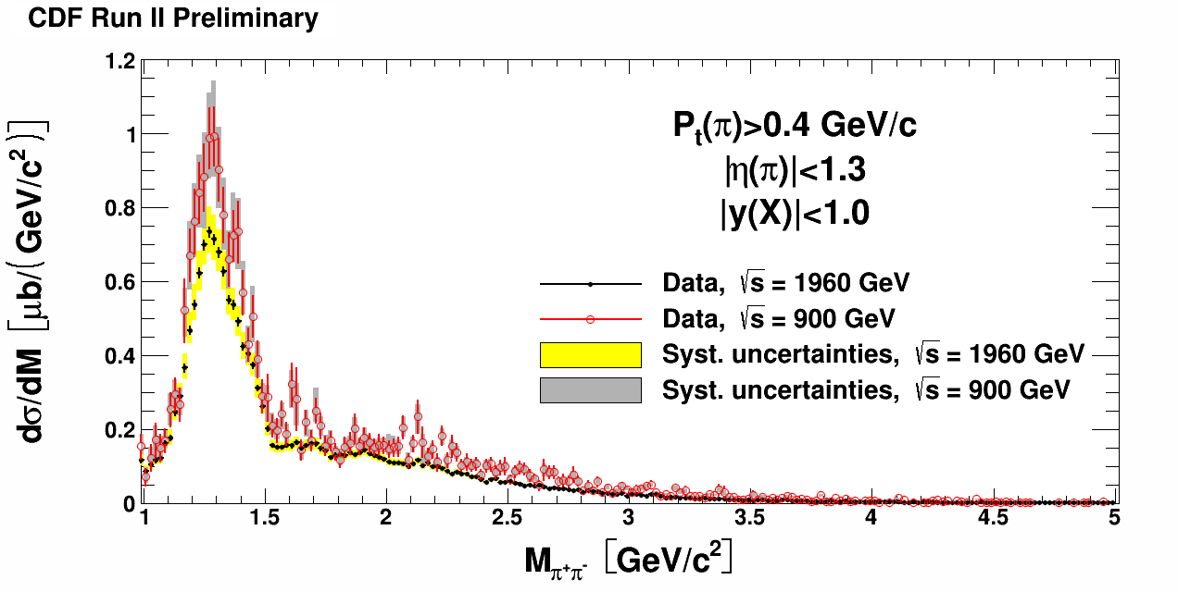
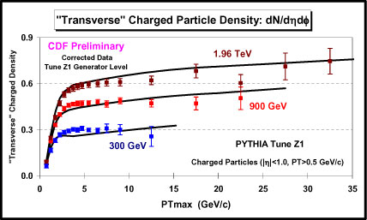
QCD: Exclusive Production
Central Exclusive Hadron Pair Production
  CDF Public Note 10841
Measurements at multiple Tevatron energies
  300, 900 and 1960 GeV
  CDF Public Notes 10841 and 10874
Important in its own right as well as for confidence in our Monte Carlos (Pythia, Herwig++ etc.)

Slide 42

Jet Substructure and
Boosted Tops
Studied inclusive jets with p_{T}>400 GeV/c for large mass objects and deviations from expectations
Search for boosted top quark production in events with 2 massive jets, or 1 massive jet with MET
σ_{95%} < 38 fb @ 95% CL
  arXiv:1407.3484
Powerful tool now in regular use by the LHC for top-tagging

Slide 43
Electroweak
The study of the electroweak sector has a long history at CDF and been invaluable to the field
Measurement of the W mass
Measurement of the A_{FB} of the Z/γ* system as a measurement of the Weinberg angle, as well as an indirect measurement of the W mass
W asymmetry has played an important role in understanding the PDFs
Full set of diboson measurements are an excellent probe of the SM and were invaluable in the Higgs searches

Slide 44


Precision EWK: A_{FB} from leptons sin²θ_{eff} and W-mass
A_{FB} above and below the Z pole probes the SM
Measure the Weinberg angle and an indirect W mass measurement - Competitive results in both areas
Just published the μμ result, with ee in progress. Discussions for a Tevatron combination have started
Plans for a W Asymmetry measurement to come shortly after

Slide 45

Dibosons:
WW, WZ, ZZ, Wγ, Zγ and γγ
Dibosons provide an important test of the SM, and are vital to measurements of Top, Higgs and other Searches
Powerful new differential measurements of the WW cross section recently released
  WW+Jets may well be impossible at LHC
Full suite of measurements done, all consistent with the SM

Slide 46


W Mass Measurement
Tevatron Combination
  PRD 88, 052018 (2013)
    CDF: PRD 89, 072003 (2014)
    DZero: PRD 89, 012005 (2014)
  M_{W} = (80387 ± 16) MeV/c²
  0.02% precision!
Further reduction of uncertainties are difficult and time consuming
  Full-data results from both CDF and DZero in progress

Slide 47
Legacy: Publications
This Year and Looking Forward
Over 675 papers published with a good chance of topping 700 by the time we’re done
Topic | Published or Accepted in 2014 | Submitted but not yet Accepted | Blessed but not yet Submitted
BSM | 2 | 0 | 3
Higgs | 1 | 0 | 1
Top | 8 | 2 | 4
SM (EWK+QCD) | 4 | 1 | 3
Heavy Flavor | 4 | 0 | 1
Combinations | 1 | 0 | 4
Total | 20 | 3 | 16

Slide 48

Data Preservation
Hypothetical: Discovery at LHC which could be further studied from archived Tevatron data
Need to do preparations now so we have moved to SL6 and made all data available on tape in a current format
Should be able to act through 2020
Have moved to archive all of CDF's documentation (including CDF notes that were only on paper).

Slide 49
Conclusions
The CDF collaboration is still doing exciting physics and publishing at a strong rate
In the last year(s) we have had many successes by focusing on legacy results that are competitive and complementary to the LHC
We have published almost 700 papers and graduated more than 575 PhD students
Soon expect publication of some our most important results including final words on the combined top mass, Higgs Spin-parity in VHiggs(bb), A_{FB} in tt and bb, and new results in W charge asymmetry and the much anticipated Wmass measurement in the 10-15 MeV range
Stay tuned… we’re not done quite yet
http://www-cdf.fnal.gov/physics/S14CDFResults.html

Slide 50
Backups

Slide 51

“Something, something, something, Legacy Program. Something, something, something, Complete”

Slide 52
http://www-cdf.fnal.gov/physics/S14CDFResults.html
Higgs Spin/Parity Limits (Tevatron Combination)Higgs7/24/2014Note 11104
CP Violation in D⁰Heavy Flavor8/21/2014Note 111171410.5435Submitted to PRL
Fermiophobic Higgs in the 3γ+X ChannelExotics8/7/2014Note 11116
Search for W'→tbTop/Exotics8/7/2014Note 11100
Higgs Spin/Parity LimitsHiggs7/21/2014Note 11103
Central Exclusive Production of Pion PairsQCD7/8/2014Note 11034
Top Mass Tevatron Combination (2014 combination)Top7/2/2014Note 111051407.2682(NA)
W/Z + D*QCD6/21/2014Note 11087
MonopolesExotics6/19/2014Note 11102
Measurement of Orbitally Excited B Mesons and
First Evidence for a New Bπ ResonanceHeavy Flavor6/13/2014Note 110221309.5961PRD 90 012013 (2014)
Single Top in S+T Channel (Met+Jets and CDF Combination)Top6/13/2014 MET+Jets ComboNote 110331410.4909Submitted to PRL
A_{FB} of bb̄Top6/11/2014Note 11092
WW+Jets Cross SectionEWK6/10/2014Note 11098
CDF Top Mass CombinationTop3/21/2014Note 11080
World (TeV+LHC) Top Mass CombinationTop3/17/2014Note 110711403.4427(NA)
Top Mass in the all hadronic final stateTop3/7/2014Note 110841409.4906PRD 90, 091101(R) (2014)
B_{c}⁺ → J/ψμ⁺ν relative cross sectionHeavy Flavor2/28/2014Note 11083
Single top (S Channel) Tevatron Combination/ObservationTop2/22/2014Note 110731402.5126PRL 112, 231803 (2014)
Search for Invisible Higgs Boson Decays in Dilepton EventsExotics2/10/2014Note 11068
Top Mass in DileptonsTop1/10/2014Note 11072
Z+Jets Cross Section MeasurementQCD3/22/2012Note 110811409.4359Submitted to PRD
Single Top (S+T Channel) in the Lep+Jets Final StateTop2/27/2012Note 107931407.4031Accepted to PRL
Studies of high-transverse momentum jet substructure and top quarksQCD/Top5-26-2011 Boosted Jets Boosted Tops Note 10199 Note 102341407.3484Submitted to PRD
Leptonic A_{FB} of tt̄ in Dilepton Final State + CDF CombinationTop9/19/2013 and 10/25/2013Note 110351404.3698PRL 113, 042001 (2014)
BR(t→ Wb)/BR(t→ Wq) in dileptonsTop10/25/2013Note 110481404.3392PRL 112, 221801 (2014)
Measurement of B Baryon PropertiesHeavy Flavor8/1/2013Note1403.8126PRD 89, 072014 (2014)
A_{CP} measurements in B→hh' decay modesHeavy Flavor6/28/2012Note 107261403.5586Accepted to PRL
ZZ production cross section measurement in lll'l' and llνν final statesEWK6/20/2013Note 109571403.2300PRD 89, 112001 (2014)
Search for Dijet Resonance in lνjj Final StateHiggs2/22/2013Note 109731402.7044PRD 89 092001 (2014)
Measurement of Top Production and Decay into Tau and Limit on Charged HiggsTop9/6/2012Note 109151402.6728PRD 89, 091101 (2014)
Single Top (S Channel) in the Met+Jets and CDF CombinationTop7/11/2013 and 10/25/2013Note 11076 and Note 110451402.3756PRL 112, 231805 (2014)
Measurement of sin²θ_{W} using μ⁺μ⁻ pairsEWK2/24/2014Note 110311402.2239PRD 89, 072005 (2014)
Single Top (S Channel) in the Lep+Jets Final StateTop8/8/2013Note 110251402.0484PRL 112, 231804 (2014)
Search for Rare Z Decays into Two Reconstructed PhotonsExotics3/8/2013Note 109781311.3282PRL 112, 111803 (2014)
W Boson Mass MeasurementEWK10/2012Note 107751311.0894PRD 89 072003 (2014)
Tevatron Combined tt̄ Cross Section MeasurementTop7/1/2012Note 109261309.7570PRD 89 072001 (2014)
Search for Trilepton New Physics and Chargino-Neutralino ProductionExotics8/25/2011Note 106361309.7509PRD 90, 012011 (2014)

Slide 53

Triphoton Details
Background dominated by Direct TriPhoton
  Estimated using MadGraph/MadEvent+Pythia
Optimization for Higgs is at 90 GeV
  5 observed events, on a background of 2.96±0.94

Slide 54



Fermiphobic Higgs
CDFNote 11116

Slide 55


Slide 56


Observation of Single Top in the S-Channel
Tevatron Combination of Single top production in the S-Channel shows observation with 6.3σ significance
PRL 112, 231802 (2014)

Slide 57

Single Top: S, T, S+T and S vs. T
Tevatron combination for S and T channels separately is complete and nearing publication

Slide 58

Cross Sections and Extracting |V_{tb}|
Cross Sections are consistent with SM
Powerful method of extracting V_{tb}

Slide 59



Slide 60
W+Dijet Mass Bump Story

Slide 61



Observation of B_{s}⁰ – B_{s}⁰ Oscillations
_
PRL 97, 062003, 242003 (2006)
Observation based on the analysis of many B_{s}⁰ hadronic decay modes made possible by the SVT trigger

Slide 62





Slide 63

Tevatron Legacy
Physics
  Discovery of top quark & measurement of its properties
  First evidence of Higgs boson in fermionic final states
  Precision measurement of W boson mass
  Precision measurements of jets, V+jets, VV cross sections
  Substantial progress in heavy flavor states and mixing
  Subtle behavior: CP violation in heavy hadrons, A_{FB}(tt)

Slide 64
Tevatron Legacy
Hardware
  Silicon tracking/vertexing taken to a whole new level
  b-tagging widely developed and used at the Tevatron
Triggers
  Entire trigger concept in a hadron collider environment
  SVT & out-of-time triggers for long-lived/slow particles
Analysis techniques
  Importance of MVA techniques (single top, Higgs)
  Combination of multiple channels (Higgs)
Innovative physics methods
  Example: “in situ” JES calibration in m_{top} measurements

Slide 65
http://www-d0.fnal.gov/d0_publications/d0_pubs_list_bydate.html
and consider reporting results which became public since after last year Users meeting. New results in all active groups QCD, top, EW and heavy flavor have become available and in some cases very important,
Very accurate top mass measurement presented this March.
There is final di-muon ass. result from DZero as well and many others.
World top mass combo might be interesting, while you are talking after(!) LHC talks, so this might already be covered (you still have to show one slide, please).
I suggest you have CDF/DZero results combined by topic and try to mix about equal number of results from each experiment.
as usually singling one result our of many is rather non-trivial. Still since last Users Meeting among published results I would point to the fundamental study (50+ pages, 10's of tables and plots) of W+jets production at the Tevatron
http://www-d0.fnal.gov/Run2Physics/WWW/results/final/QCD/Q13C/
Another interesting study is double-parton interactions
http://www-d0.fnal.gov/Run2Physics/WWW/results/final/QCD/Q14A/
there is set of ~6 papers on this topic by now and the review of these results will be subject of W&C during Users Meeting week (will be nice to advertize this talk in your presentation).

Slide 66
Stuff from Dzero page
Submitted
5. Precision measurement of the top quark mass in lepton+jets final states at D0
Submitted 05/08/14: Phys. Rev. Lett., arXiv:1405.1756 plots 9.7 fb⁻¹
4. Measurement of the forward-backward asymmetry in pp → tt production in l+jets channel
Submitted 05/02/14: Phys. Rev. D, arXiv:1405.0421 plots 9.7 fb⁻¹
3. Measurement of the forward-backward asymmetry in the distribution of leptons in tt in the lepton+jets channel
Submitted 02/07/14: Phys. Rev. D, arXiv:1403.1294 plots 9.7 fb⁻¹
2. Measurement of differential tt production cross sections in pp collisions
Submitted 01/21/14: Phys. Rev. D, arXiv:1401.5785 plots
1. Observation of s-channel production of single top quarks at the Tevatron PRL Editors' Suggestion
Accepted 04/24/14: Phys. Rev. Lett., arXiv:1402.5126 plots up to 9.7 fb⁻¹
318. Combination of measurements of the top-quark pair production cross section from the Tevatron Collider
Published 04/01/14: Phys. Rev. D 89, 072001 (2014), arXiv :1309.7570 plots up to 8.8 fb⁻¹
316. Measurement of the W boson mass with the D0 detector
Published 01/30/14: Phys. Rev. D 89, 012005 (2014), arXiv:1310.8628 plots 4.3 fb⁻¹
11. Measurement of the asymmetry in angular distributions of leptons produced in dilepton tt final states in pp collisions at √s = 1.96 TeV
Published 12/02/13: Phys. Rev. D 88, 112002 (2013), arXiv:1308.6690 plots 9.7 fb⁻¹
306. Combination of CDF and D0 W-Boson Mass Measurements
Published 09/24/13: Phys. Rev. D 88, 052018 (2013), arXiv:1307.7627 plots 5.3 fb⁻¹
305. Higgs Boson Studies at the Tevatron
Published 09/17/13: Phys. Rev. D 88, 052014 (2013), arXiv:1303.6346 plots 10 fb⁻¹
304. Combined search for the Higgs boson with the D0 experiment

Slide 67
CDF Recent Papers
B Baryon Properties Measured with the Full Run II Data Set
Dimuon Afb using the full dataset PRD 2013-09-25 2013-11-01 2013-12-11 2014-02-08 2014-02-27
ZZ to lll'l' and llnunu using the full CDF dataset PRD 2013-07-02 2013-09-24 2013-11-18 2014-03-10 2014-05-12
Combination of CDF and D0 W Mass measurements PRD 2009-04-06 2013-05-14 2013-07-10 2013-07-29 2013-08-27
sin2θW (indirect MW) with Z→ee events
Search for Dijet Resonance in lnujj Final State
Forward-backward asymetry of bb̄
Single Top S+T

Slide 68


Sample
Delivered 12 fb⁻¹
Acquired 10 fb⁻¹/experiment
15B + 9B events total in Run II
Total dataset 10 + 9 PB
(including Monte Carlo)
A well understood sample
Coverage for “soft” physics
Variety of collision energies
Unique p-pbar initial state
(unlikely to have again)

Slide 69

Run II history

Slide 70
Future
Priorities: Finish relevant measurements with full luminosity,
including combinations of results (CDF + D0 and
LHC + Tevatron, when appropriate)
Long term: Ongoing joint effort by Fermilab and Tevatron
experiments to preserve data and analysis
knowledge of the unique proton-antiproton
Tevatron sample

Slide 71


1,000+ PhD theses in 25 years (1988–present)
The making of a new generation of scientists

Slide 72


σ_{eff} = 12.7 ± 0.2 (stat) ± 1.3 (syst) mb
σ_{eff} = 14.6 ± 0.6 (stat) ± 3.2 (syst) mb

Slide 73

Top cross section backup

Slide 74


V+HF Backups
Observe one Upsilon + W candidate over an expected background of 1.2 ± 0.5 events, and one Upsilon + Z candidate over an expected background of 0.1 ± 0.1 events.
Measurements of σ(V+D*)/σ(V)

Slide 75


Slide 76


Slide 77
Notes on Charmless decayse
Non invariance of the fundamental interactions under the combined symmetry transformation of charge conjugation and parity inversion (CP violation) is an established experimental fact. The vast majority of experimental data are well described by the standard model (SM), and have supported the success of the Cabibbo-Kobayashi-Maskawa (CKM)[1] theory of quark-flavor dynamics.
However, additional sources of CP violation are required to explain the matter-antimatter asymmetry of the Universe in standard big-bang cosmology. This would have profound consequences on our understanding of fundamental interactions.
Violation of CP is direct if the partial decay-width of a particle into a final state differs from the width of the corresponding antiparticle into the CP-conjugate final state. In recent times, the pattern of direct CP violation in charmless mesonic decays of B mesons has shown some unanticipated discrepancies from expectations. Under standard assumptions of isospin symmetry and smallness of contributions from higher-order processes, similar CP asymmetries are predicted for B⁰→K⁺ π⁻ and B⁺→K⁺ π⁰ decays [2][3], However, experimental data show a significant discrepancy [4], which has prompted intense experimental and theoretical activity. Several simple extensions of the standard model could accommodate the discrepancy[5], but uncertainty on the contribution of higher-order SM amplitudes has prevented a firm conclusion[6].
Recently, it has been suggested a way [7] to accommodate this discrepancy within the SM, taking into account only constraints imposed by the Pauli principle. Nevertheless, high accuracy measurements of the violation of CP symmetry in charmless modes remains, therefore, a very interesting subject of study and may provide useful information to our comprehension of this discrepancy.
Rich samples of bottom-flavored hadrons of all types from the Tevatron offer the opportunity to explore new territory in the field of Bs mesons and b-flavored baryons. Additional information coming from different decays yields further constraints on the possible explanations of previous findings, and may possibly reveal new deviations from expectations. Specifically, measurements of direct CP violation in B⁰_{s}→π⁺ K⁻ decays have been proposed as a nearly model-independent test for the presence of non-SM physics [8][9].
The relationships between charged-current quark couplings in the SM predict a well-defined hierarchy between direct CP violation in B⁰→K⁺ π⁻ and B⁰_{s}→π⁺ K⁻ decays, yielding a significant asymmetry for the latter, of about 30%. This large effect allows easier experimental investigation and any discrepancy may indicate contributions from non-SM amplitudes.
Supplementary information could come from CP\ violation in bottom baryons. Interest in charmless b-baryon decays is prompted by branching fractions recently observed being larger than expected [10]. Asymmetries up to about 10% are predicted for Λ⁰_{b}->p π and Λ⁰_{b}->pK decays in the SM [11] and are accessible with current CDF event samples.
Published in PRL 113, 242001 (2014)
The measurement of CP violation in the B mesons system is compatible and of comparable accuracy with current results from B-Factories and LHCb.
We report an updated measurement of ACP in Bs->Kpi decays, with a significance of about 3 sigma. This result confirms the LHCb evidence with the same level of resolution.
The measurement of CP violation in the Bs mesons system is in agreement at 2 sigma level with the prediction within the SM [10].
The observed asymmetry in the Λ⁰_{b}->ph decays are consistent with zero. However the limited experimental precision does not allow a conclusive discrimination between SM prediction (~8%), much suppressed values expected in supersymmetric scenarios (~0.3%), or prevision from pQCD approach [12], that are 31% for ACP(Λ⁰_{b}->ppi) and 5% for ACP(Λ⁰_{b}->pK).

Slide 78
D⁰ and D⁺ Productions
In the future… Unique charm production cross section measurements in the works…
D⁰ Cross section at low P_{t} (D⁰ → K⁻π⁺ at √s=1960)
D⁺ Cross section at low P_{t} (D⁺ → K⁻π⁺π⁻ at √s=1960)
D⁰ Cross section at low P_{t} (D⁰ → K⁻π⁺ at √s=900)
D⁺ Cross section at low P_{t} (D⁺ → K⁻π⁺π⁻ at √s=900)

Slide 79
Like-sign dimuon charge asymmetry
  N⁺⁺, N ⁻⁻ − number of events with two muons of the same charge
The only inclusive measurement of CP violation so far
  Large statistics is available
  As yet unknown sources of CP violation could contribute in this asymmetry
Assuming that the measured charge asymmetries are produced by known types of CP violation, we can extract their parameters
  Semileptonic charge asymmetry of B_{d} meson: a^{d}_{sl}
  Semileptonic charge asymmetry of B_{s} meson: a^{s}_{sl}
  Relative width difference of B_{d} meson: ΔΓ_{d}/Γ_{d}
CP violation in mixing
CP violation in interference

Slide 80

Results
We get:
  deviates from the SM prediction
  by 3.0 σ
Published: PRD 89, 012002 (2014)
Result is consistent with independent
DØ measurements of
  a^{d}_{sl} : PRD 86, 072009 (2012)
  a^{s}_{sl} : PRL 110, 011801 (2013)
This effect is one of a few remaining puzzles from the Tevatron program which might indicate physics beyond standard model
muon asymmetry

Slide 81

Higgs Couplings
The world-wide emphasis has shifted to property measurements
Combination of CDF and DZero results on Higgs Spin-parity is in progress
  DZero results are public (Conf Notes 6387 and 6404)
  CDF results are nearing completion
All results are currently consistent with the SM

Slide 82


Lepton A_{FB} in tt→l+jets decays
CDF public note 10975
Partially correlated with A_{FB}(tt) (if tt production polarized), essentially free of event reconstruction uncertainties
Measured total A_{FB}^{lep} = 0.094 ± 0.032_{stat} ± 0.029_{syst}
SM@NLO A_{FB}^{lep} = 0.036

Slide 83


Lepton A_{FB} in tt→dilepton decays
PRD 87, 011103(R) (2013)
Measured total A_{FB}^{lep} = 0.058 ± 0.051_{stat} ± 0.013_{syst}
Combined with l+jets result, A_{FB}^{lep} = 0.112 ± 0.032
SM@NLO A_{FB}^{lep} = 0.047

Slide 84


AFB 3

Slide 85



dσ/dcosθ_{t} in tt→l+jets decays
CDF public note 10974
Legendre moments characterize
the shape of the cross section
Agreement with SM@NLO
for all but 1st moment
A_{FB} dominated by
anomalously large 1st moment

Slide 86
      In total reconstructed asymmetry
        CDF:
        Most pronounced as a function of mass
      In dσ/dcosθ_{t} in l+jets
        CDF: PRD 88, 072003(2013)
      In lepton asymmetry
      CDF: PRL 111, 182002(2013)
Full suite of CDF and DZero results since in then
  Leptonic: l+jets & dileptons
  Full Reconstruction: Lep+Jets only
Recent results from CDF and DZero
    DZero leptonic Asy: PRD 88, 112002 (2013)
    DZero Reconstructed: arXiv:1403.1294
    CDF asym: arXiv:1404.3698
    Not sure what the final conclusion is: working to finish results, reconcile them all and combine

Slide 87

Tevatron M_{W} combination
arXiv:hep-ex/1204.0042
M_{W} = (80387 ± 16) MeV/c²
0.02% precision!
Fine corrections in M_{W} calculation are sensitive to unobserved particles → Precision is probing for new physics

Slide 88



sin²θ_{W} (or M_{W})
PRL 106, 241801 (2011)
CDF public note 10952
Measured A₄ (V-A interference) from cosθ term of the angular distribution of e⁺e⁻ pairs with M_{ee} in [66,116] GeV/c²
Derived sinθ_{eff}^{lep} and M_{W} from A₄ and ResBos prediction

Slide 89



