Slide 1




Tevatron Physics
Fermilab Users Meeting
David Toback
Texas A&M University
June 2014

Slide 2
Overview
The CDF and DZero collaborations are still doing exciting physics and publishing at a strong rate
Focusing on legacy results that are competitive and complementary to the LHC
In a phrase, our motto is “get the papers out!”

Slide 3
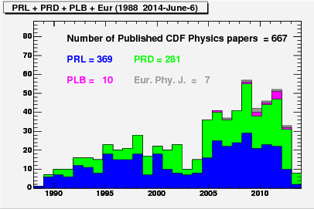
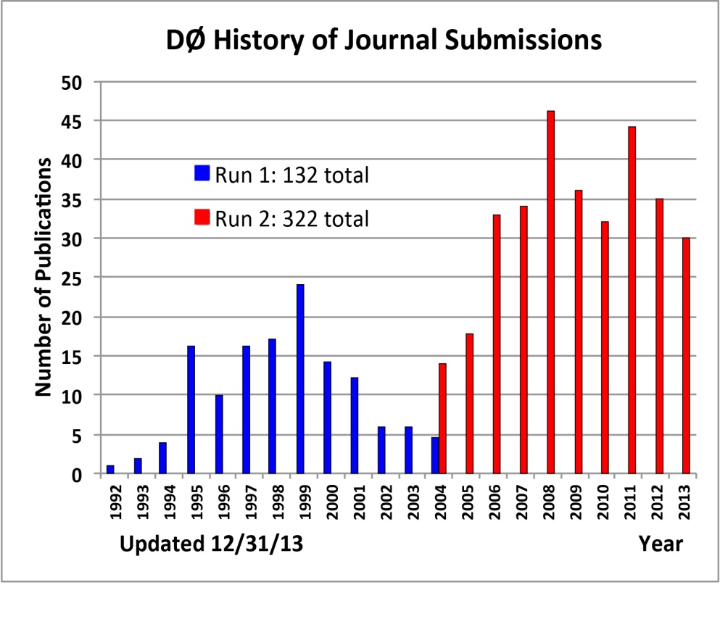
Publication History
CDF and DZero: ~30 paper each in 2013
Excellent results in all physics groups
Tevatron Legacy: Over 1,000 papers published and 1,000 PhD’s granted

Slide 4
Rich Program
Selected Results
Higgs
Final Higgs Combination
Higgs Couplings
Exotics/New Phenomena
Search for Heavy Vector Bosons
QCD
Exclusive production
Double parton Interactions
W/Z + Jets
Vector Boson +HF
Heavy Flavor
CP Violation B± decays
Excited B-mesons
b-Baryon properties
Di-muon charge asymmetry
EWK
A_{FB}: Sin²θ_{eff} and M_{W}
WW and ZZ Results
W Mass
Top
Top Pair-Production Cross section
Top Mass
Single Top s+t
Single Top in s-only
A_{FB} in tt
A_{FB} in bb

Slide 5
Final Higgs Combination
The Higgs groups at both CDF and DZero have completed their search work
Powerful results in bb are complementary to the final states from the LHC
Observed significance is 3.0σ at a Higgs mass of 125 GeV
Tevatron combination published in PRD 88, 052014 (2013)

Slide 6
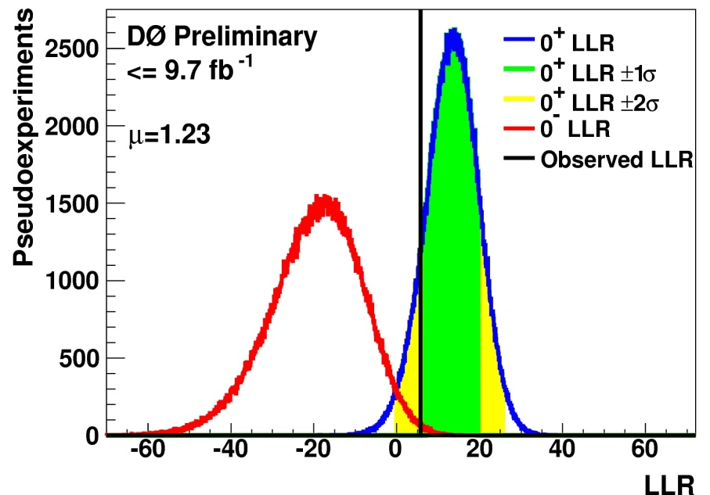
Higgs Couplings
The world-wide emphasis has shifted to property measurements
Combination of CDF and DZero results on Higgs Spin-parity is in progress
DZero results are public (Conf Notes 6387 and 6404)
CDF results are nearing completion
All results are currently consistent with the SM

Slide 7
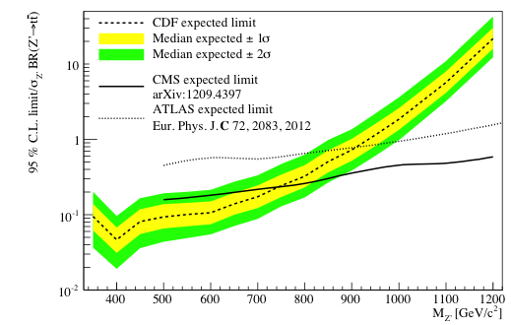
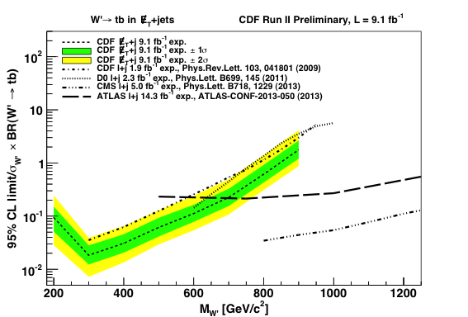
Search for Heavy Vector Bosons Exotics/New Phenomena
While the Tevatron isn’t competitive for the high mass searches any more, there are still a number of places where it has advantages
PPbar vs. PP
Low number of interactions per crossing
New limits on W’→tb and Z’→tt are the world’s best at intermediate masses
PRL 110, 121802 (2013)
CDF Public note 11079
A few more results to come in the next year
Delayed photons
Monopoles
Others

Slide 8
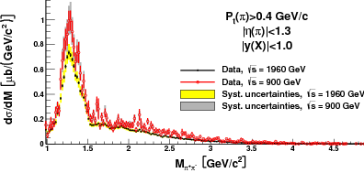
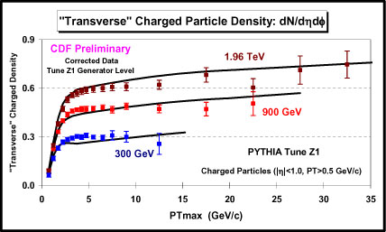
QCD: Exclusive Production
Central Exclusive Hadron Pair Production
CDF Public Note 10841
List of many exclusive results
High mass di-jet production
Exclusive di-jet production,
exclusive di-photon
exclusive χ_{c} production
Measurements at multiple Tevatron energies
300, 900 and 1960 GeV
CDF Pub Note 10841 and 10874
Important in its own right as well as for confidence in our Monte Carlos (Pythia, Herwig++ etc.)

Slide 9
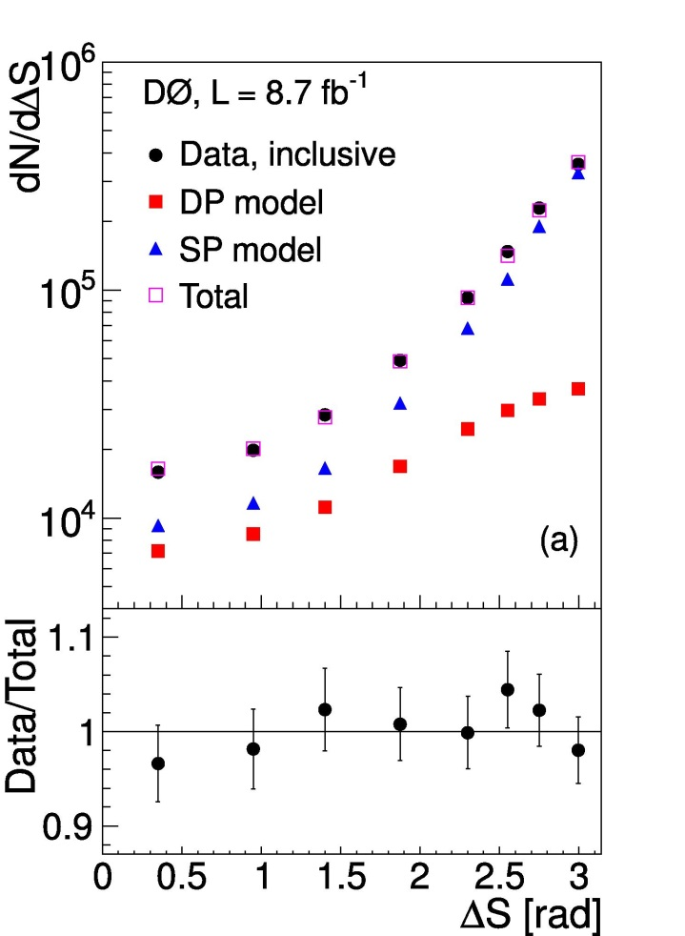
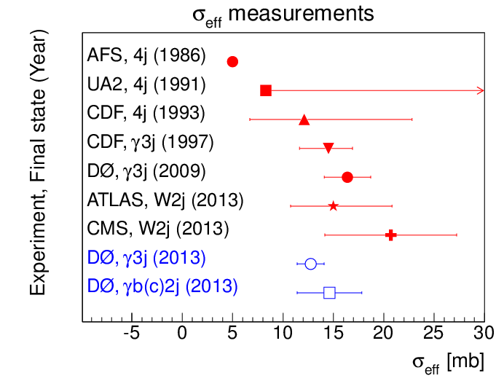
Double Parton Interactions
Ability to separate single and double parton interactions
Measurements in both γ + 3 jets and γ + b/c + 2 jets events
DZero: Phys. Rev. D 89, 072006 (2014)
In agreement with the SM

Slide 10
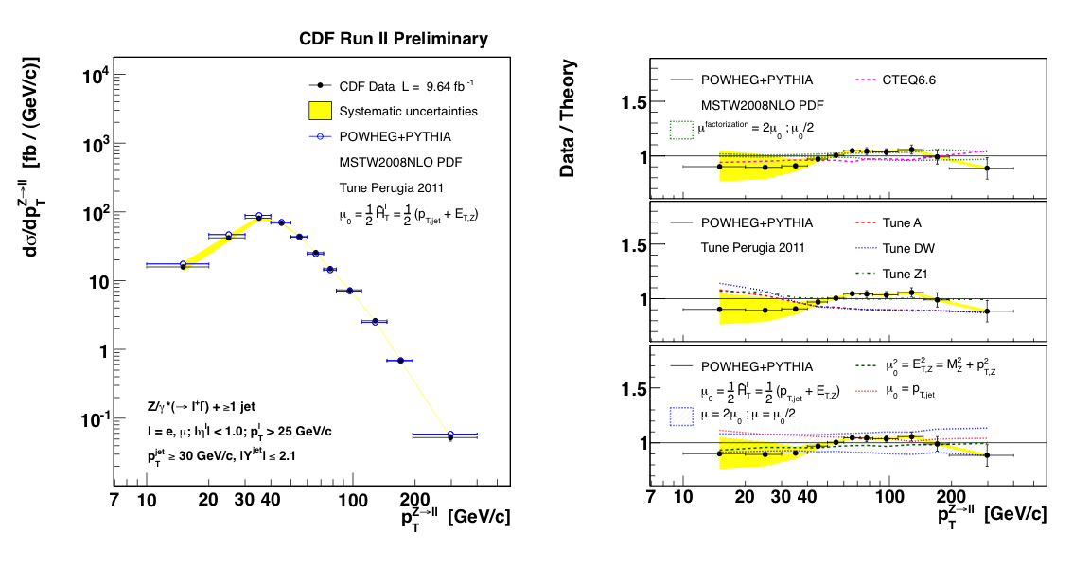
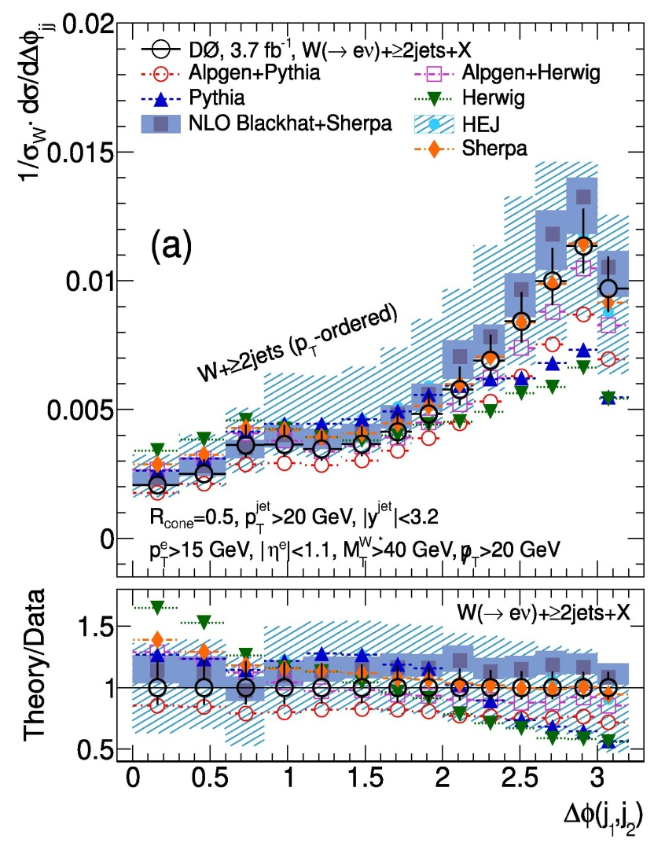
W/Z+Jets
Z+jets & W+jets Cross Section Measurements
CDF: Public Note 10216
DZero: Phys. Rev. D 88, 092001 (2013)
QCD@NLO works reasonably well and is very useful for model builders

Slide 11
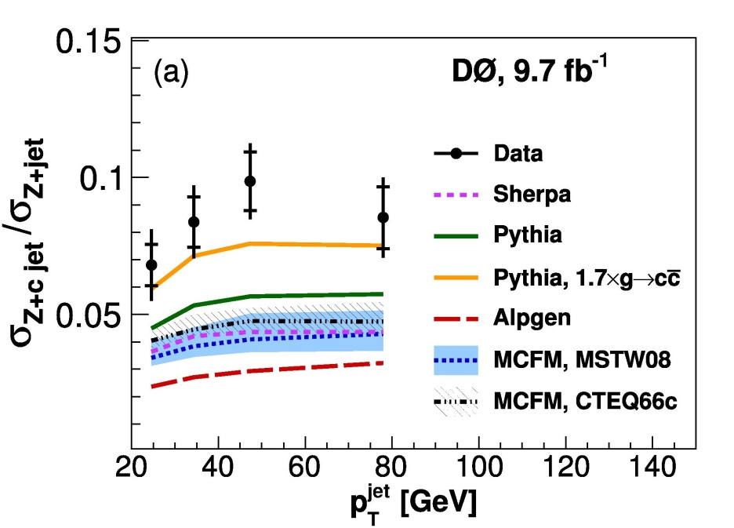
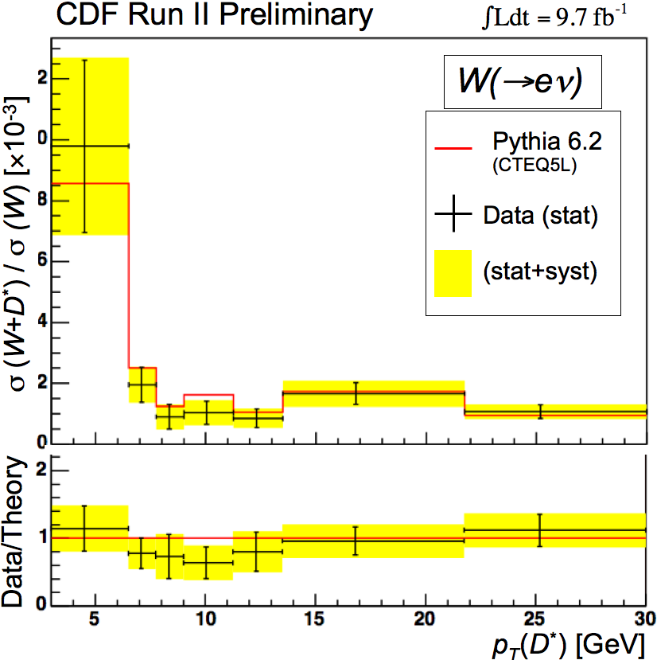
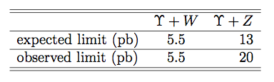
Vector Boson + HF
Using the low pileup environment to pushing down to low rate and/or soft production
V+Charm jet
DZero: Phys. Rev. Lett. 112, 042001 (2014)
V+D*
New method allows for lower P_{T} Charm
CDF Public Note 11087
W/Z+Upsilon
No observation, new limits
CDF Public Note 11099

Slide 12
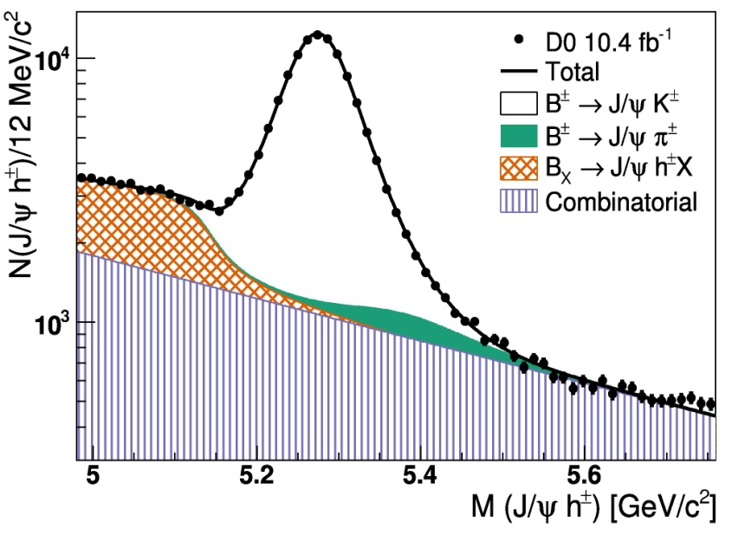
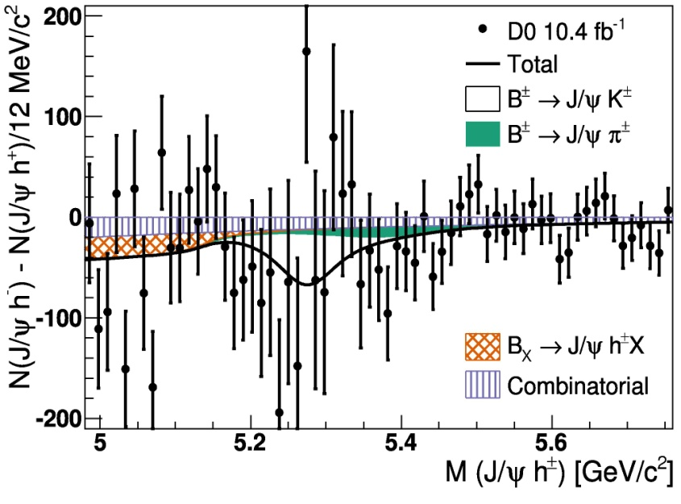
CP violation in B± decays
Analyzed decay multiple modes of B± for CP violation
B± →J/ψK± →μ⁺μ⁻K±
B± →J/ψπ± →μ⁺μ⁻π±
World’s most precise measurement
A^{J/ψK} = (0.59 ± 0.36)%
A^{J/ψπ} = (−4.2 ± 4.8)%
Consistent with SM expectations
DZero: PRL 110, 241801 (2013)

Slide 13
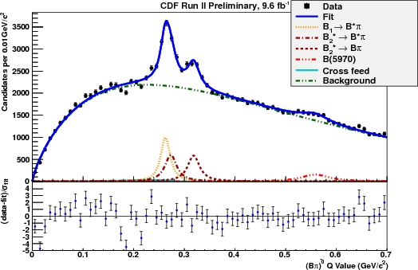
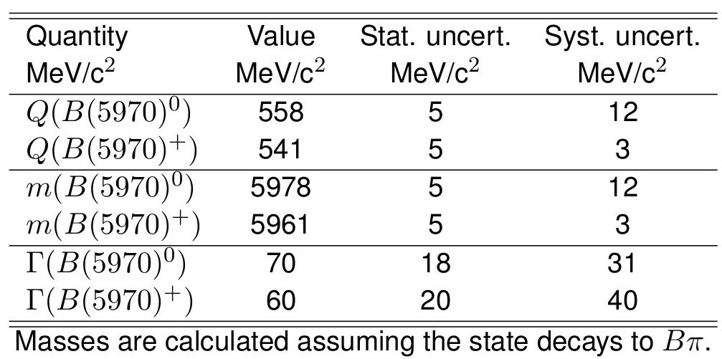
Excited B-mesons
First evidence of resonances (4.4σ) consistent with two states of orbitally excited (L=1) B⁺-mesons
In both B⁰π⁺ and a B⁺π samples
Measured masses and widths of all states, as well as the relative production rates
CDF: arXiv:1309.5961

Slide 14
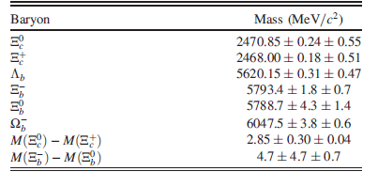
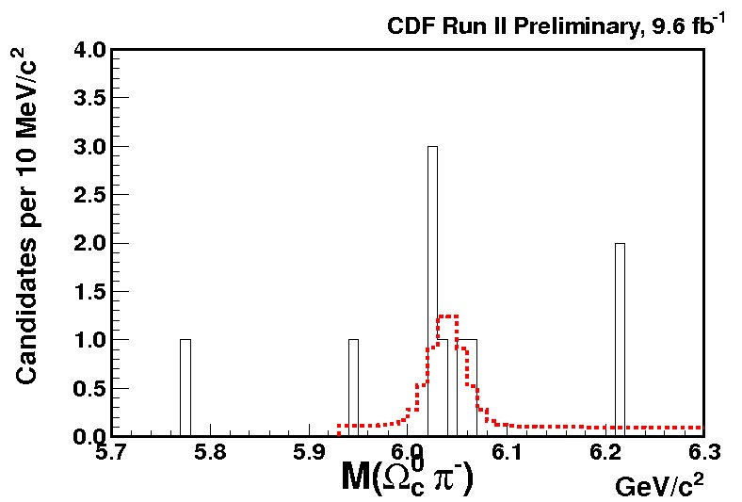
b-Baryon Properties
Full dataset measurement of the masses and lifetimes of Ξ_{c} and b-baryons
First observations of Ω_{b}⁻→Ω_{c}⁰π⁻ and Ξ_{b}⁰ → Ξ_{c}⁺ π⁻
CDF: PRD 89 072014 (2014)
Not yet seen at LHC

Slide 15
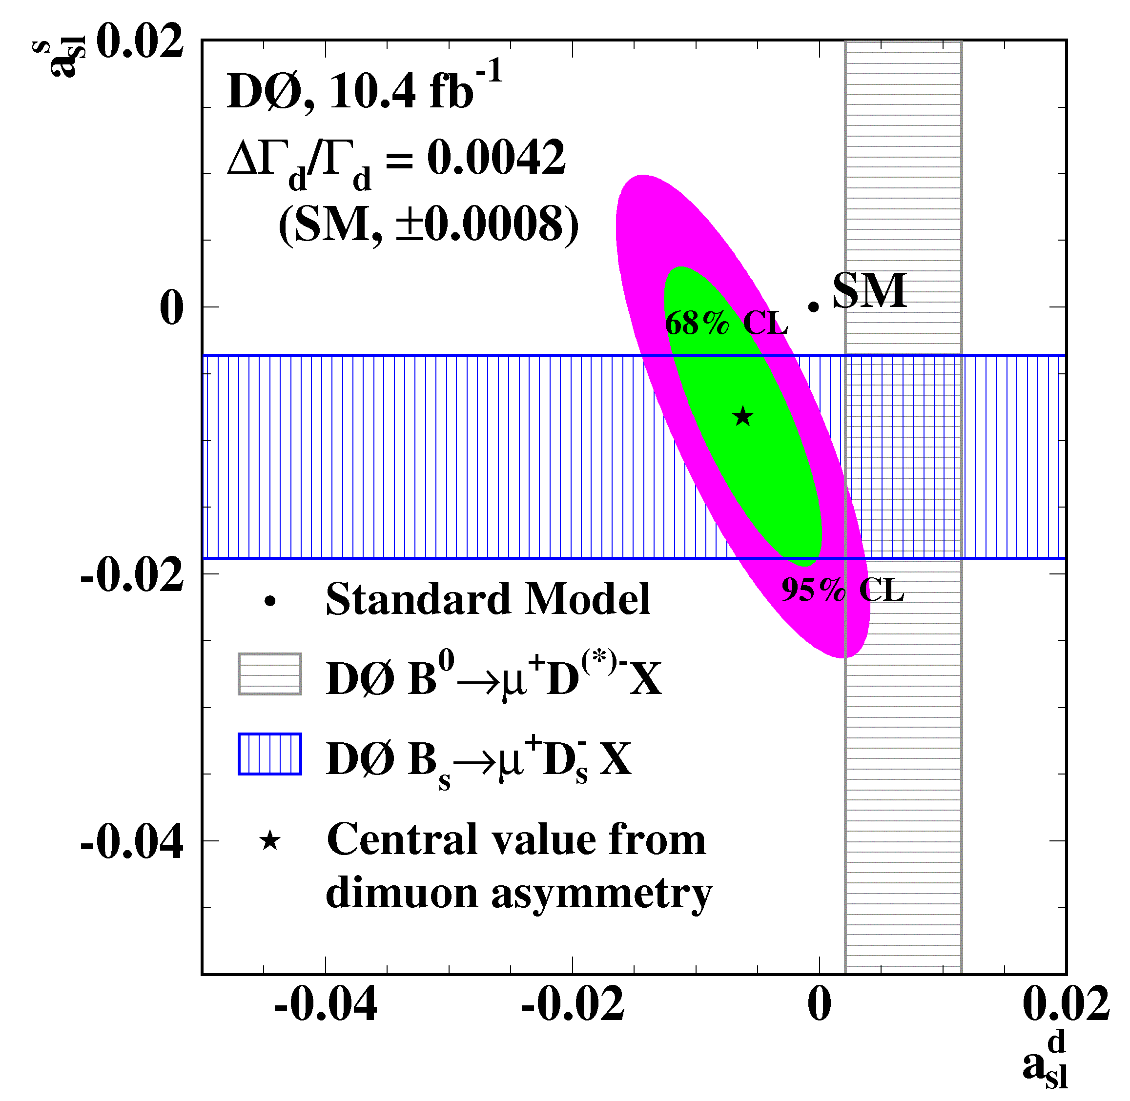
Like-sign di-muon charge asymmetry
Current result deviates from the SM prediction by 3.0σ
DZero: PRD 89, 012002 (2014)
Result is consistent with independent DZero measurements
Semi-leptonic asymmetry in B⁰ (a^{d}_{sl}): PRD 86, 072009 (2012)
Semi-leptonic asymmetry in B_{s} (a^{s}_{sl}): PRL 110, 011801 (2013)
This effect is one of a few remaining puzzles from the Tevatron program which might indicate physics beyond standard model

Slide 16
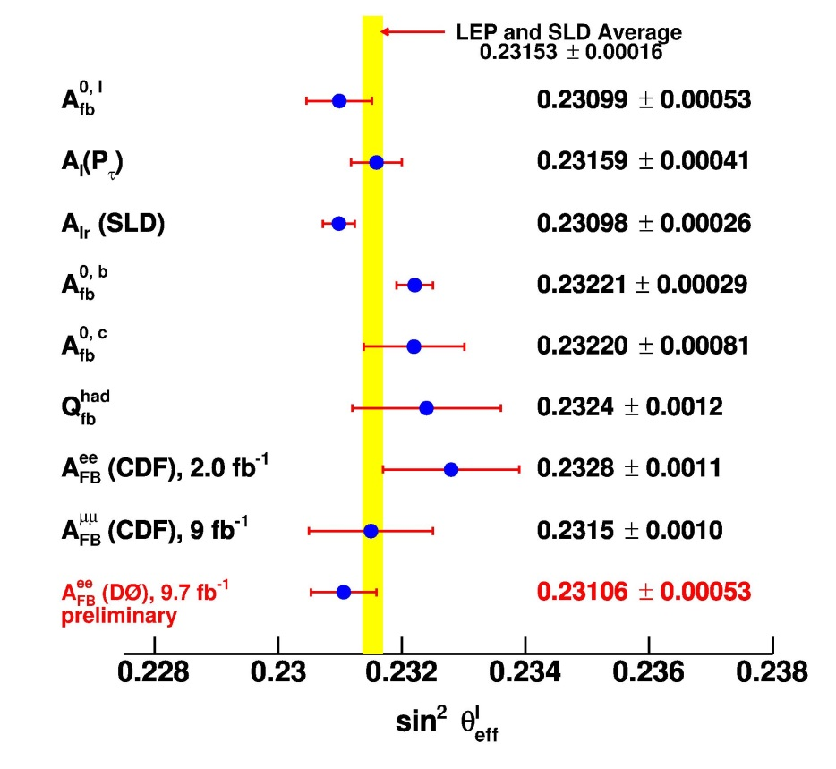
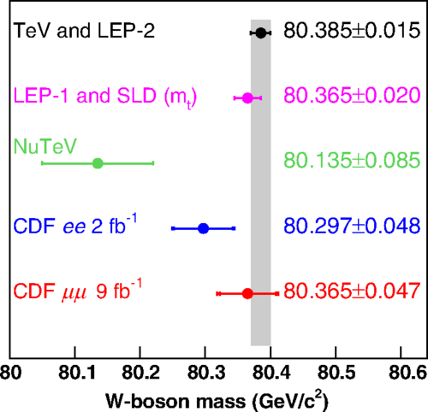
Precision EWK: A_{FB} from leptons sin²θ_{eff} and W-mass
CDF: A_{FB} in μμ with the full data just published
Phys. Rev. D 89, 072005 (2014)
Interpret the results as an indirect W mass measurement → quite competitive
Result for ee in progress
DZero: Single most precise measurement is in ee final state
Public Note 6426

Slide 17
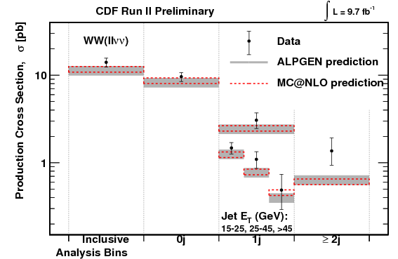
WW and ZZ Results
WW cross section
New full data set results as a function of N_{jet} and Jet E_{T}
CDF Public note 11098
DZero PRD 88, 112005 (2012)
ZZ Cross Section
σ_{zz}=1.04^{+0.32}_{−0.25} pb
CDF: PRD 89, 112001 (2014)
DZero: PRD 88, 0230080 (2013)
All in agreement with the SM

Slide 18
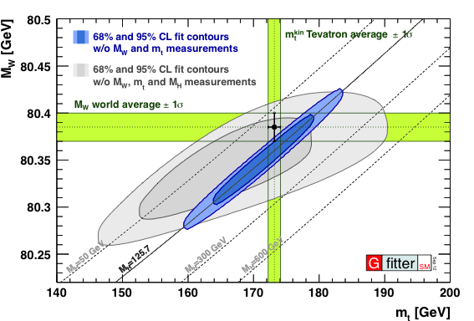
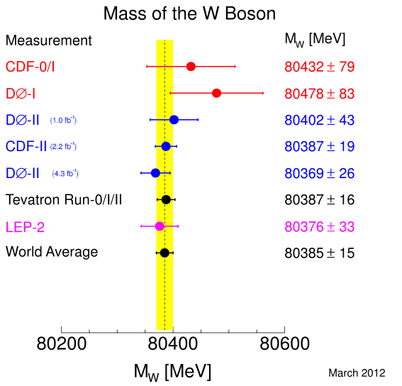
W Mass Measurement
Tevatron Combination
PRD 88, 052018 (2013)
CDF: PRD 89, 072003 (2014)
DZero: PRD 89, 012005 (2014)
M_{W} = (80387 ± 16) MeV/c²
0.02% precision!
Further reduction of uncertainties are difficult and time consuming
Full-data results from both CDF and DZero in progress

Slide 19
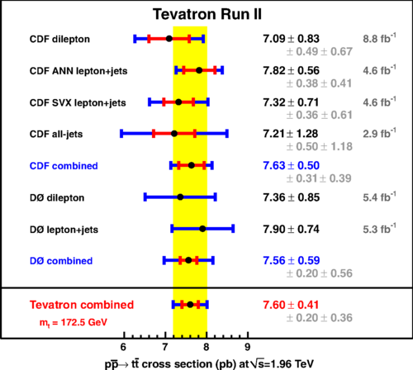
Top Pair-Production Cross Section
Combined CDF/DZero results from ~8.8 fb⁻¹ published
Phys. Rev. D 89, 072001 (2014)
Result is 7.60±0.41 pb
CDF version in lep+jets with the full dataset nearing release

Slide 20
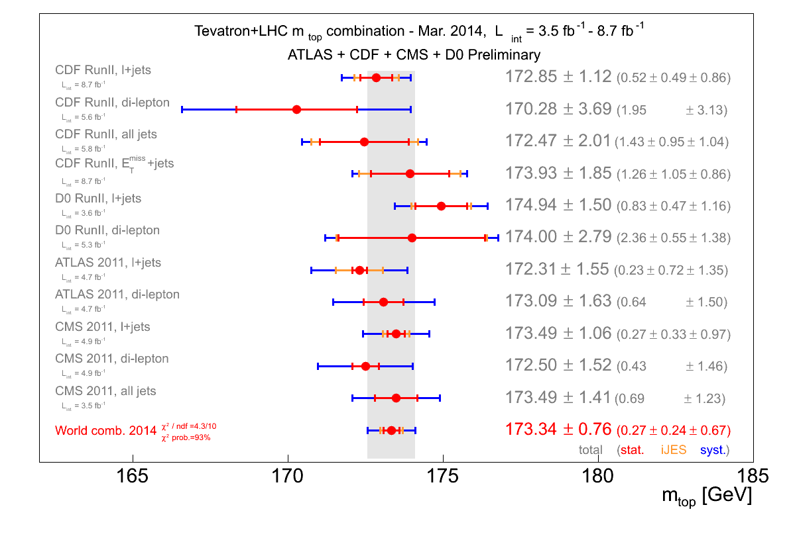
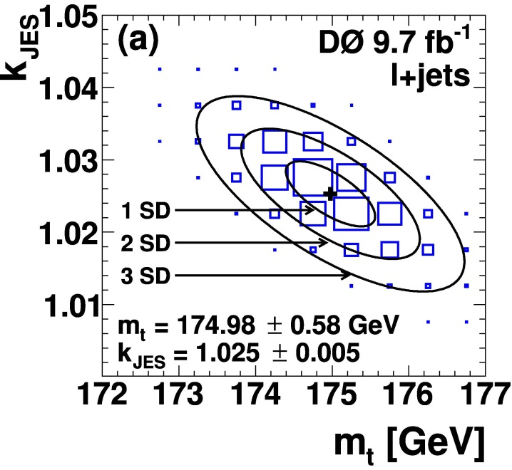
Top Mass
CDF Combination now complete in all channels
Public Note 11080
Tevatron Combination
arXiv:1305.3939
Strong impact on World combination
arXiv:1403.4427
New DZero results in lepton+jets
Very small uncertainties: M_{top} = 174.98±0.76
arXiv:1405.1756

Slide 21
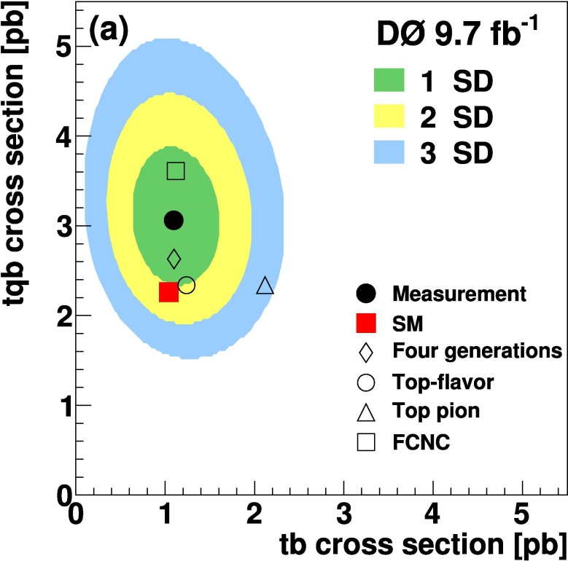
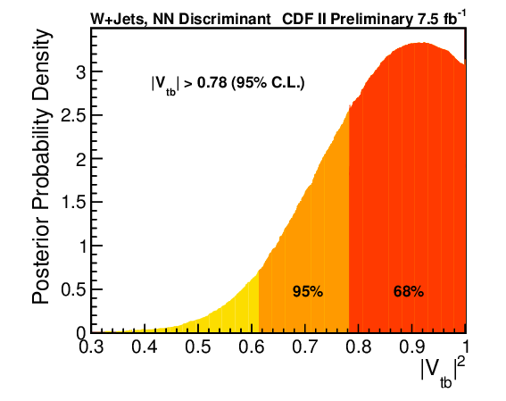
Single Top s+t
CDF Results in Met+Jets and Lep+Jets
Public Notes 10793 and 10926
Combined results coming soon
DZero Result
Phys. Lett. B 726, 656 (2013)
Tevatron Combination is well underway, results expected soon

Slide 22
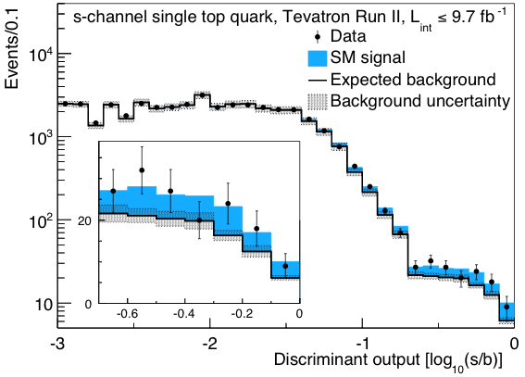
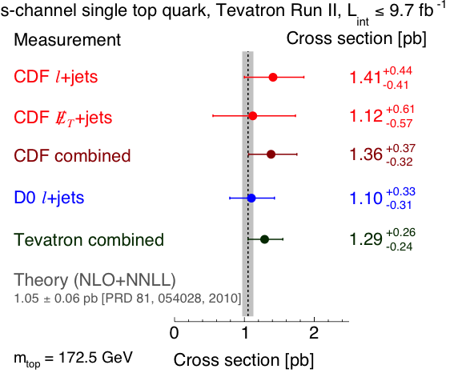
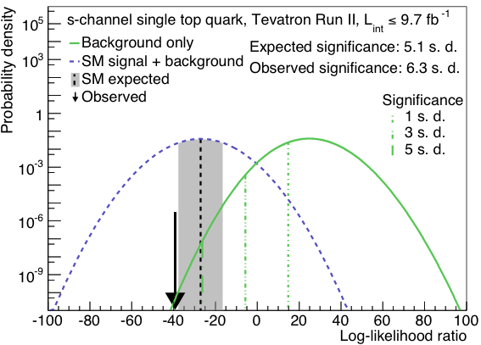
Observation of Single Top in the S-Channel
Single top production in the S-only Channel has now been observed
Combination complete
PRL 112, 231802 (2014)
Observed significance 6.3σ

Slide 23
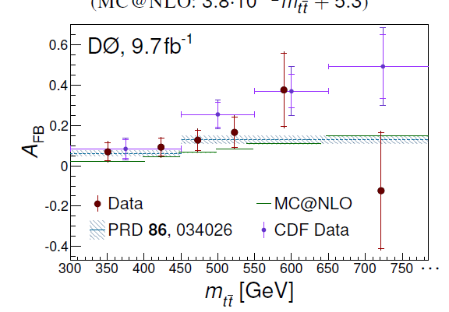
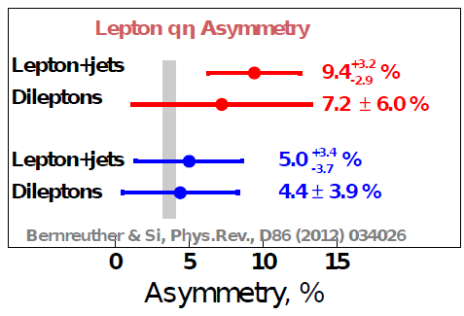
Forward-Backward Asymmetry in ttbar
Hot topic for a number of years
CDF Lep+Jets results shows anomalies
In total reconstructed asymmetry
CDF: PRD 87, 092002(2013)
Most pronounced as a function of mass
In dσ/dcosθ_{t} in l+jets
CDF: PRD 88, 072003(2013)
In lepton asymmetry
CDF: PRL 111, 182002(2013)
Full suite of CDF and DZero results since in then
Leptonic: l+jets & dileptons
Full Reconstruction: Lep+Jets only
Recent results from CDF and DZero
DZero leptonic Asy: PRD 88, 112002 (2013)
DZero Reconstructed: arXiv:1403.1294
CDF asym: arXiv:1404.3698
Not sure what the final conclusion is: working to finish results, reconcile them all and combine

Slide 24
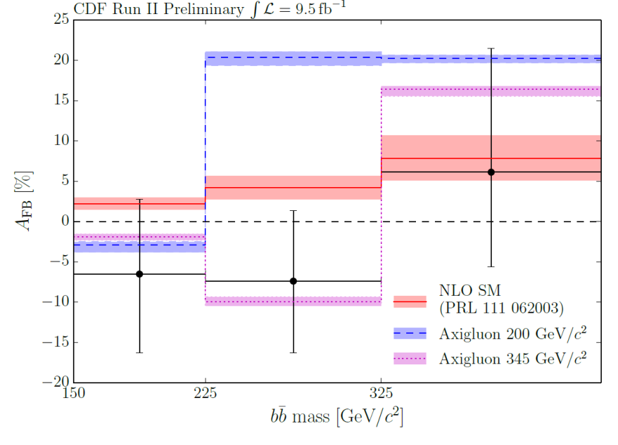
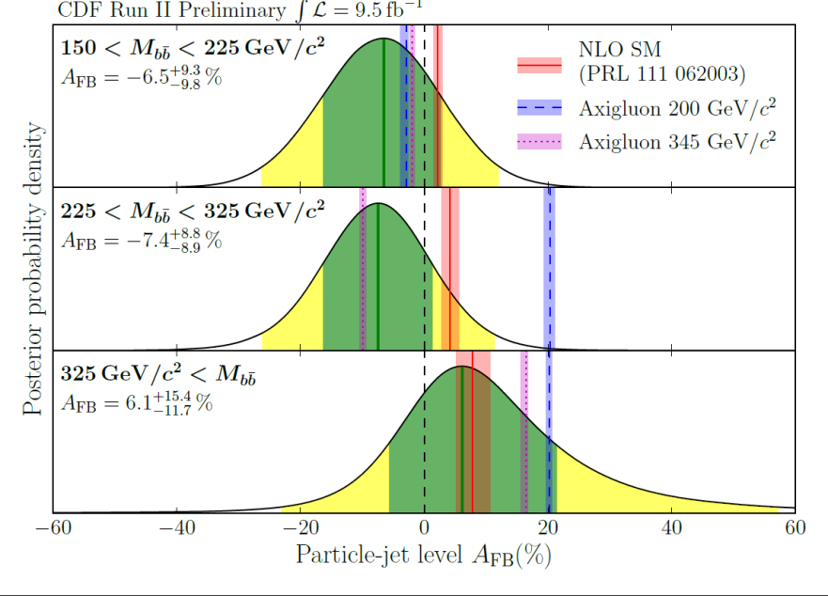
A_{FB} in High Mass bb
The A_{FB} in ttbar suggests that looking in the lower mass bbbar state is useful at large bbbar invariant masses
New results consistent with SM
CDF Public note 11092
DZero results in the works

Slide 25
Future Publication Plans
CDF
Expect ~30 papers in 2014
Expect ~15 in 2015
DZero:
Expect ~25 papers in 2014
Expect ~15 papers in 2015
CDF
Topic | 2014 | 2015
BSM | 3 | 3
Higgs | 1 | 0
Top | 11 | 2
SM (EWK+QCD) | 8 | 6
Heavy Flavor | 6 | 4
Combinations | 4 | 3
Total | 34 | 18
DZero
Topic | By summer 2014 | Beyond summer 2014
EWK | 4 | 5
Higgs | 1 | 1
Top | 3 | 5
QCD | 3 | 5
Heavy Flavor | 2 | 3
Combinations | 3 | 4
NIM | - | 1
Total | 16 | 24

Slide 26
Conclusions
The CDF and DZero collaborations are still doing exciting physics and publishing at a strong rate
The Tevatron has now published over 1,000 papers and graduated over 1,000 PhD students
In the last year(s) we have had many successes by focusing on legacy results that are competitive and complementary to the LHC
Single Top, Wmass, Top mass, A_{FB} in tt, Higgs(bb)
Modest support from the laboratory and funding agencies around the world is well leveraged and will assure many more important results to come based on the Tevatron data
In the next year or so we expect many exciting results including the final Tevatron word on the Higgs Spin-parity in VHiggs(bb) Top mass, AFB in tt and bb, W charge asymmetry and a Wmass measurement in the 10-15 MeV range

Slide 27
Backups

Slide 28
W+Dijet Mass Bump Story

Slide 29
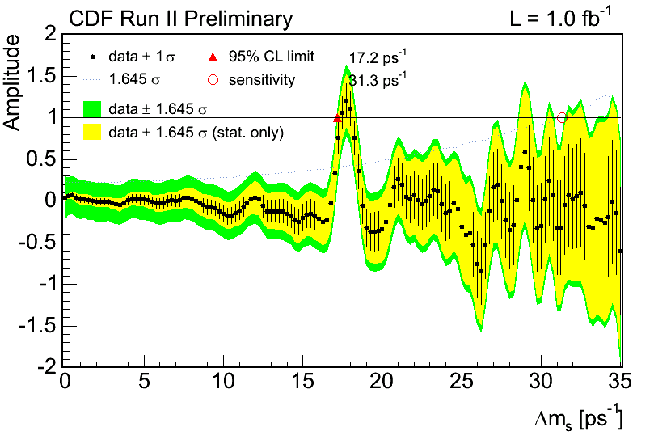
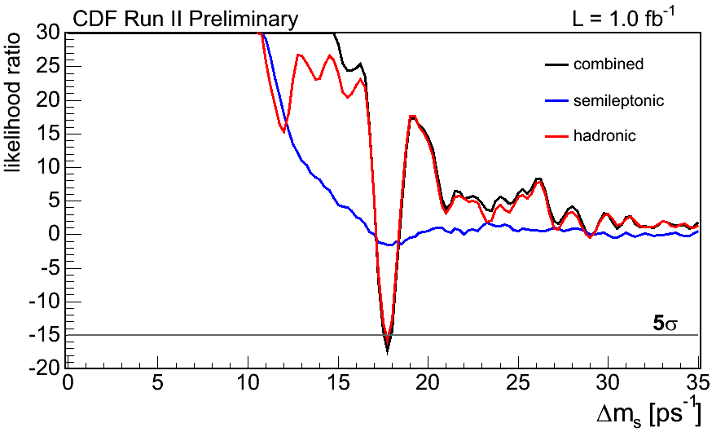
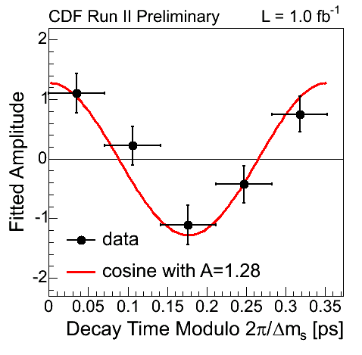
Observation of B_{s}⁰ – B_{s}⁰ Oscillations
_
PRL 97, 062003, 242003 (2006)
Observation based on the analysis of many B_{s}⁰ hadronic decay modes made possible by the SVT trigger

Slide 30
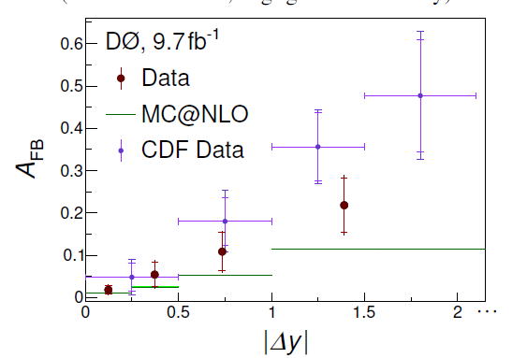
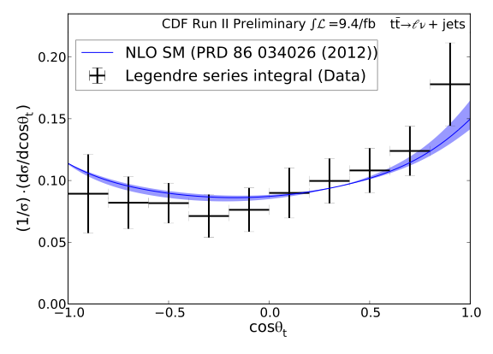
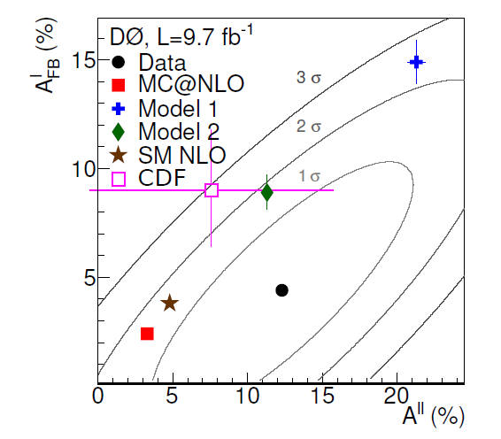
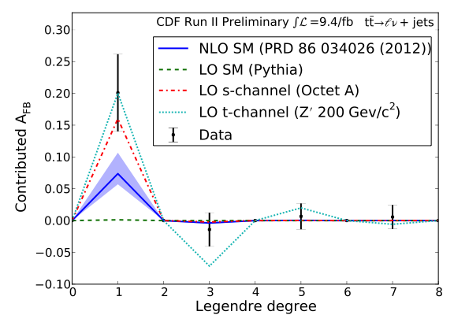

Slide 31

Tevatron Legacy
Physics
Discovery of top quark & measurement of its properties
First evidence of Higgs boson in fermionic final states
Precision measurement of W boson mass
Precision measurements of jets, V+jets, VV cross sections
Substantial progress in heavy flavor states and mixing
Subtle behavior: CP violation in heavy hadrons, A_{FB}(tt)

Slide 32
Tevatron Legacy
Hardware
Silicon tracking/vertexing taken to a whole new level
b-tagging widely developed and used at the Tevatron
Triggers
Entire trigger concept in a hadron collider environment
SVT & out-of-time triggers for long-lived/slow particles
Analysis techniques
Importance of MVA techniques (single top, Higgs)
Combination of multiple channels (Higgs)
Innovative physics methods
Example: “in situ” JES calibration in m_{top} measurements

Slide 33
http://www-d0.fnal.gov/d0_publications/d0_pubs_list_bydate.html and consider reporting results which became public since after last year Users meeting. New results in all active groups QCD, top, EW and heavy flavor have become available and in some cases very important,
Very accurate top mass measurement presented this March.
There is final di-muon ass. result from DZero as well and many others.
World top mass combo might be interesting, while you are talking after(!) LHC talks, so this might already be covered (you still have to show one slide, please). I suggest you have CDF/DZero results combined by topic and try to mix about equal number of results from each experiment.
as usually singling one result our of many is rather non-trivial. Still since last Users Meeting among published results I would point to the fundamental study (50+ pages, 10's of tables and plots) of W+jets production at the Tevatron http://www-d0.fnal.gov/Run2Physics/WWW/results/final/QCD/Q13C/ Another interesting study is double-parton interactions http://www-d0.fnal.gov/Run2Physics/WWW/results/final/QCD/Q14A/ there is set of ~6 papers on this topic by now and the review of these results will be subject of W&C during Users Meeting week (will be nice to advertize this talk in your presentation).

Slide 34
Stuff from Dzero page
Submitted 5. Precision measurement of the top quark mass in lepton+jets final states at D0 Submitted 05/08/14: Phys. Rev. Lett., arXiv:1405.1756 plots 9.7 fb⁻¹ 4. Measurement of the forward-backward asymmetry in pp → tt production in l+jets channel Submitted 05/02/14: Phys. Rev. D, arXiv:1405.0421 plots 9.7 fb⁻¹ 3. Measurement of the forward-backward asymmetry in the distribution of leptons in tt in the lepton+jets channel Submitted 02/07/14: Phys. Rev. D, arXiv:1403.1294 plots 9.7 fb⁻¹ 2. Measurement of differential tt production cross sections in pp collisions Submitted 01/21/14: Phys. Rev. D, arXiv:1401.5785 plots
1. Observation of s-channel production of single top quarks at the Tevatron PRL Editors' Suggestion Accepted 04/24/14: Phys. Rev. Lett., arXiv:1402.5126 plots up to 9.7 fb⁻¹
318. Combination of measurements of the top-quark pair production cross section from the Tevatron Collider Published 04/01/14: Phys. Rev. D 89, 072001 (2014), arXiv :1309.7570 plots up to 8.8 fb⁻¹
316. Measurement of the W boson mass with the D0 detector Published 01/30/14: Phys. Rev. D 89, 012005 (2014), arXiv:1310.8628 plots 4.3 fb⁻¹
11. Measurement of the asymmetry in angular distributions of leptons produced in dilepton tt final states in pp collisions at √s = 1.96 TeV Published 12/02/13: Phys. Rev. D 88, 112002 (2013), arXiv:1308.6690 plots 9.7 fb⁻¹
306. Combination of CDF and D0 W-Boson Mass Measurements Published 09/24/13: Phys. Rev. D 88, 052018 (2013), arXiv:1307.7627 plots 5.3 fb⁻¹ 305. Higgs Boson Studies at the Tevatron Published 09/17/13: Phys. Rev. D 88, 052014 (2013), arXiv:1303.6346 plots 10 fb⁻¹ 304. Combined search for the Higgs boson with the D0 experiment

Slide 35
CDF Recent Papers
B Baryon Properties Measured with the Full Run II Data Set
Dimuon Afb using the full dataset PRD 2013-09-25 2013-11-01 2013-12-11 2014-02-08 2014-02-27
ZZ to lll'l' and llnunu using the full CDF dataset PRD 2013-07-02 2013-09-24 2013-11-18 2014-03-10 2014-05-12
Combination of CDF and D0 W Mass measurements PRD 2009-04-06 2013-05-14 2013-07-10 2013-07-29 2013-08-27
sin2θW (indirect MW) with Z→ee events
Search for Dijet Resonance in lnujj Final State
Forward-backward asymetry of bb̄
Single Top S+T

Slide 36
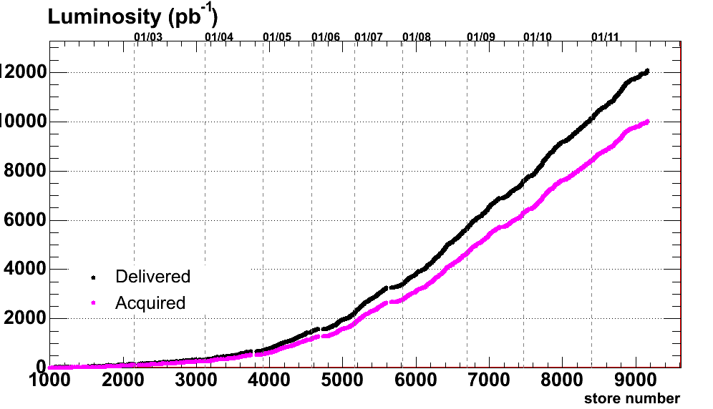
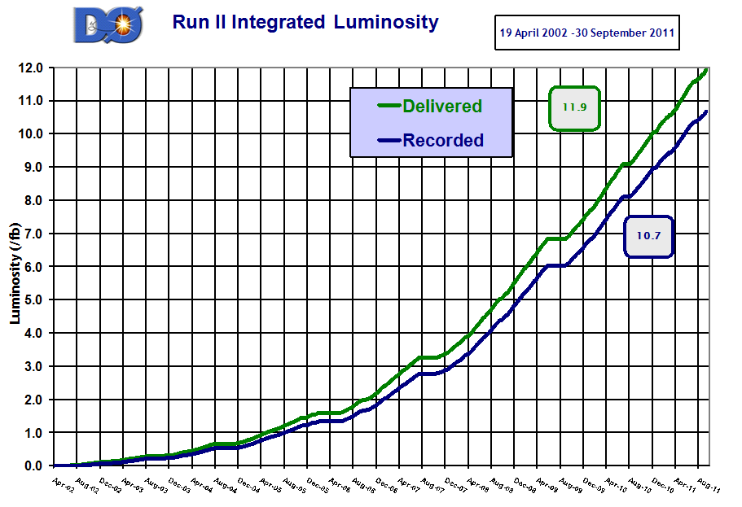
Sample
Delivered 12 fb⁻¹
Acquired 10 fb⁻¹/experiment
15B + 9B events total in Run II
Total dataset 10 + 9 PB
(including Monte Carlo)
A well understood sample
Coverage for “soft” physics
Variety of collision energies
Unique p-pbar initial state
(unlikely to have again)

Slide 37
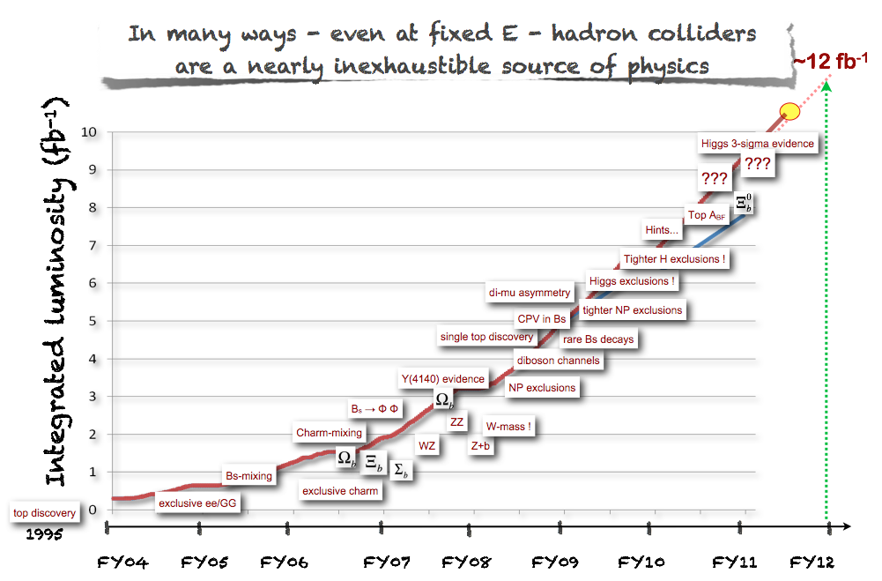
Run II history

Slide 38
Future
Priorities: Finish relevant measurements with full luminosity,
including combinations of results (CDF + D0 and
LHC + Tevatron, when appropriate)
Long term: Ongoing joint effort by Fermilab and Tevatron
experiments to preserve data and analysis
knowledge of the unique proton-antiproton
Tevatron sample

Slide 39
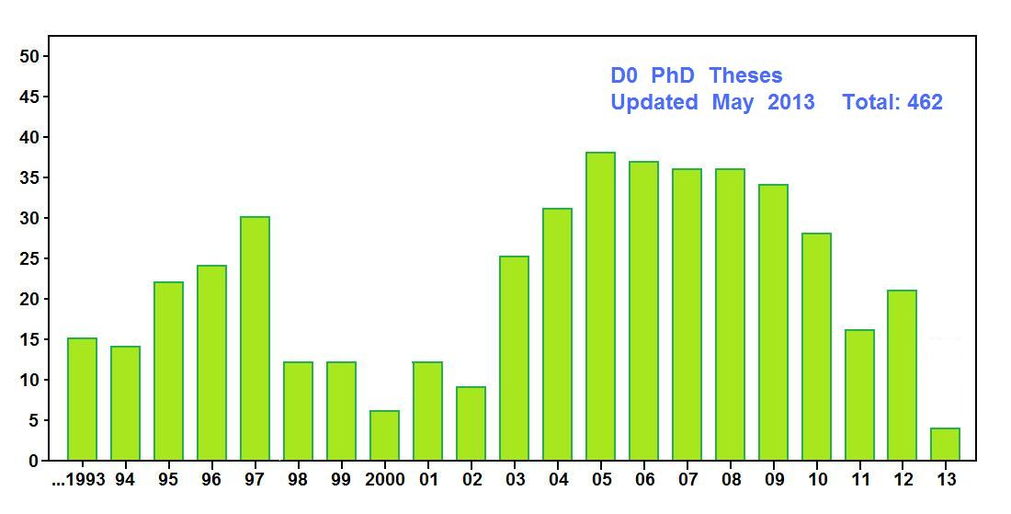
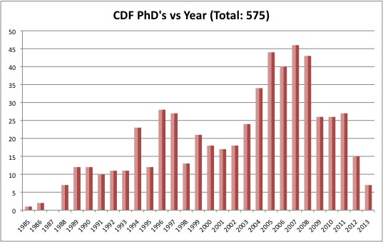
1,000+ PhD theses in 25 years (1988–present)
The making of a new generation of scientists

Slide 40


σ_{eff} = 12.7 ± 0.2 (stat) ± 1.3 (syst) mb
σ_{eff} = 14.6 ± 0.6 (stat) ± 3.2 (syst) mb

Slide 41

Top cross section backup

Slide 42


V+HF Backups
Observe one Upsilon + W candidate over an expected background of 1.2 ± 0.5 events, and one Upsilon + Z candidate over an expected background of 0.1 ± 0.1 events.
Measurements of σ(V+D*)/σ(V)

Slide 43



Slide 44


Slide 45
Like-sign dimuon charge asymmetry
N⁺⁺, N ⁻⁻ − number of events with two muons of the same charge
The only inclusive measurement of CP violation so far
Large statistics is available
As yet unknown sources of CP violation could contribute in this asymmetry
Assuming that the measured charge asymmetries are produced by known types of CP violation, we can extract their parameters
Semileptonic charge asymmetry of B_{d} meson: a^{d}_{sl}
Semileptonic charge asymmetry of B_{s} meson: a^{s}_{sl}
Relative width difference of B_{d} meson: ΔΓ_{d}/Γ_{d}
CP violation in mixing
CP violation in interference

Slide 46
Results
We get:
deviates from the SM prediction by 3.0 σ
Published: PRD 89, 012002 (2014)
Result is consistent with independent DØ measurements of
a^{d}_{sl} : PRD 86, 072009 (2012)
a^{s}_{sl} : PRL 110, 011801 (2013)
This effect is one of a few remaining puzzles from the Tevatron program which might indicate physics beyond standard model
muon asymmetry

