Slide 1


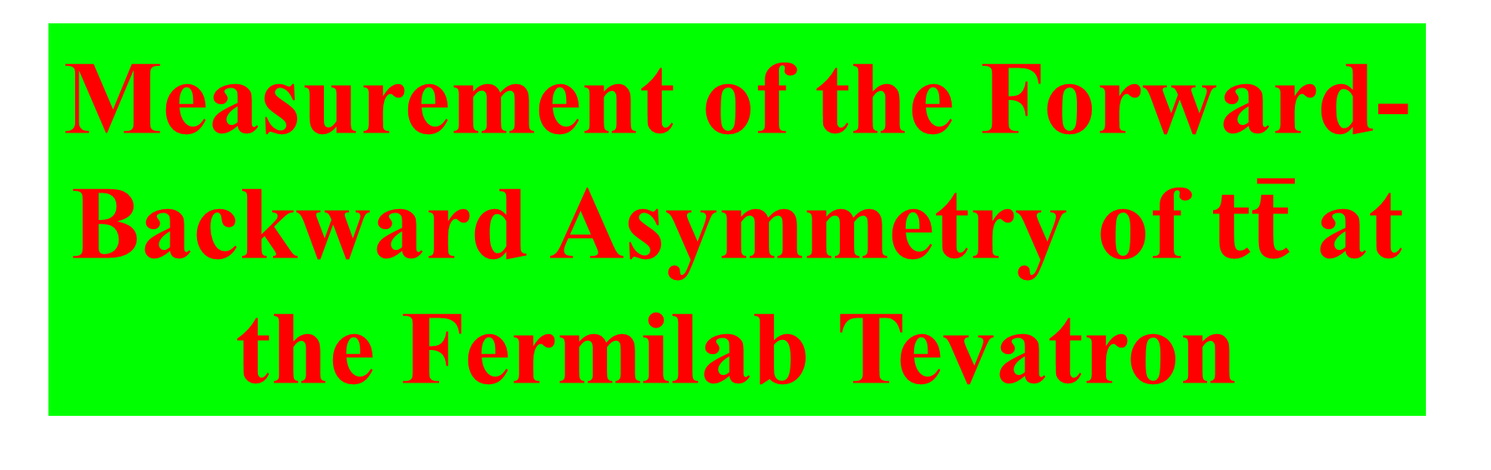
Measurement of the Forward-Backward Asymmetry of $t\overline{t}$ at the Fermilab Tevatron
David Toback
Texas A&M University
University of Chicago Seminar
November 2015

Slide 2
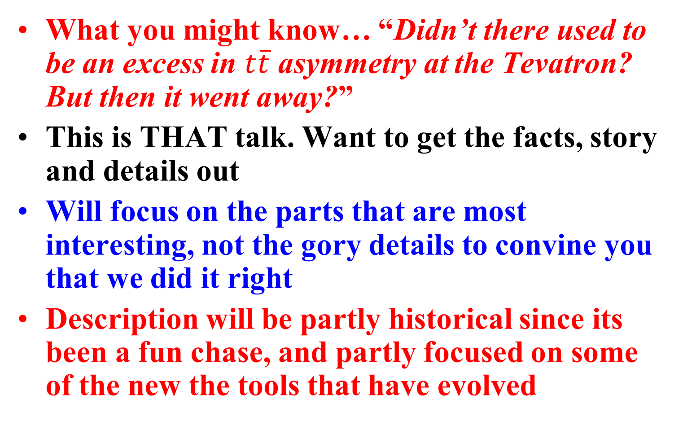
Prologue
What you might know… “Didn’t there used to be an excess in $t\overline{t}$ asymmetry at the Tevatron? But then it went away?”
This is THAT talk. Want to get the facts, story and details out
Will focus on the parts that are most interesting, not the gory details to convine you that we did it right
Description will be partly historical since its been a fun chase, and partly focused on some of the new the tools that have evolved

Slide 3
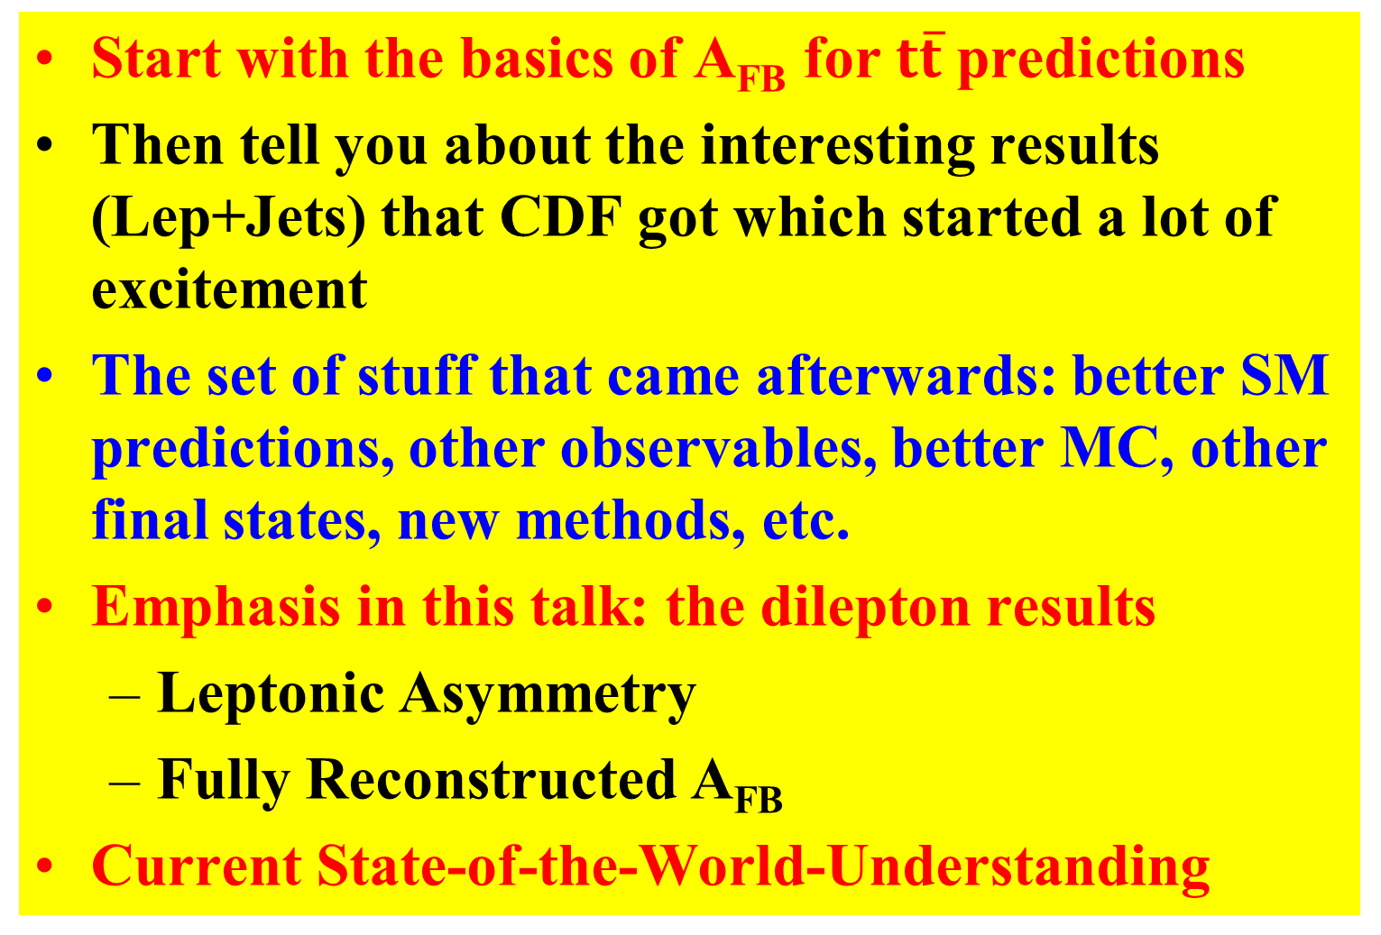
Outline
Start with the basics of A_{FB} for $t\overline{t}$ predictions
Then tell you about the interesting results (Lep+Jets) that CDF got which started a lot of excitement
The set of stuff that came afterwards: better SM predictions, other observables, better MC, other final states, new methods, etc.
Emphasis in this talk: the dilepton results
Leptonic Asymmetry
Fully Reconstructed A_{FB}
Current State-of-the-World-Understanding

Slide 4
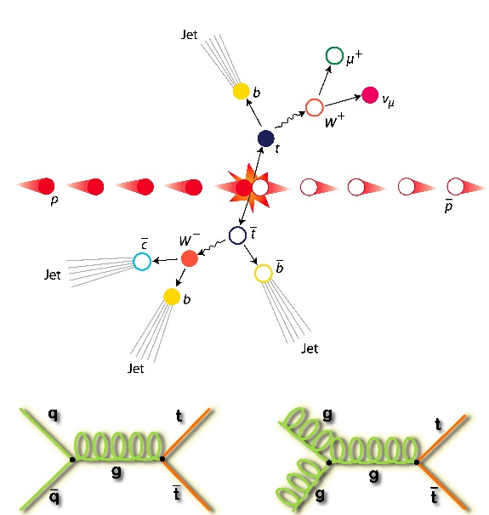
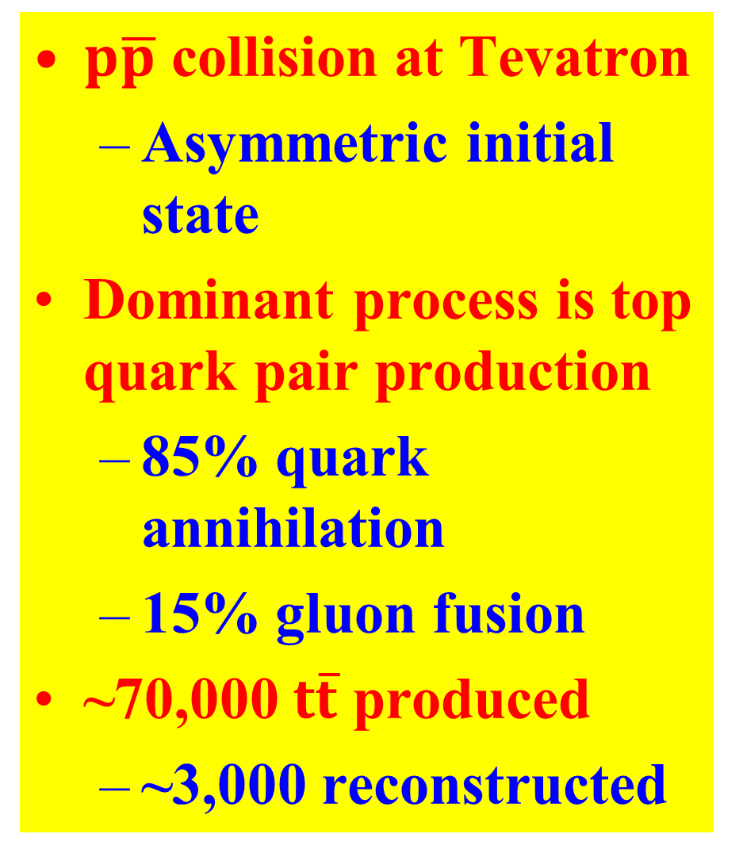
Top Production at the Tevatron
$p\overline{p}$ collision at Tevatron
Asymmetric initial state
Dominant process is top quark pair production
85% quark annihilation
15% gluon fusion
~70,000 $t\overline{t}$ produced
~3,000 reconstructed

Slide 5
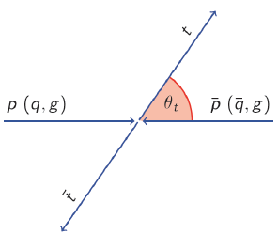
Definition of A_{FB}
In proton-antiproton collisions can measure the relative angle between the outgoing top and the proton direction
This is a forward event… If the top was going in the direction of the anti-proton →backward event
Forward-Backward Asymmetry:
A_{FB} = Fraction(Forward) – Fraction(Backward)

Slide 6
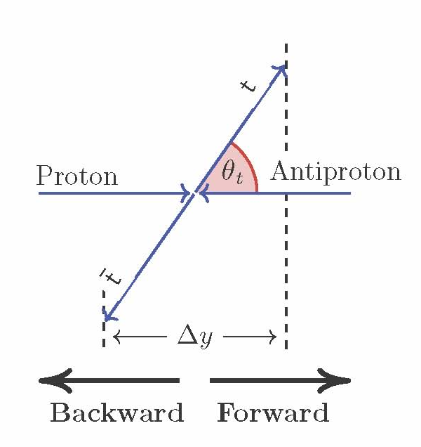
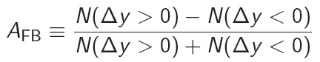
Quick Aside on Variable Choice Δy
Transform from Θ_{t} to rapidity (y)
Rapidity difference is a good proxy for production angle
Invariant under longitudinal boosts
Asymmetry in Δy is bigger than in Θ_{t,} easier to distinguish from 0
Note: y doesn’t have the usual geometric angle many of us are used to.
At hadron colliders we usually use pseudo-rapidity which assumes m=0
→ Here E and p not close to equal because of the top mass

Slide 7
Tevatron VS. LHC
Isn’t the LHC better for this?
Tevatron is proton-antiproton while LHC is proton-proton
Tevatron provides a direction in space, while LHC only provides a line in space
Can directly use the opening angle relative to learn about Feynman diagrams
Can get at the same diagrams at LHC, but takes much larger statistics and more indirect methods

Slide 8
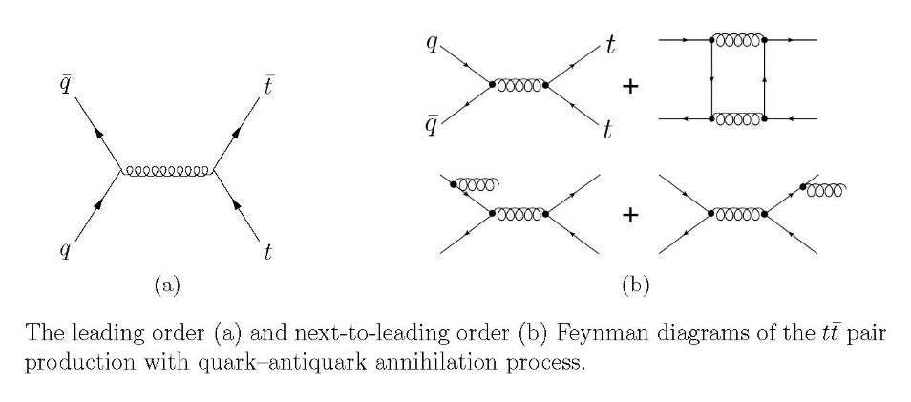
Asymmetry Predictions
First SM predictions of A_{FB} after top discovery (~1995)
No A_{FB} at LO, all asymmetry comes from NLO diagrams. Took many years to get decent predictions
Interference among diagrams
Larger-than-expected EW correction and higher order QCD corrections complicate the calculation
Note: Process has been a harbinger of things to come: We have learned during the process that LO MC’s are simply not good enough to measure properties of the top quark

Slide 9
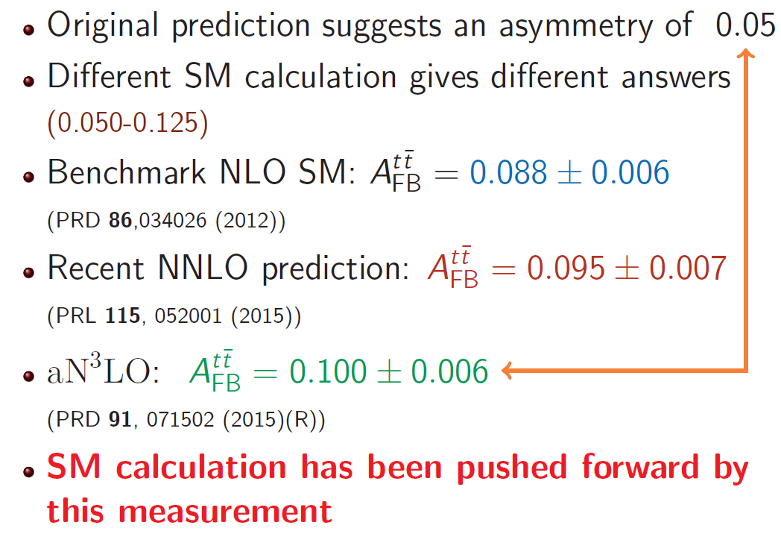
Lots of Predictions

Slide 10
Comments on Systematics & Biases
The measurements presented today are statistics limited, so focus on techniques which make the most of the data
Spent a lot of time worrying that our methods aren’t biased
Won’t rehash the results from Lep+Jets analysis as those were published a few years ago…

Slide 11
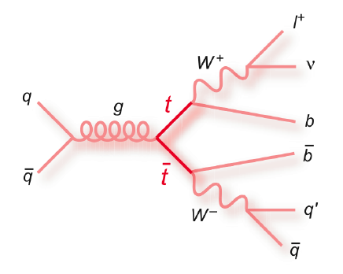
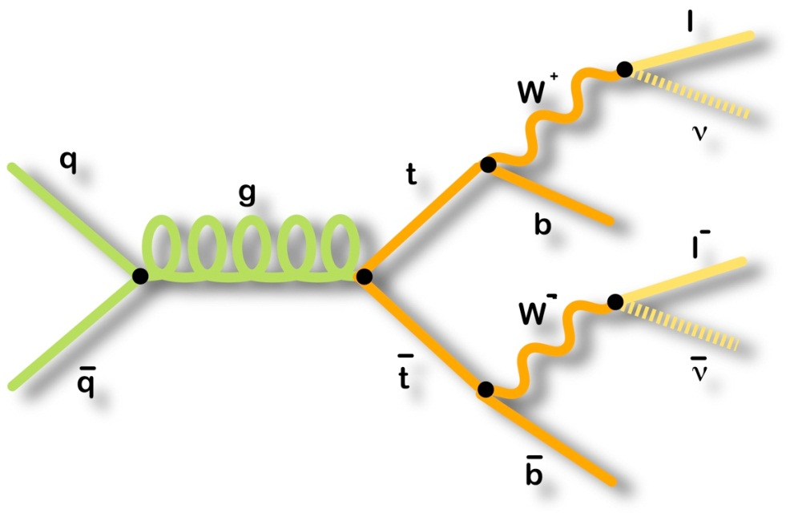
Selecting Top Quark Events
Lepton+Jets
Final State
Dilepton
Final State
1 reconstructed lepton
Missing transverse energy
≥4 jets (1 b-tag)
ΣE_{T} > 220 GeV
Bigger branching fraction, more final state particles to measure, bigger backgrounds
2 reconstructed leptons
Missing transverse energy
≥2 jets
ΣE_{T} > 200 GeV
Higher purity sample, but smaller branching fraction, two leptons have better angles, but two neutrinos cause reconstruction ambiguities

Slide 12
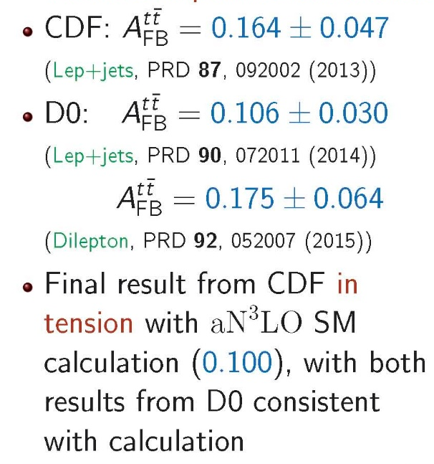
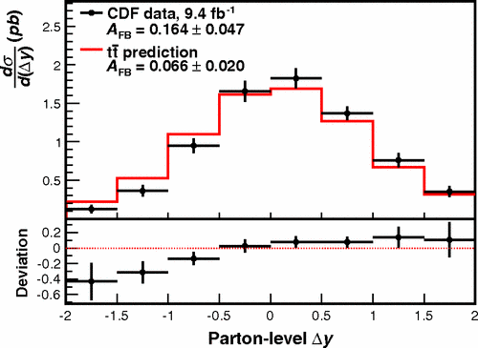
Inclusive A_{FB} Results
Prediction in plot is old so one can see where the excitement came from
Can already tell that the asymmetry is larger than expected for large |Δy|

Slide 13
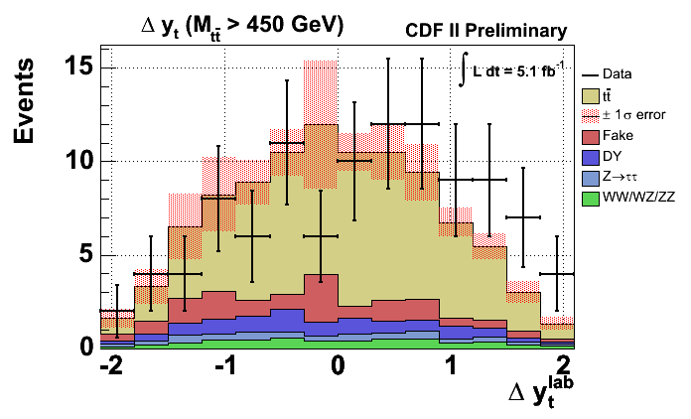
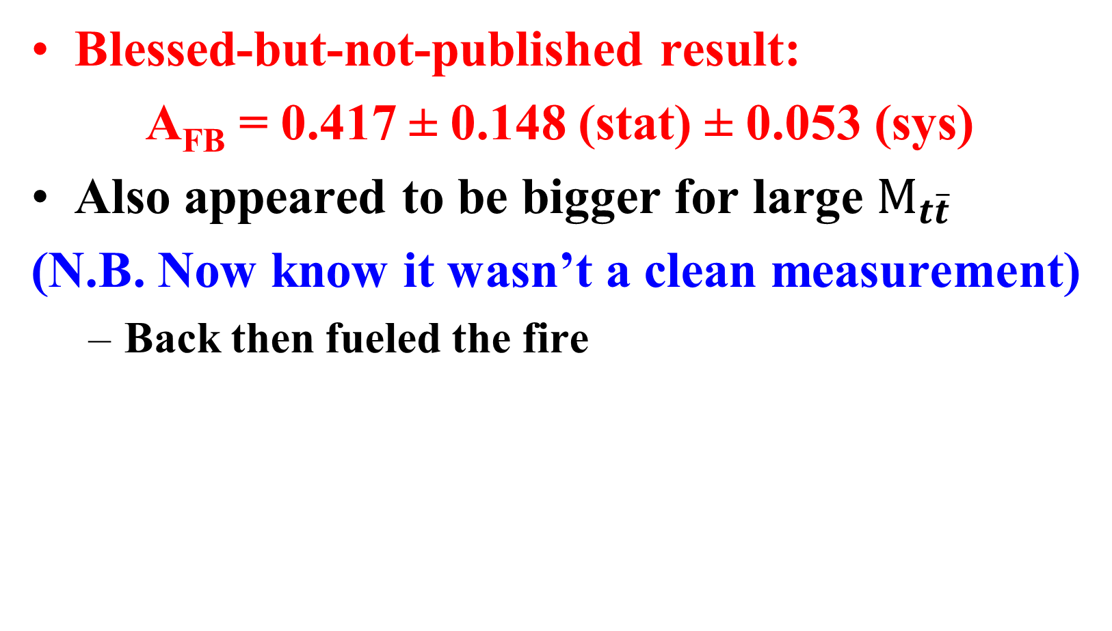
CDF Dilepton Result with 5.1fb⁻¹
Blessed-but-not-published result:
A_{FB} = 0.417 ± 0.148 (stat) ± 0.053 (sys)
Also appeared to be bigger for large $M_{t\overline{t}}$
(N.B. Now know it wasn’t a clean measurement)
Back then fueled the fire

Slide 14
Moving Forward
Adopt a quasi-historical approach from here on out
For awhile there was a the real sense that there was a significant discrepancy between the data and the SM predictions
Goals:
Improve SM prediction
Consider other ways to look at the data
New physics models?

Slide 15
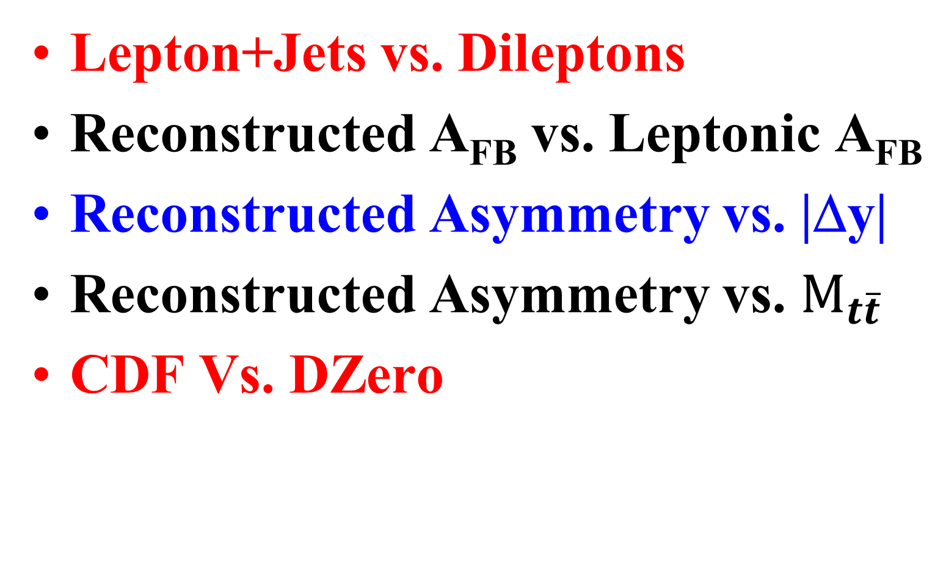
Recurring Theme: Lots of Ways to Measure and/or Compare to predictions
Lepton+Jets vs. Dileptons
Reconstructed A_{FB} vs. Leptonic A_{FB}
Reconstructed Asymmetry vs. |Δy|
Reconstructed Asymmetry vs. $M_{t\overline{t}}$
CDF Vs. DZero

Slide 16
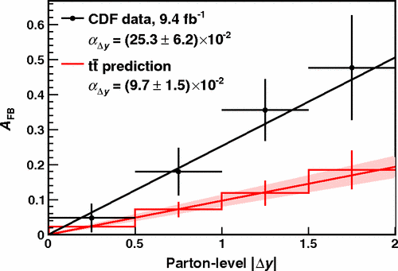
A_{FB} as a function of Δy
Observe larger asymmetry at larger values of Δy
Differential values of A_{FB} well described by a linear relationship
Not clear to theorists why this should be so…
Slope: 0.253±0.062
PRD 87, 092002 (2012)
2.2 higher than NNLO SM prediction
Slope: 0.114^{+0.005}_{-0.012}
PRL 115, 052001 (2015)

Slide 17
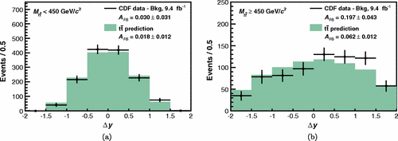
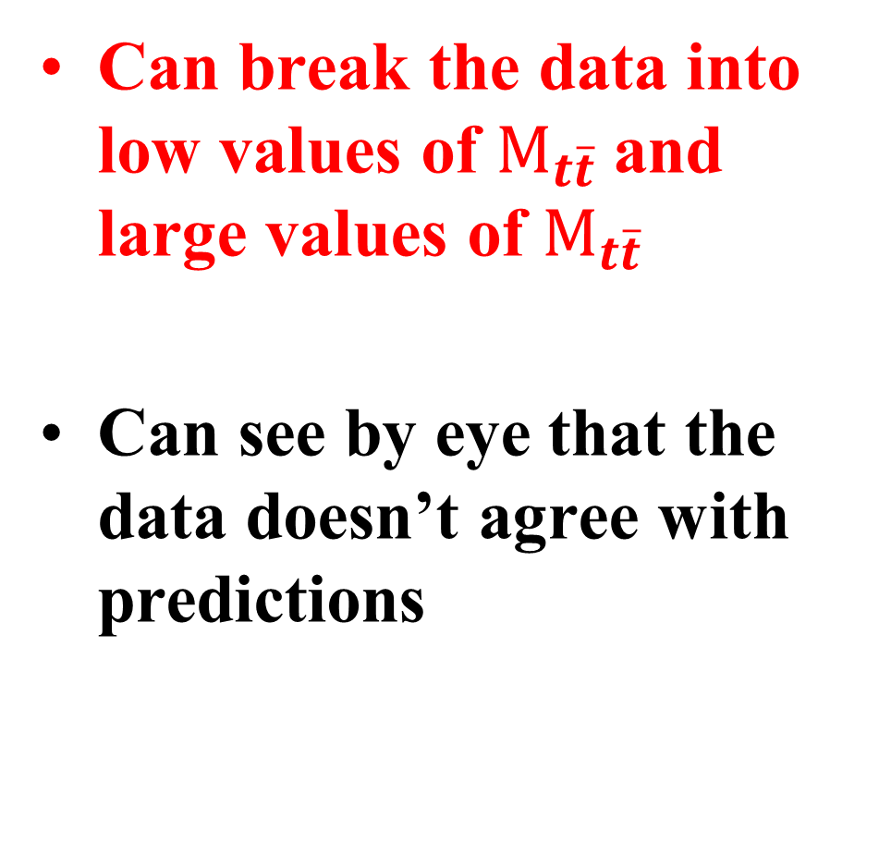

A_{FB} vs. $M_{t\overline{t}}$
Can break the data into low values of $M_{t\overline{t}}$and large values of $M_{t\overline{t}}$
Can see by eye that the data doesn’t agree with predictions

Slide 18
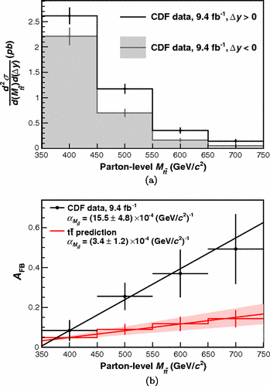

A_{FB} vs. $M_{t\overline{t}}$ Cont…
Quantify with a Slope:
(15.5±4.8)x10⁻⁴ Observed
(3.4±1.2)x10⁻⁴ NLO
Not a huge anomaly, but certainly we notice it and push forward…
Can the numerical values of these slopes be useful to model builders?

Slide 19
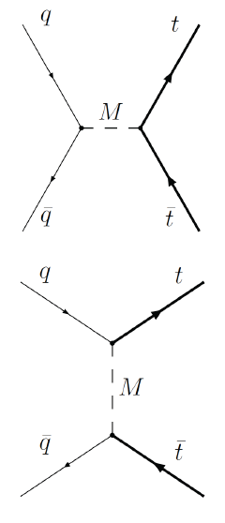
Examples of New Physics that could give a Large A_{FB}
Two main classes of models
S-channel mediator
e.g. axigluon
T-channel flavor changing mediator
e.g. W’ or Z’
Although many of these have strong constraints (and many are now excluded), they provide a good model for searches
For a review see:
M. Gresham, I.-W. Kim and K. Zurek,
Phys. Rev. D83 114027 (2011)

Slide 20
Fun historical aside…
This is when my team joined the hunt
Before we joined: UChicago tie-in Amidei and his group led Lep+Jets
His postdoc Jon Wilson now works with me
Top→Dileptons datasets were a mess
Ziqing Hong, student who worked with me, cleaned up dilepton datasets, then systematically did all the measurements
Start picking them off one-by-one…

Slide 21
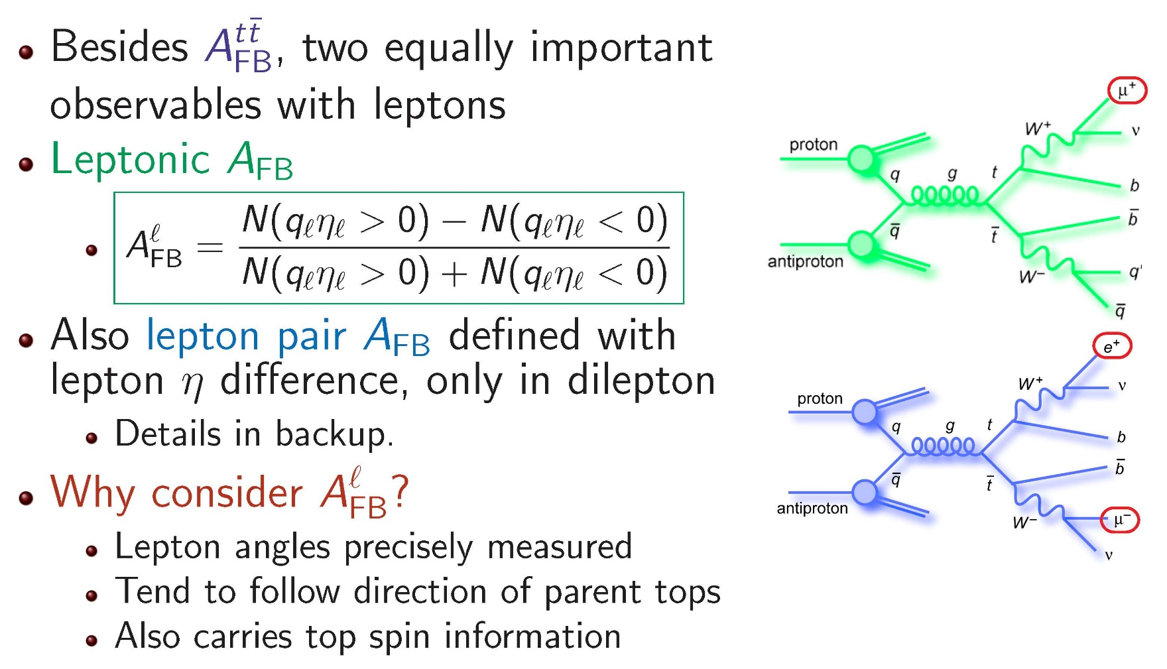
Leptonic A_{FB} Definition
SM: A_{FB} = 3.8%, specific ratio for Reconstructed/Leptonic
Various BSM Models: -5% < A_{FB} < 15%, ratio can vary significantly

Slide 22
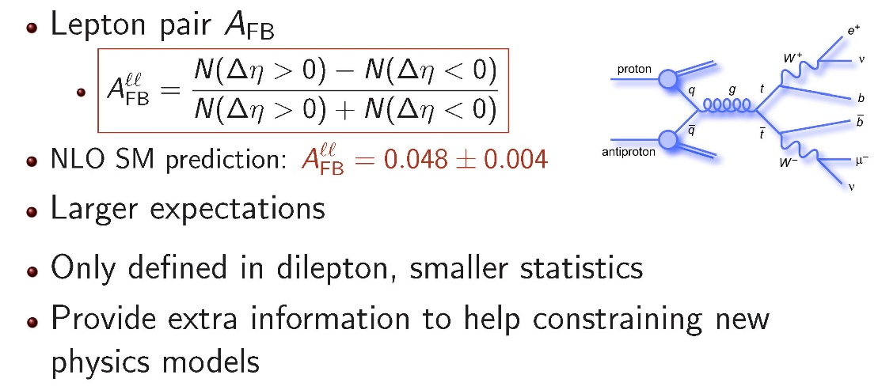
Dilepton-only Observable
Same BSM models: -9% < A_{FB} < 22%

Slide 23
Quick Aside on the Method
The methodology for measuring the Leptonic asymmetry turned out to be both simple and complicated
Not sure why it worked
Spent some real time trying to understand why
Turned out to be so simple that I thought I’d share what we learned

Slide 24
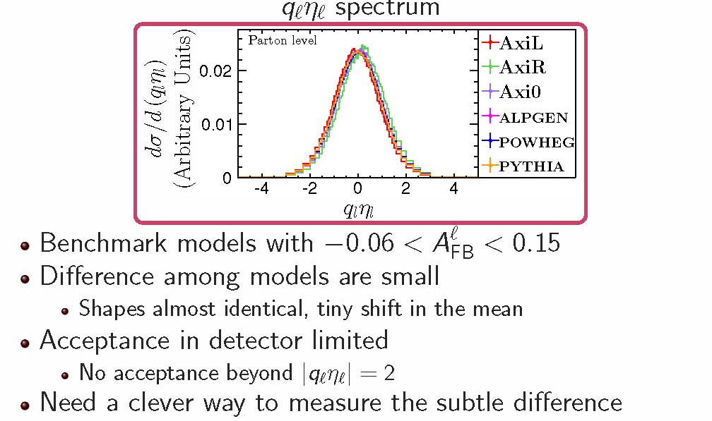
Leptonic Methodology

Slide 25
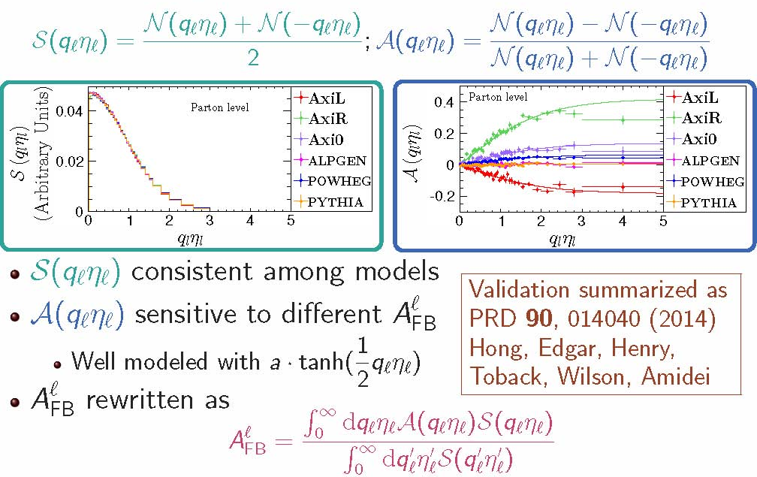
Clever idea: Break into parts

Slide 26
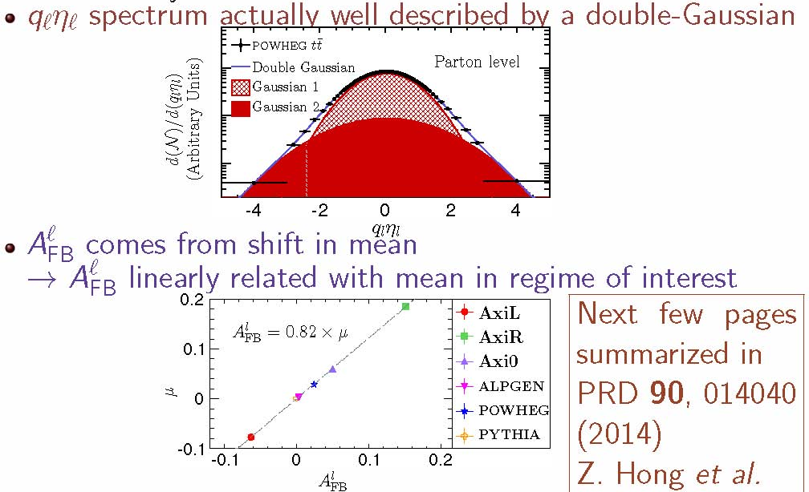
Why does it work?

Slide 27
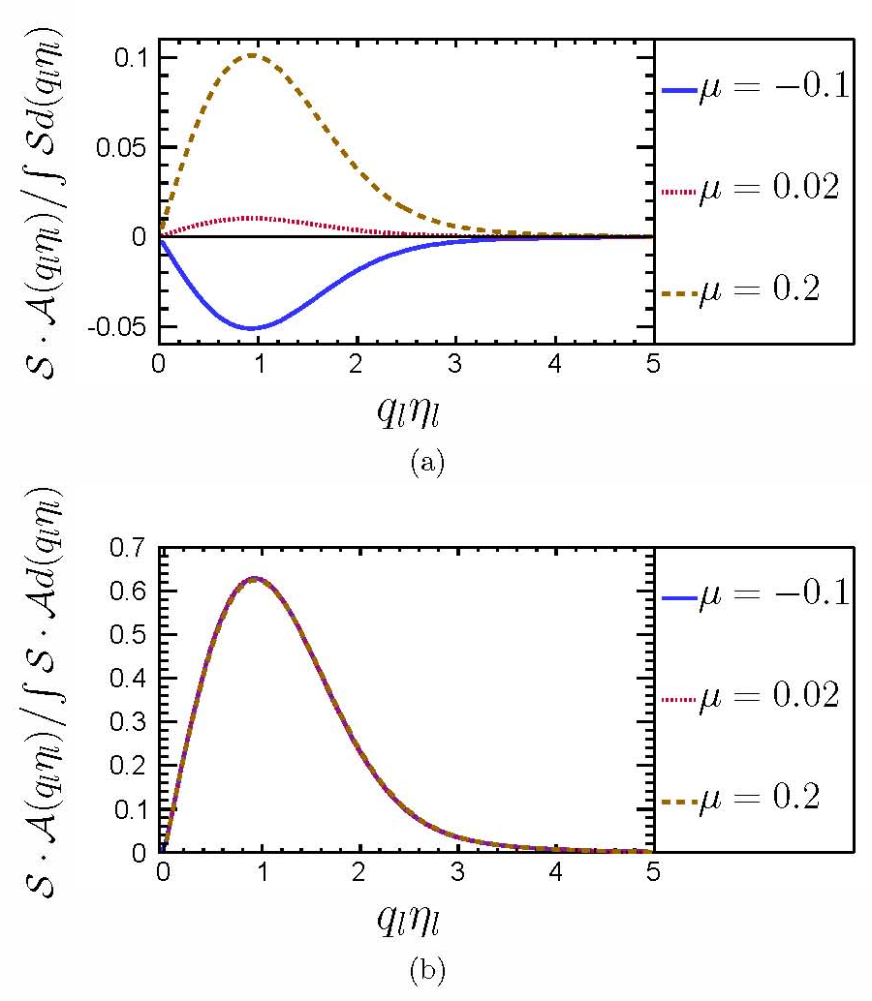
Fun details
If we look at the contribution to the asymmetry as a function of η, we see that for different means (total A_{FB}) we get very different shapes
However, the shapes basically look the same, just with a different overall normalization
Gives us a robust way to measure things
Interesting:
Very little sensitivity at the center of the detector/where most of the events are
Most of the sensitivity comes around |η|=1

Slide 28
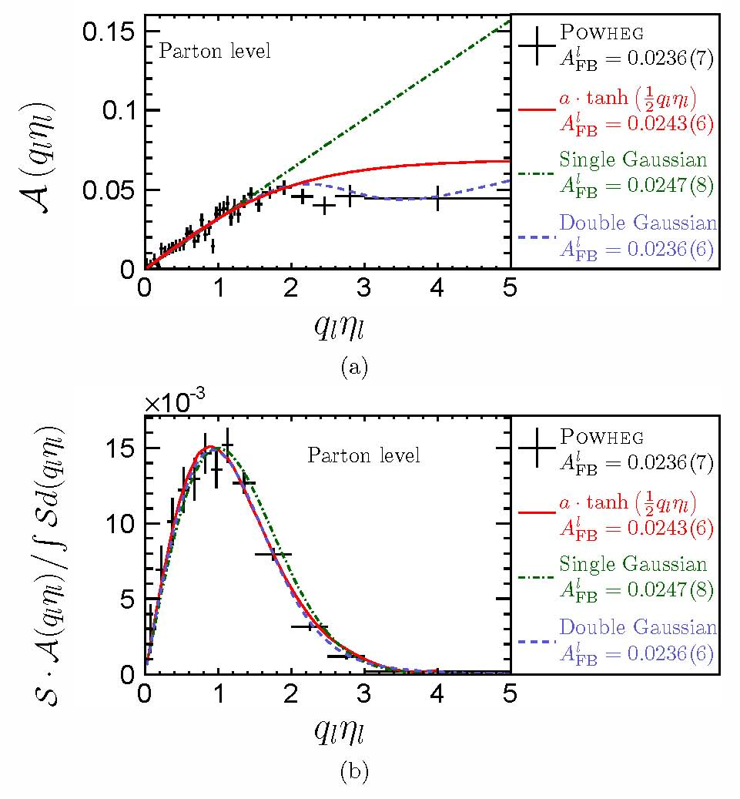
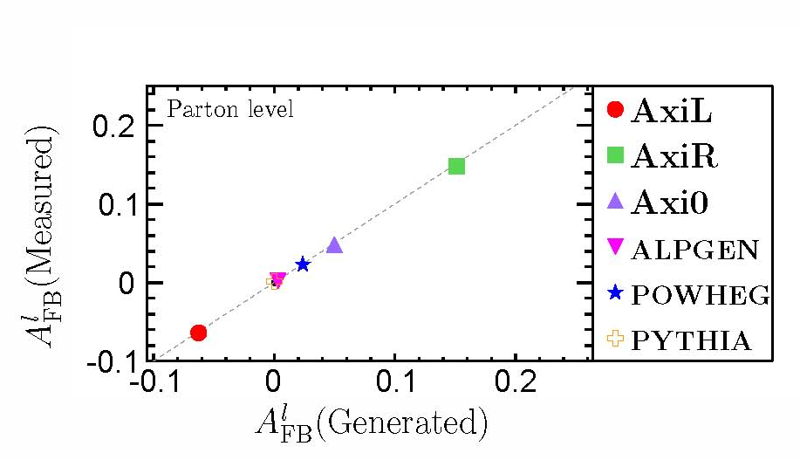
More on how well it worked
Works well as a function of qη
Works well for many different input values of A_{FB}

Slide 29
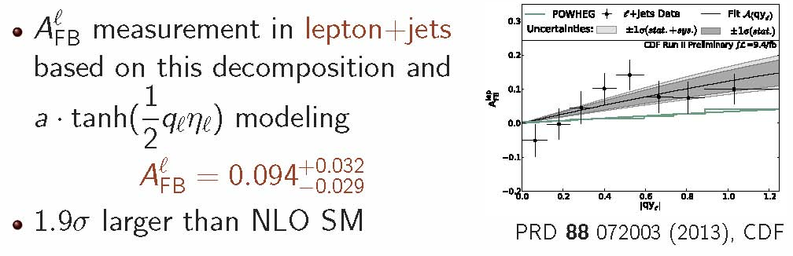
Leptonic A_{FB} from Lepton+Jets

Slide 30
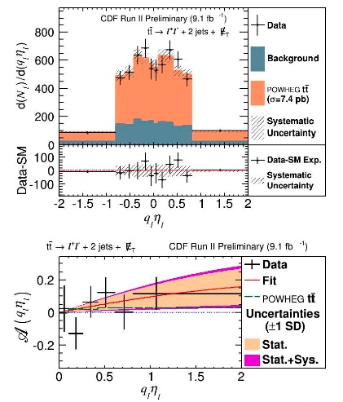
Leptonic A_{FB} from Dileptons
Measure A_{FB} with CDF full dataset in dilepton (9.1 fb⁻¹)
A_{FB} = 0.072±0.060
A_{FB}(SM,NLO) = 0.038 ±0.003
Combine CDF measurements →Result is 2σ larger than NLO SM prediction:
A_{FB} = 0.090 ± 0.028
Published as PRL 113, 042001 (2014) (CDF)

Slide 31
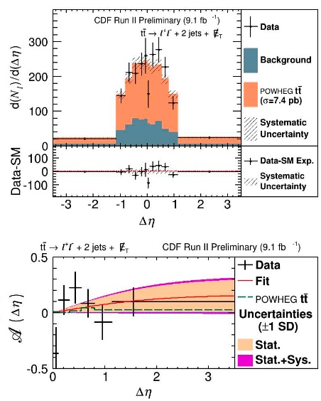
Leptonic Δη Results (Dileptons only)
Measurement techniques works equally well for A_{FB} in Δη
A_{FB} =0.076±0.072(st)±0.039(sys)
= 0.076± 0.081
Result consistent with SM
A_{FB}(SM,NLO) = 0.048 ±0.004
PRL 113, 042001 (2014)

Slide 32
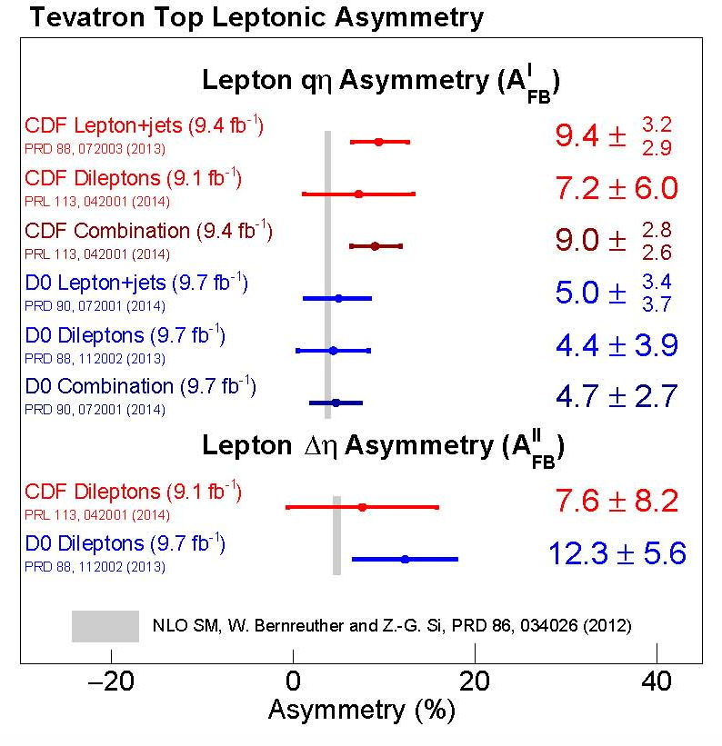
State of the Art for Leptonic A_{FB}
All the results, including from DZero, are consistent with SM predictions
Notice that all of them are above…

Slide 33
Transition to Reconstructed A_{FB}
Taking Stock of where we are, and looking forward
Observed large A_{FB} in reconstructed Lep+Jets, but only big in differential measurements
Looked at Leptonic A_{FB}: Still above predictions, but not anomalously so
Next: Even though we won’t have enough statistics to say anything conclusive we measure the full reconstructed A_{FB} in dileptons

Slide 34
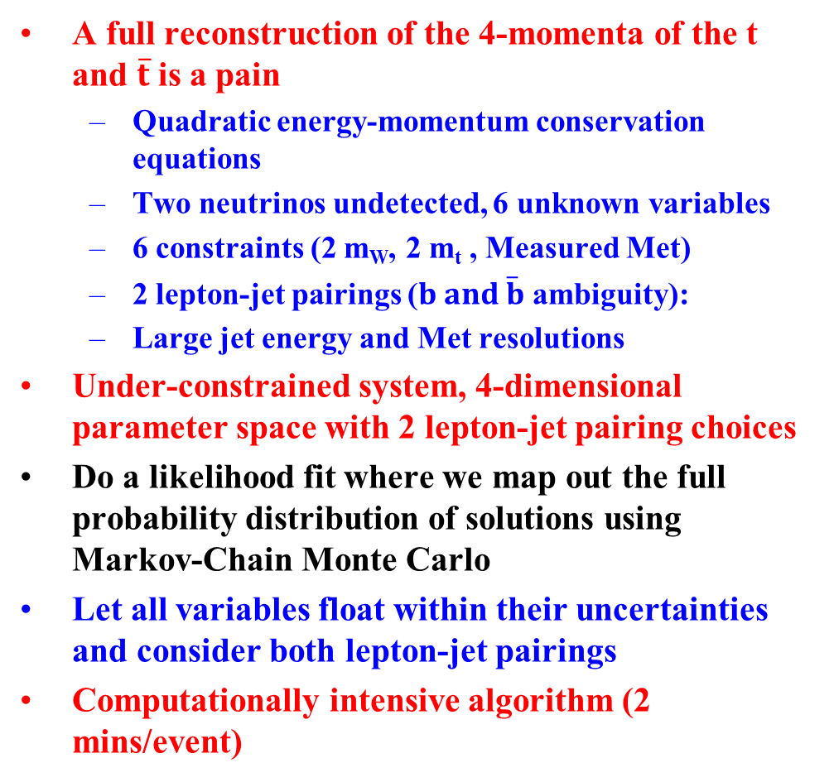
Reconstruction in Dileptons
A full reconstruction of the 4-momenta of the t and $\overline{t}$ is a pain
Quadratic energy-momentum conservation equations
Two neutrinos undetected, 6 unknown variables
6 constraints (2 m_{W}, 2 m_{t} , Measured Met)
2 lepton-jet pairings ($b and \overline{b}$ ambiguity):
Large jet energy and Met resolutions
Under-constrained system, 4-dimensional parameter space with 2 lepton-jet pairing choices
Do a likelihood fit where we map out the full probability distribution of solutions using Markov-Chain Monte Carlo
Let all variables float within their uncertainties and consider both lepton-jet pairings
Computationally intensive algorithm (2 mins/event)

Slide 35
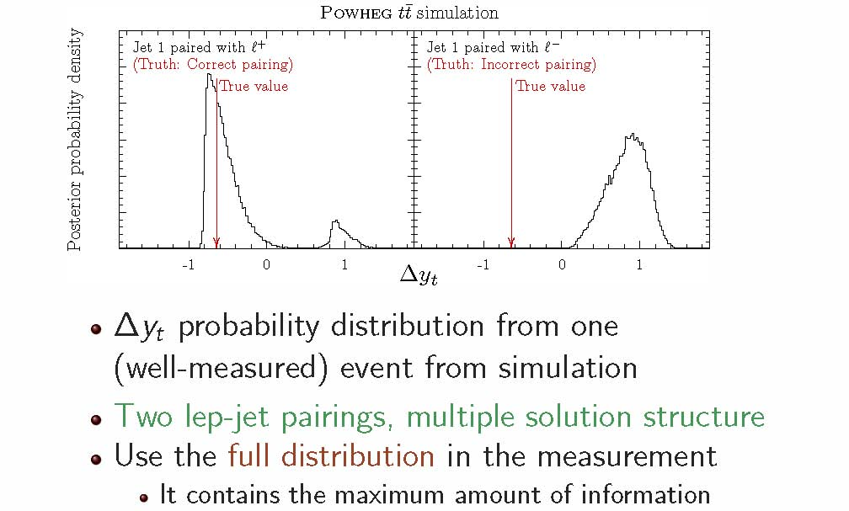
How well does the Reconstruction Do?

Slide 36
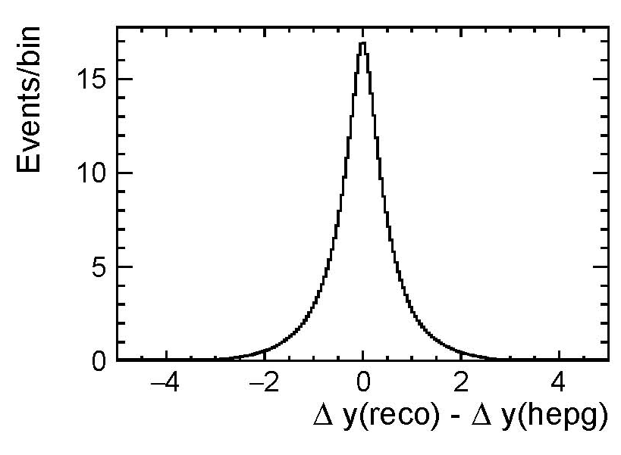
Resolution Continued
Consider all solutions and weight them according to their probability from the fit
Find 61% have a y_{t} measured within 0.5 of truth value

Slide 37
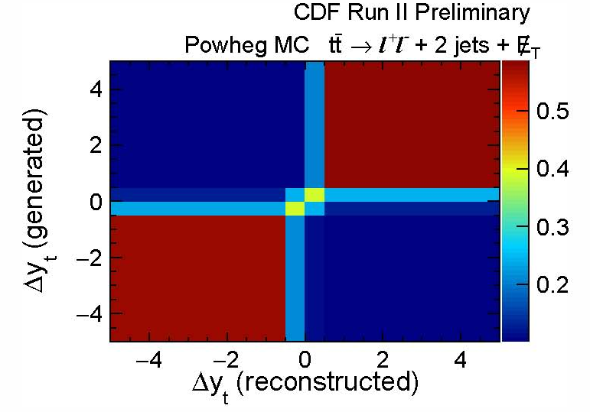
Going from Reconstruction to a Measurement of A_{FB}
Need a sophisticated methodology to turn reconstructed Δy measurement into a measurement of Δy at the parton level
Want to measure the inclusive A_{FB} as well as the differential A_{FB} vs. Δy.
Correct for two effects:
Not able to measure all events
Limited detector coverage
Imperfect event selection efficiency
Not able to measure y_{t} correctly for events we do have a measurement
Finite detector response resolution
Imperfect tt momenta reconstruction

Slide 38
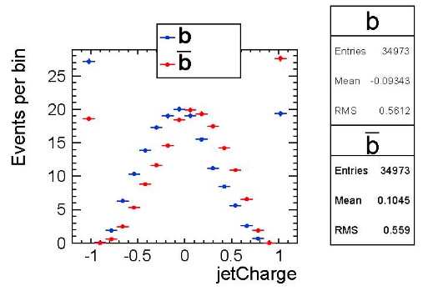
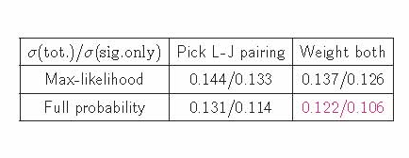
Optimization Slide 1
Tried to do something state-of-the-art since this is a legacy measurement
Optimize before looking at data
Minimize the expected uncertainty on A_{FB}
1) Use more information in the measurement
Keep full probability distribution rather than pick the most probable solution
Weight both lep-jet pairings with likelihoods
Add information from b-jet charge

Slide 39
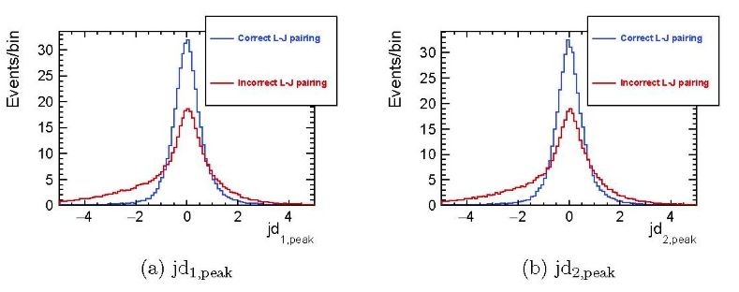
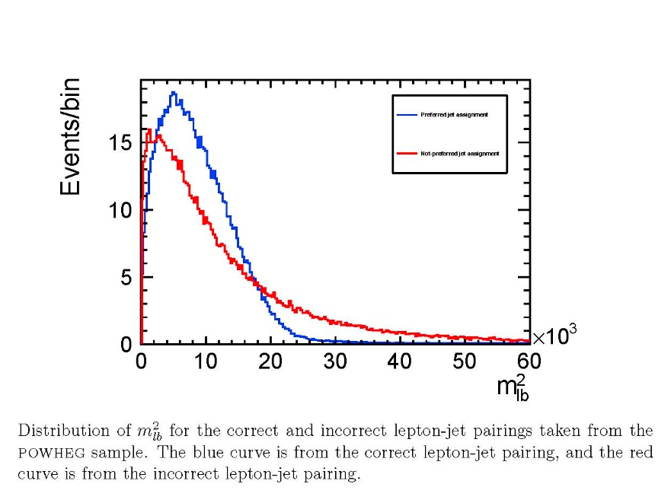
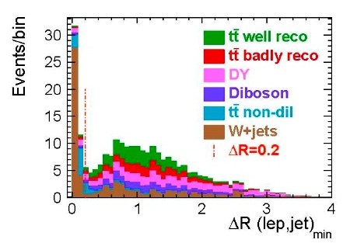
Optimization Slide 2
2) Reject tt with low reconstruction quality
Jet energy dragged too far from measured values to make a tt
m²_{lb} too high, not likely a good top
Lepton lying on top of a jet, most likely a W+Jets
Expected uncertainty goes from 0.144 before optimization and 0.122 after

Slide 40
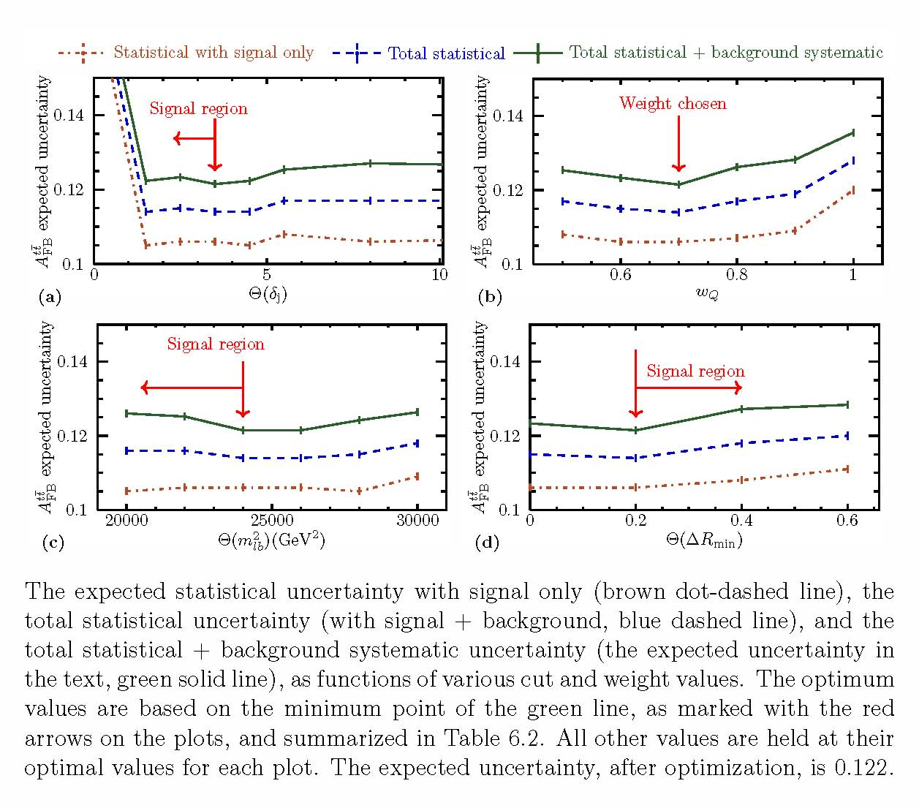
Optimization Results

Slide 41
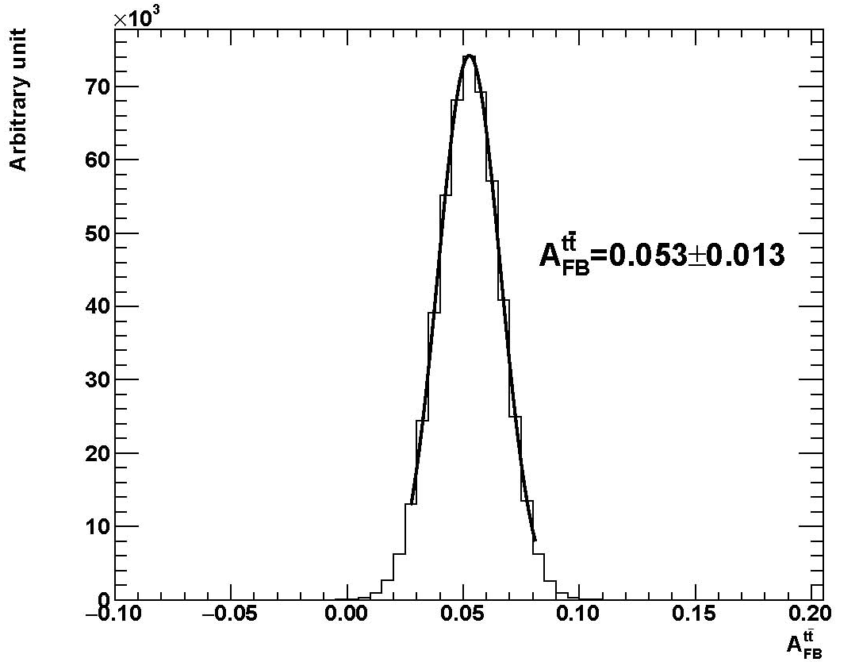
Validation/Unfolding Results
To extract parton-level A_{FB}, run MCMC to find most probable parameters that match observation
Extract A_{FB} from marginalized posterior distribution
POWHEG sample with 10M events gives 0.053±0.013 with 0.0524 generated

Slide 42
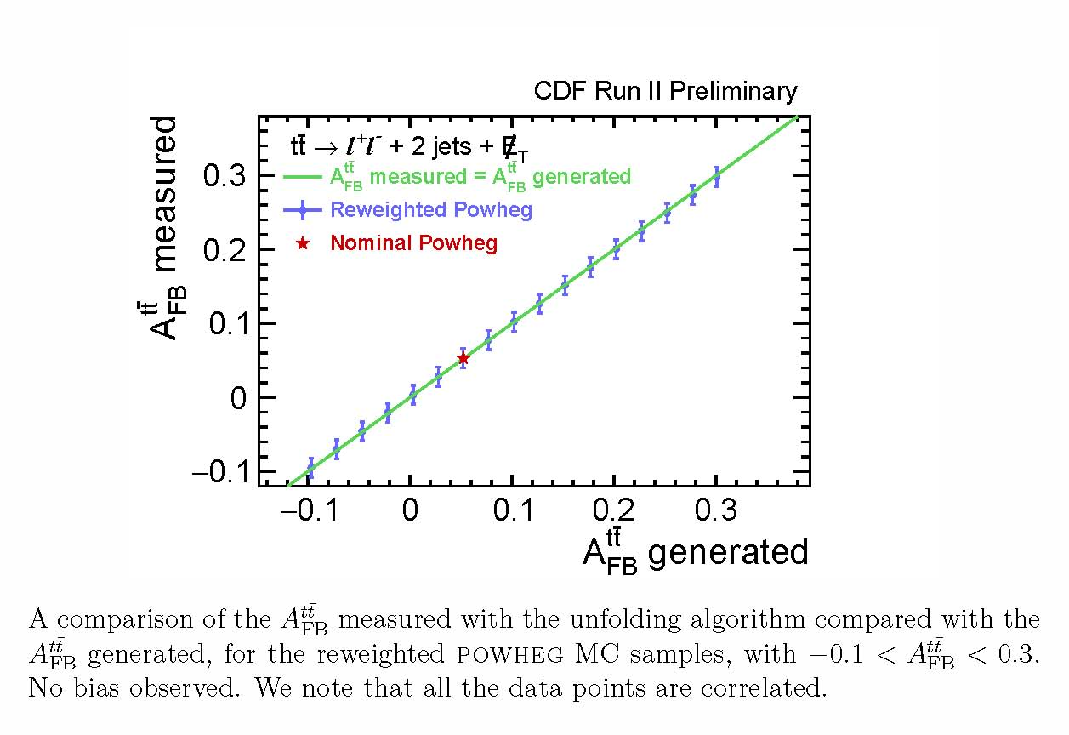
Comparing MC to Truth

Slide 43
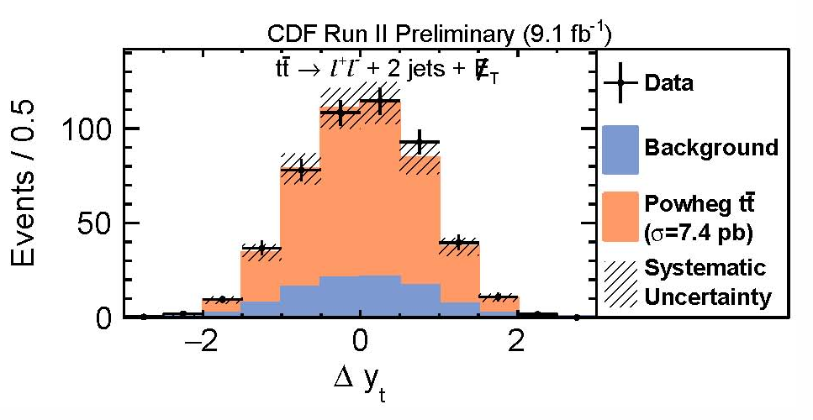
Reconstruct/Unfolding Results
Results with dilepton data:
A_{FB} = 0.12±0.11(stat) ±0.07(syst) = 0.12±0.13
Combined with CDF result in lepton+jets
A_{FB}(CDF) = 0.160±0.045
Consistent with prediction
A_{FB} (N³LO SM) = 0.100±0.006 within 1.5σ
Manuscript in
preparation,
to be submitted
to PRD

Slide 44
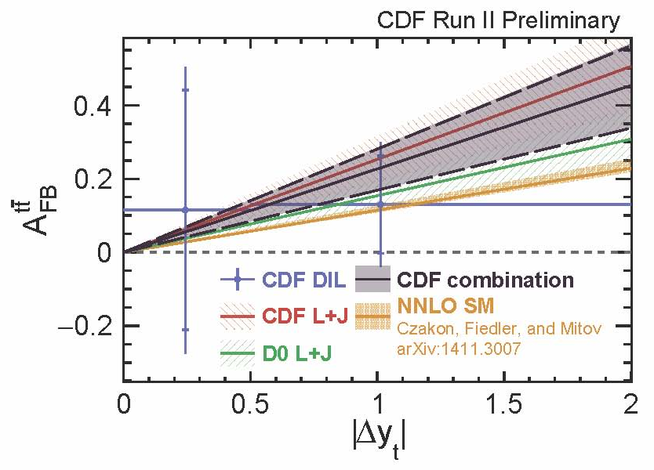
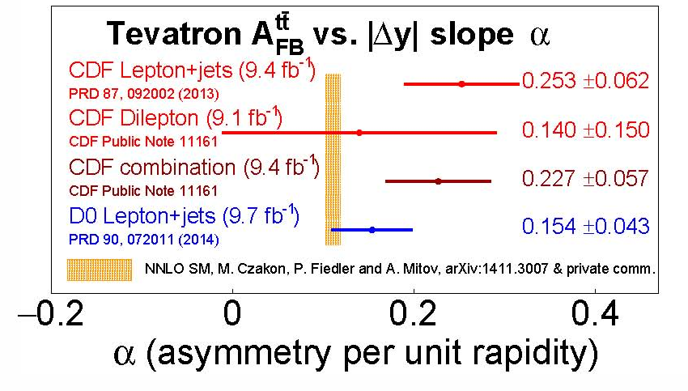
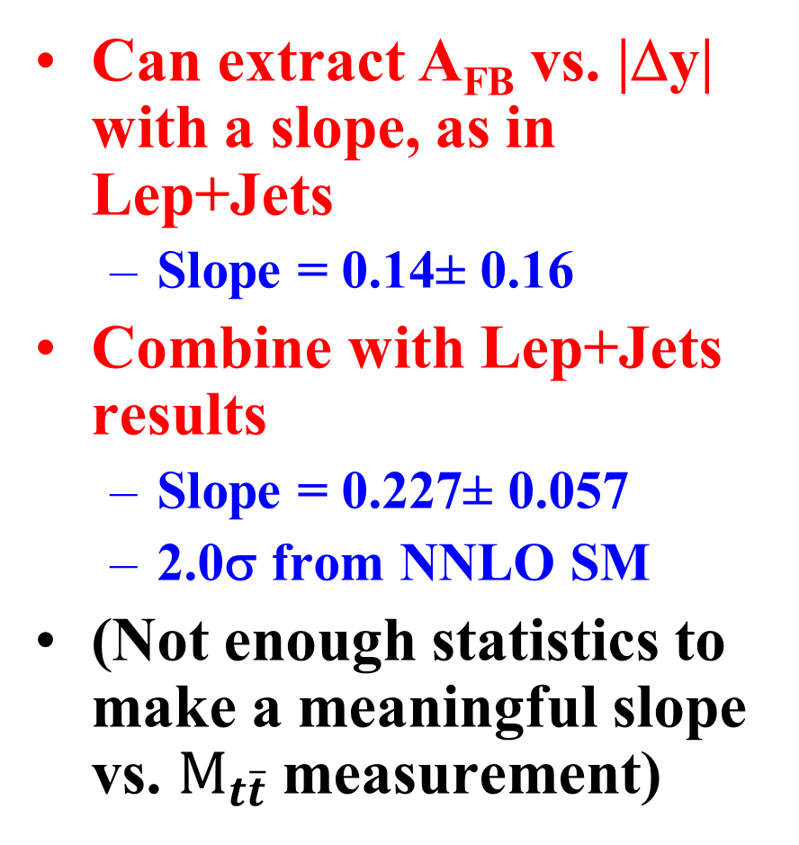
A_{FB} Reconstructed Results
Can extract A_{FB} vs. |Δy| with a slope, as in Lep+Jets
Slope = 0.14± 0.16
Combine with Lep+Jets results
Slope = 0.227± 0.057
2.0σ from NNLO SM
(Not enough statistics to make a meaningful slope vs. $M_{t\overline{t}}$measurement)

Slide 45

Tevatron Results
Final individual results on A_{FB} from Tevatron
All results consistent but higher than NLO (and NNLO) SM predictions
A combination of CDF+DZero results is in the works

Slide 46

Summary and Conclusions
The A_{FB} of top-quark pairs at the Tevatron has been a hot topic for years, mostly based on early results from the CDF Lep+Jets measurement
Have completed measurements in Lepton+Jets and Dilepton Final states with the full dataset
Legacy measurements of the reconstructed A_{FB}, A_{FB} vs. $M_{t\overline{t}}$, A_{FB} vs. |Δy| as well as the Leptonic asymmetry and the dilepton asymmetry are now done
The SM calculations in the NLO+ era explain much, and an apparent fluctuations high appear to account for the rest
Either way it has been an exciting chase for new physics

Slide 47
Backups

