Slide 1





Top Production at the Fermilab Tevatron
David Toback
Texas A&M University
March 2016

Slide 2
Outline
Total and Differential Cross Sections
Angular distributions to determine the amount of Spin Correlation and Polarization
Legacy result for the Forward-Backward Asymmetry (A_{FB})
Conclusions

Slide 3
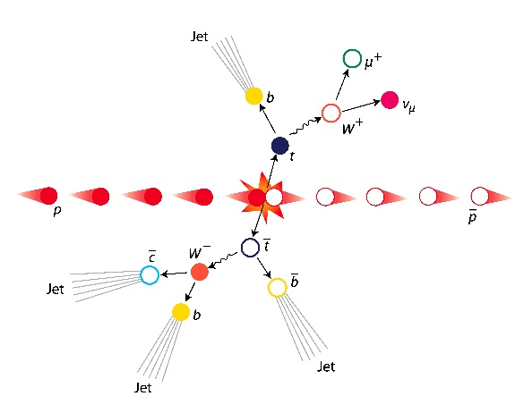
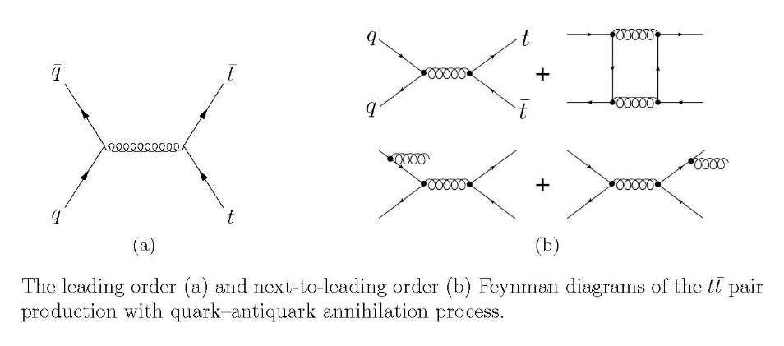
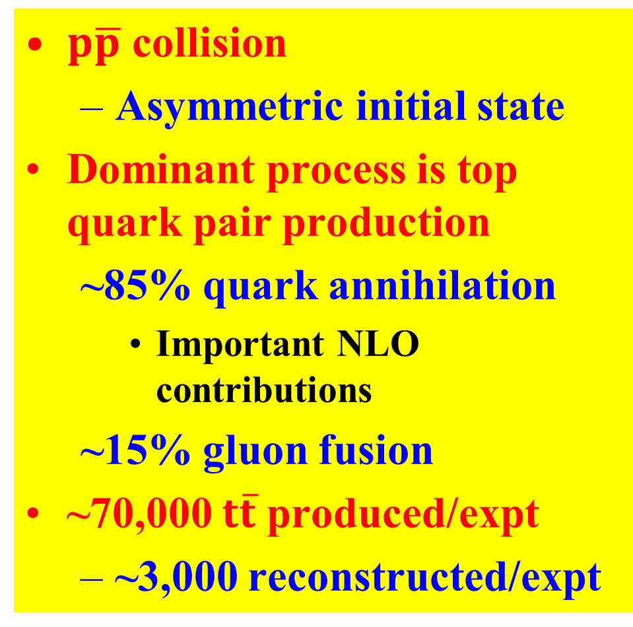
Top Production at the Tevatron
$p\overline{p}$ collision
Asymmetric initial state
Dominant process is top quark pair production
~85% quark annihilation
Important NLO contributions
~15% gluon fusion
~70,000 $t\overline{t}$ produced/expt
~3,000 reconstructed/expt

Slide 4
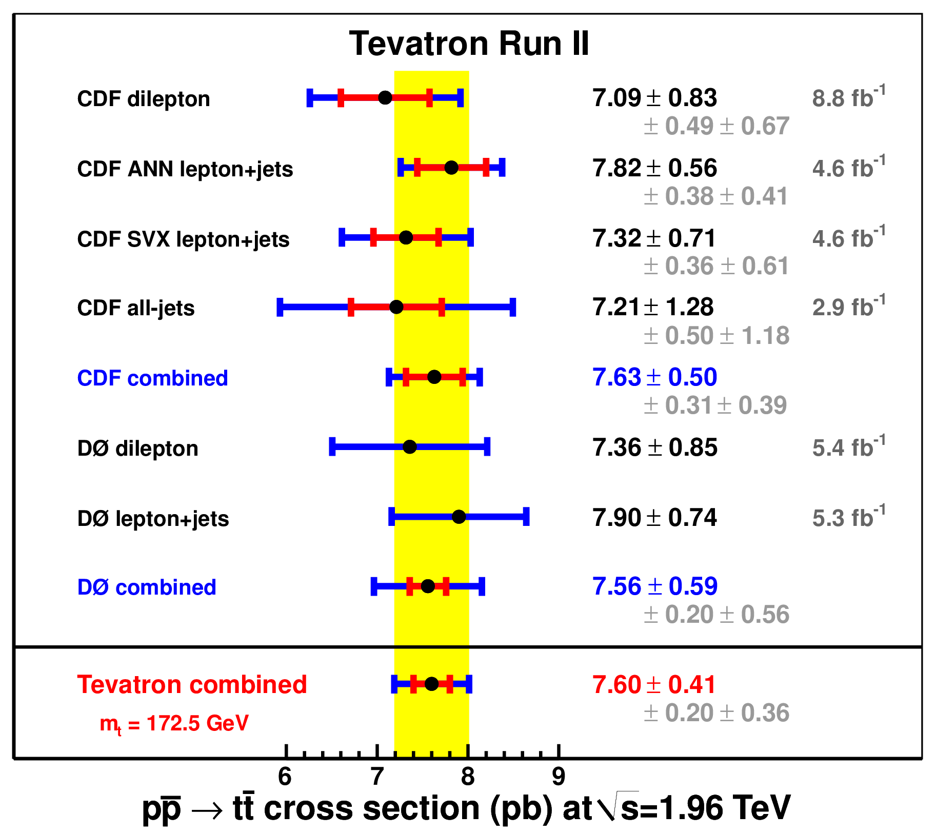
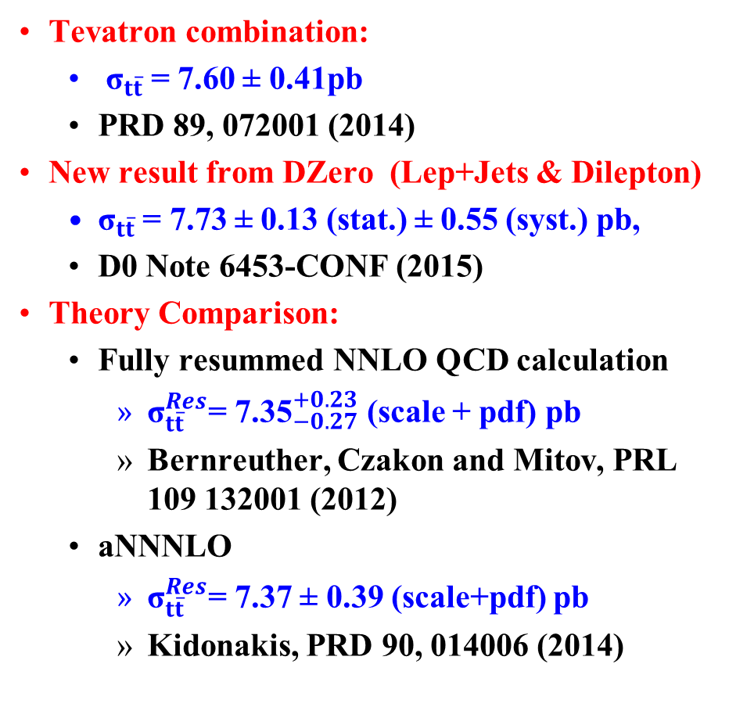
Total Cross Section Measurements
Tevatron combination:
${\text{σ}}_{t\overline{t}}$ = 7.60 ± 0.41pb
PRD 89, 072001 (2014)
New result from DZero (Lep+Jets & Dilepton)
${\text{σ}}_{t\overline{t}}$ = 7.73 ± 0.13 (stat.) ± 0.55 (syst.) pb,
D0 Note 6453-CONF (2015)
Theory Comparison:
Fully resummed NNLO QCD calculation
${\text{σ}}_{t\overline{t}}^{Res}$= ${\text{7.35}}_{−0.27}^{+0.23}$ (scale + pdf) pb
Bernreuther, Czakon and Mitov, PRL 109 132001 (2012)
aNNNLO
${\text{σ}}_{t\overline{t}}^{Res}$= 7.37 ± 0.39 (scale+pdf) pb
Kidonakis, PRD 90, 014006 (2014)
DØ Preliminary

Slide 5
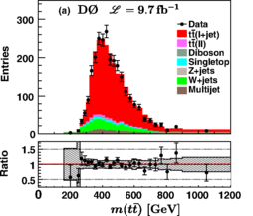
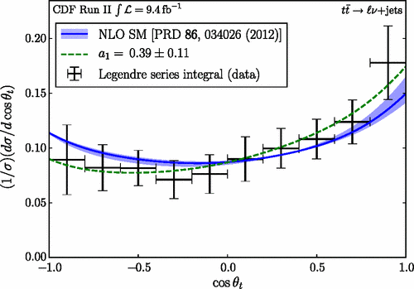
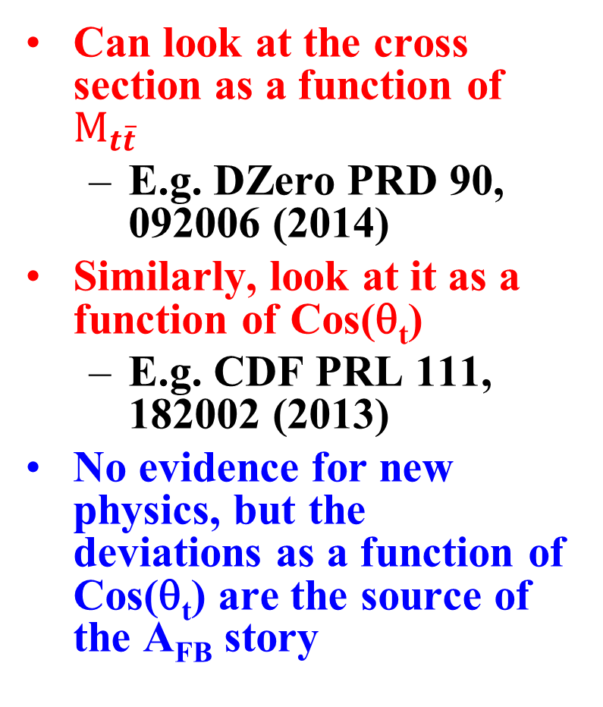
Differential Production Cross Sections
Can look at the cross section as a function of $M_{t\overline{t}}$
E.g. DZero PRD 90, 092006 (2014)
Similarly, look at it as a function of Cos(θ_{t})
E.g. CDF PRL 111, 182002 (2013)
No evidence for new physics, but the deviations as a function of Cos(θ_{t}) are the source of the A_{FB} story

Slide 6

Polarization in $t\overline{t}$ Events
Tops are almost un-polarized at the Tevatron
Small longitudinal polarization from parity-violating weak interactions
Transverse polarization is allowed in strong interactions
BSM can make these bigger
Since the top lifetime (~5x10⁻²⁵ s) is smaller than the spin-decorrelation time from spin-spin interactions (~3x10⁻²¹ s) tops transfer their spin properties to their decay products
Can measure polarization through the final angular distributions with respect to a chosen axis

Slide 7
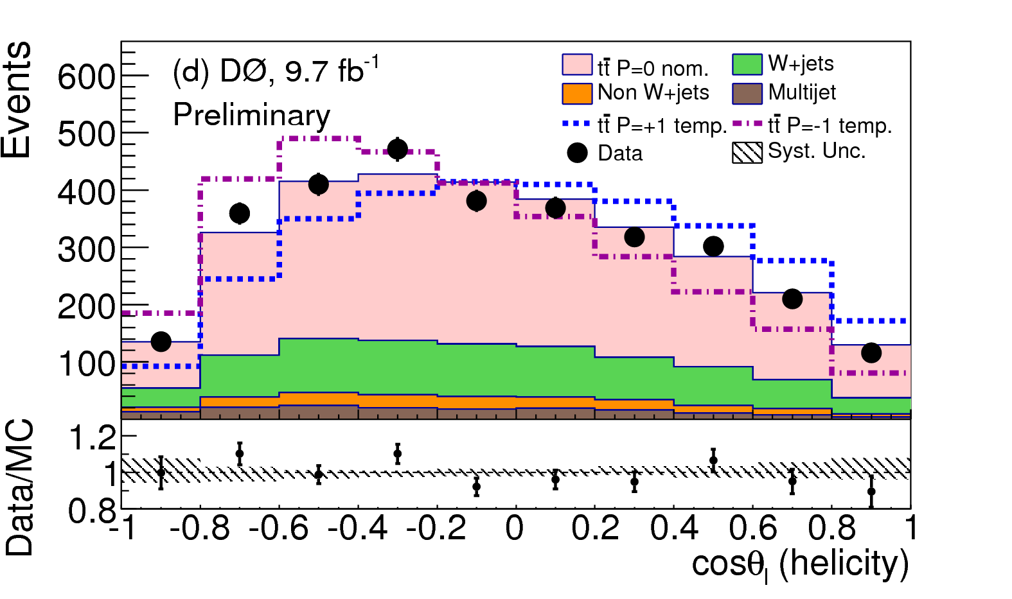
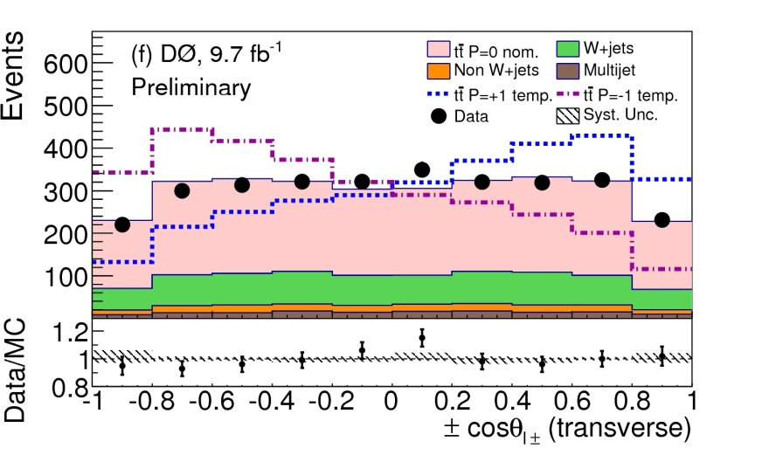
Top Quark Polarization Cont…
After full reconstruction the final angle distributions gives the amount of polarization in three different configurations
Data are consistent with zero polarization, and with the predicted SM values
First measurement of polarization along the transverse axis at a hadron collider
DZero Conference Note 6471 (2015)

Slide 8
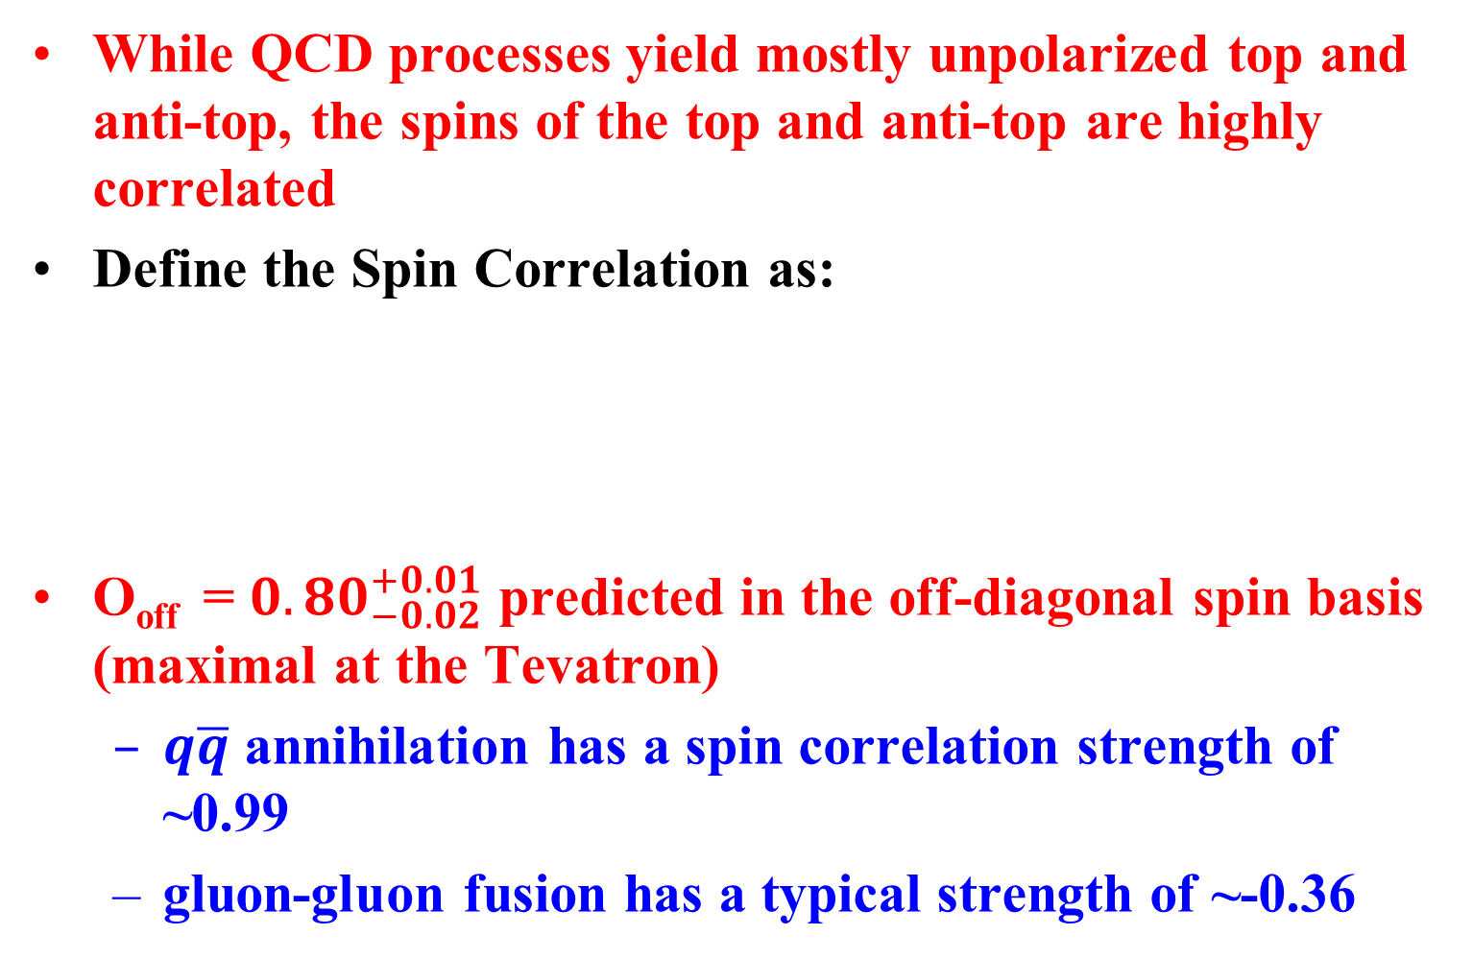
Spin Correlations
While QCD processes yield mostly unpolarized top and anti-top, the spins of the top and anti-top are highly correlated
Define the Spin Correlation as:
O_{off} = ${0.80}_{−0.02}^{+0.01}$ predicted in the off-diagonal spin basis (maximal at the Tevatron)
$q\overline{q}$ annihilation has a spin correlation strength of ~0.99
gluon-gluon fusion has a typical strength of ~-0.36

Slide 9
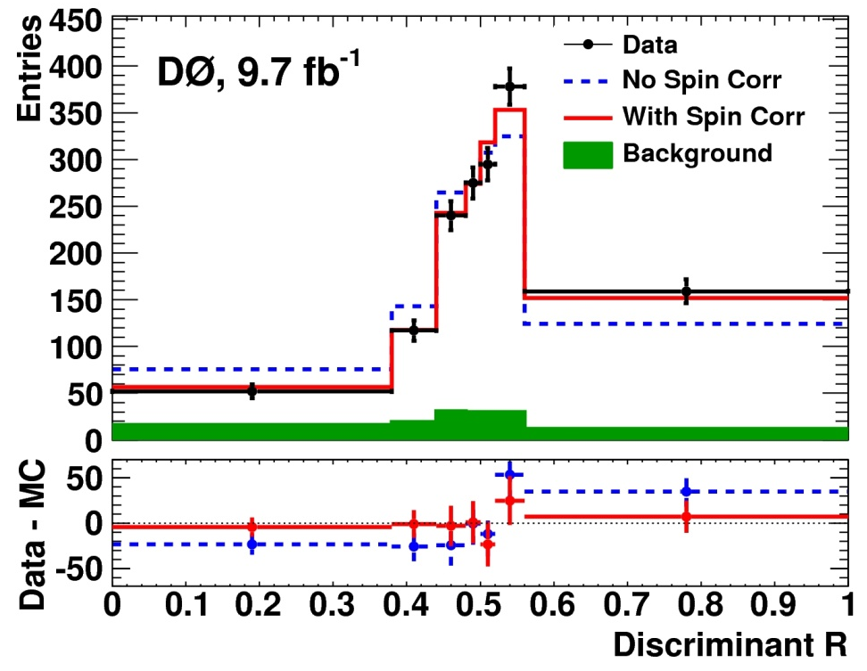
Spin Correlation Data
Create an event-by-event discriminant for the probability “With Spin Correlations” and for “No Spin Correlations”
Fit the data allowing the total cross section and the fraction of “With Spin Correlations” to float
Dzero
arXiv:1512.08818, Submitted to PLB

Slide 10
Spin Correlation Conclusions
Results:
O_{off} = 0.89 ±0.16 (stat)±0.15 (syst)
Exclude the Uncorrelated scenario
P-value is 2.5x10⁻⁵ for obtaining a spin correlation larger than the observed value (4.2σ)
Assuming no BSM contributions, constrain the fraction of events from gluon fusion to f_{gg}=0.08±12(stat) ±0.11(sys) which is in agreement with the NLO prediction of 0.135

Slide 11
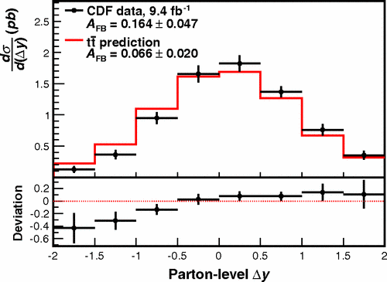
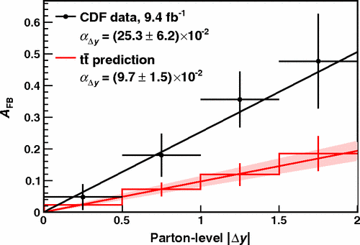
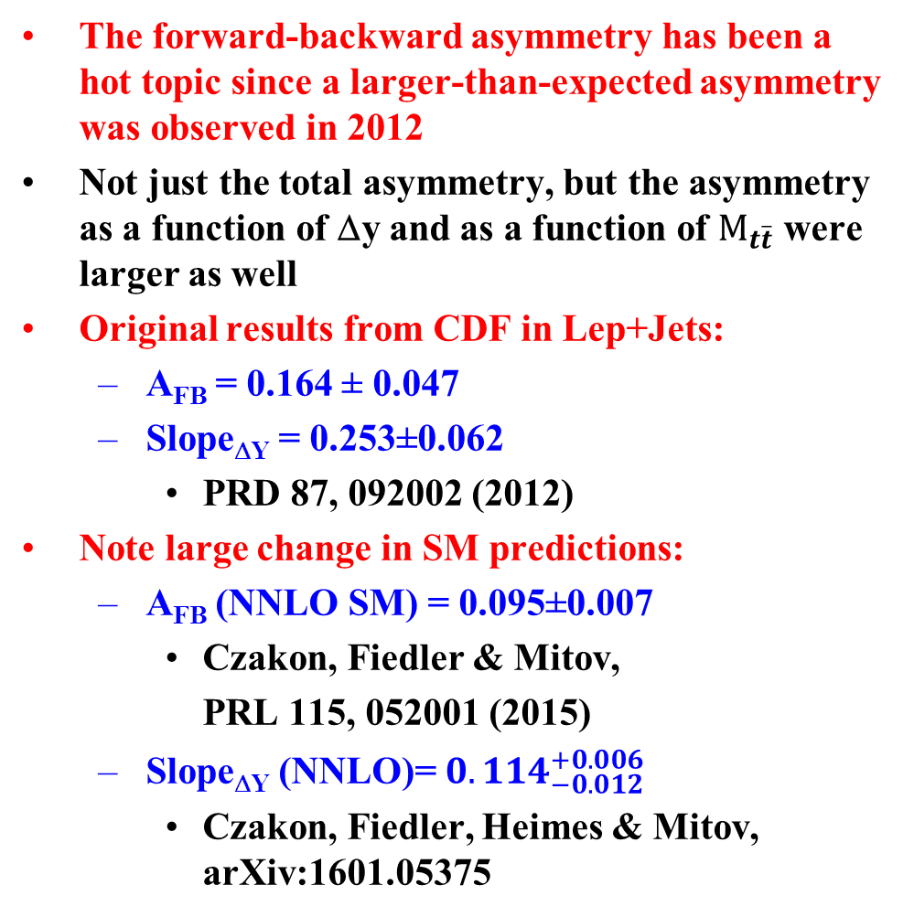

Last of the A_{FB} Measurements in $t\overline{t}$ at the Tevatron
The forward-backward asymmetry has been a hot topic since a larger-than-expected asymmetry was observed in 2012
Not just the total asymmetry, but the asymmetry as a function of Δy and as a function of $M_{t\overline{t}}$ were larger as well
Original results from CDF in Lep+Jets:
A_{FB} = 0.164 ± 0.047
Slope_{ΔY} = 0.253±0.062
PRD 87, 092002 (2012)
Note large change in SM predictions:
A_{FB} (NNLO SM) = 0.095±0.007
Czakon, Fiedler & Mitov,
PRL 115, 052001 (2015)
Slope_{ΔY} (NNLO)= ${0.114}_{−0.012}^{+0.006}$
Czakon, Fiedler, Heimes & Mitov, arXiv:1601.05375

Slide 12
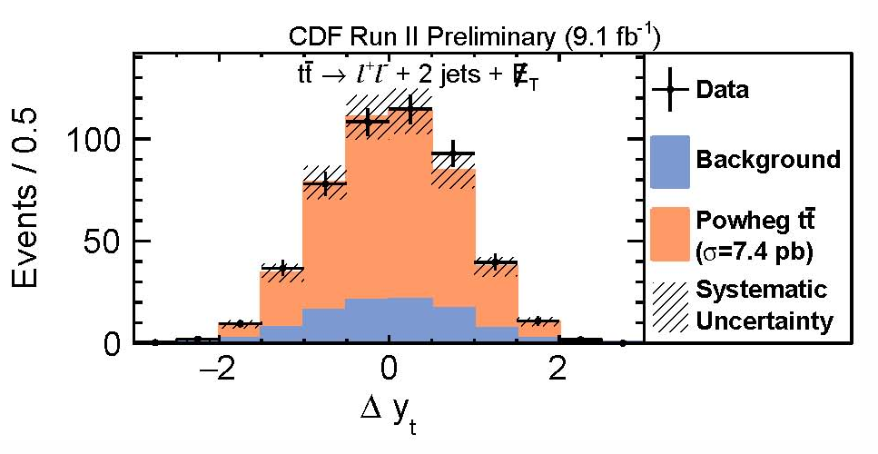
New A_{FB} Results from CDF
Results with dilepton data:
A_{FB} = 0.12±0.11(stat) ±0.07(syst) = 0.12±0.13
Combined with CDF result in lepton+jets
A_{FB} = 0.160±0.045
Consistent with SM and DZero
A_{FB} (NNLO SM) = 0.095±0.007 within 1.5σ
A_{FB} = 0.118±0.028 DZero, PRD 92 052007 (2015)
CDF arXiv: 1602.09015, Submitted to PRD

Slide 13
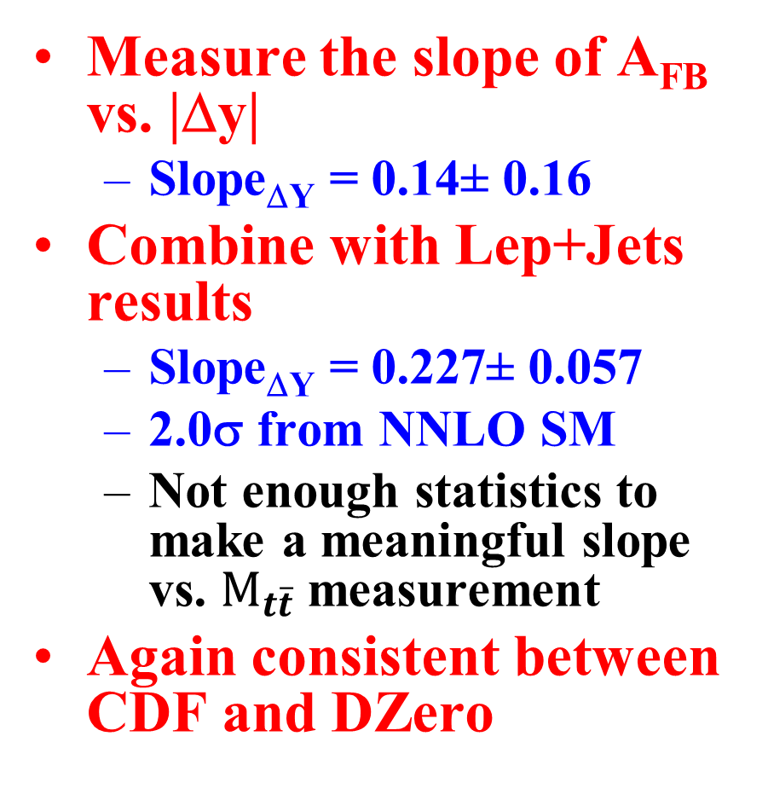
Look at Differential Distributions
Measure the slope of A_{FB} vs. |Δy|
Slope_{ΔY} = 0.14± 0.16
Combine with Lep+Jets results
Slope_{ΔY} = 0.227± 0.057
2.0σ from NNLO SM
Not enough statistics to make a meaningful slope vs. $M_{t\overline{t}}$measurement
Again consistent between CDF and DZero

Slide 14
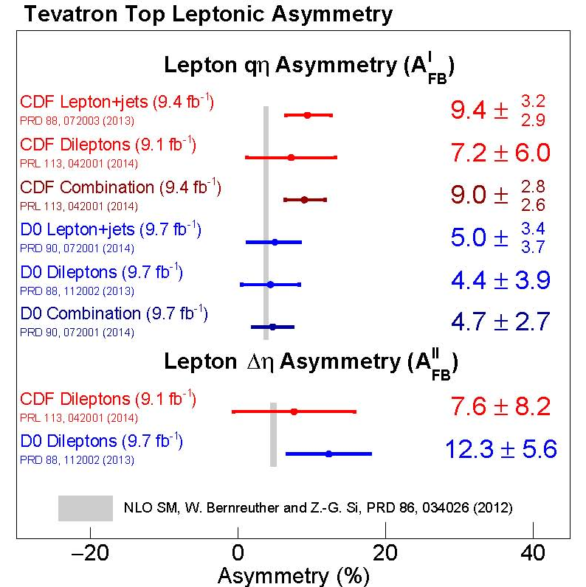
Legacy A_{FB} Tevatron Results
Final individual results on A_{FB} from Tevatron
All the results, including from DZero, are consistent with SM predictions
Notice that all of them are above…
A combination of CDF+DZero results is in the works

Slide 15
Conclusions
Top production at the Tevatron has yielded a wealth of important information about the heaviest known fundamental particle
While many of the distributions have shown to be similar to SM predictions, the measured precisions have pushed well beyond LO, to NLO and NLO+
Indeed, many of the corrections have been larger than expected, and appear to have been the cause of some of exciting hunts for new physics while we figured it out
The legacy results from the Tevatron are nearing completion, bringing this long, wonderful story to a close

Slide 16
Backups

Slide 17
1 | Cover
2 | Outline
3 | Big picture
4 | Cross Section 1
5 | Cross Section 2
6 | Spin Correlation 1
7 | Spin Correlation 2
8 | Spin Correlation 3
9 | Polarization 1
10 | Polarization 2
11 | AFB & Polarizatino 1
12 | AFB & Polarization 2
13 | AFB CDF 1
14 | AFB CDF 2
15 | AFB Combination 1
16 | AFB Combination 2
17 | Conclusions

Slide 18
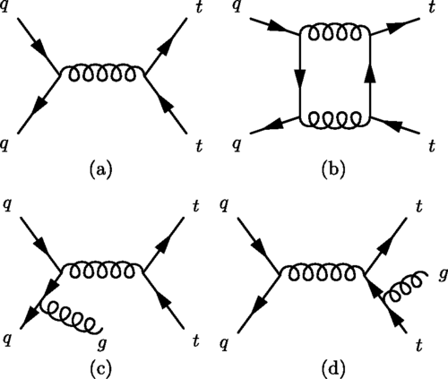

Slide 19
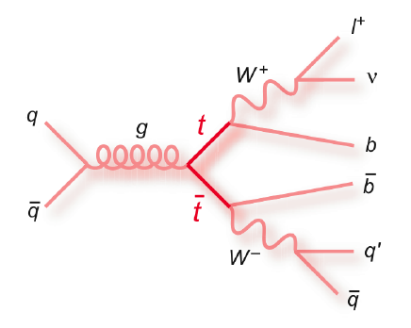
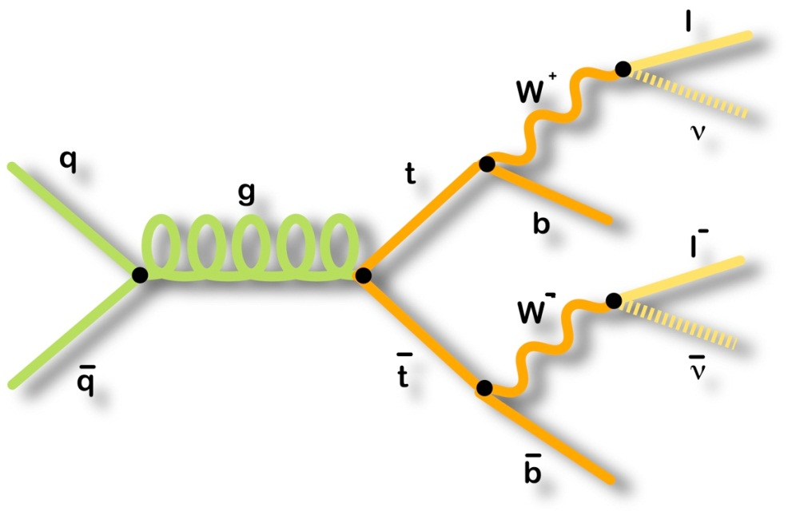
Selecting Top Quark Events
Lepton+Jets
Final State
Dilepton
Final State
1 reconstructed lepton
Missing transverse energy
≥4 jets (1 b-tag)
ΣE_{T} > 220 GeV
Bigger branching fraction, more final state particles to measure, bigger backgrounds
2 reconstructed leptons
Missing transverse energy
≥2 jets
ΣE_{T} > 200 GeV
Higher purity sample, but smaller branching fraction, two leptons have better angles, but two neutrinos cause reconstruction ambiguities

Slide 20
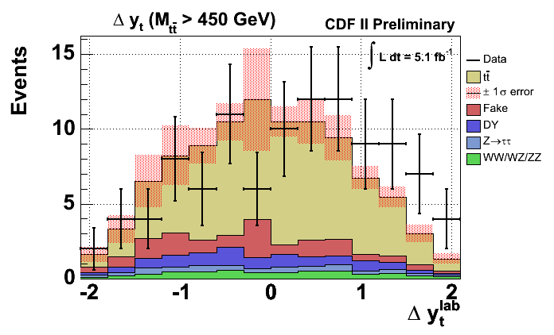
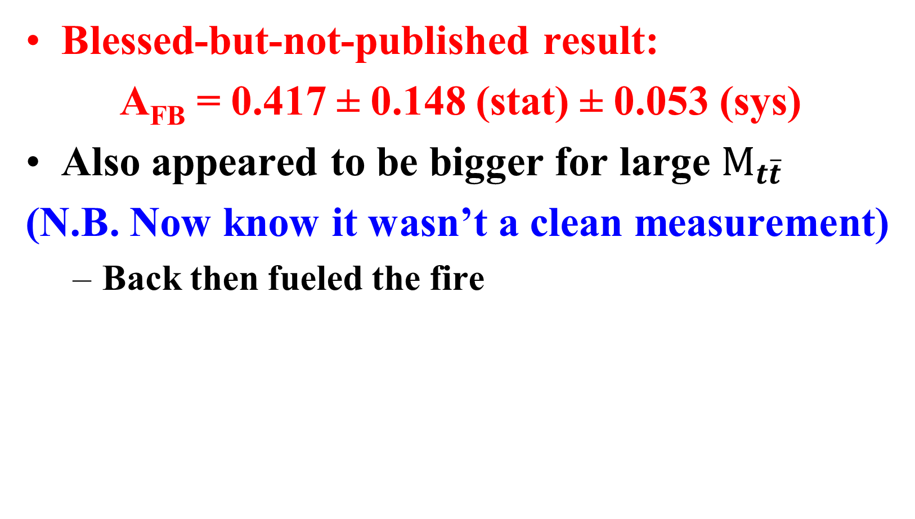
CDF Dilepton Result with 5.1fb⁻¹
Blessed-but-not-published result:
A_{FB} = 0.417 ± 0.148 (stat) ± 0.053 (sys)
Also appeared to be bigger for large $M_{t\overline{t}}$
(N.B. Now know it wasn’t a clean measurement)
Back then fueled the fire

Slide 21
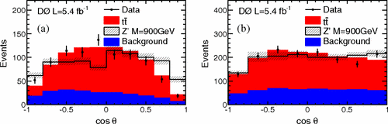
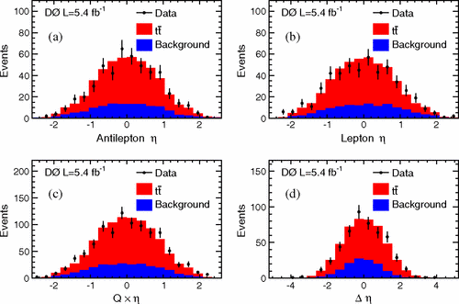
Dzero Leptonic Asymmetries 1
Measurement of leptonic asymmetries and top-quark polarization in tt¯ production
Phys. Rev. D 87, 011103(R) – Published 24 January 2013

Slide 22
Dzero AFB in Lep+Jets
Measurement of the forward-backward asymmetry in top quark-antiquark production in pp¯ collisions using the lepton+jets channel
Phys. Rev. D 90, 072011 – Published 29 October 2014

Slide 23
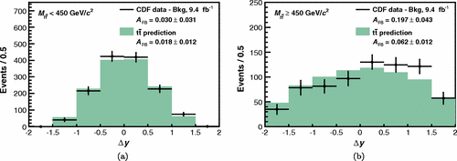
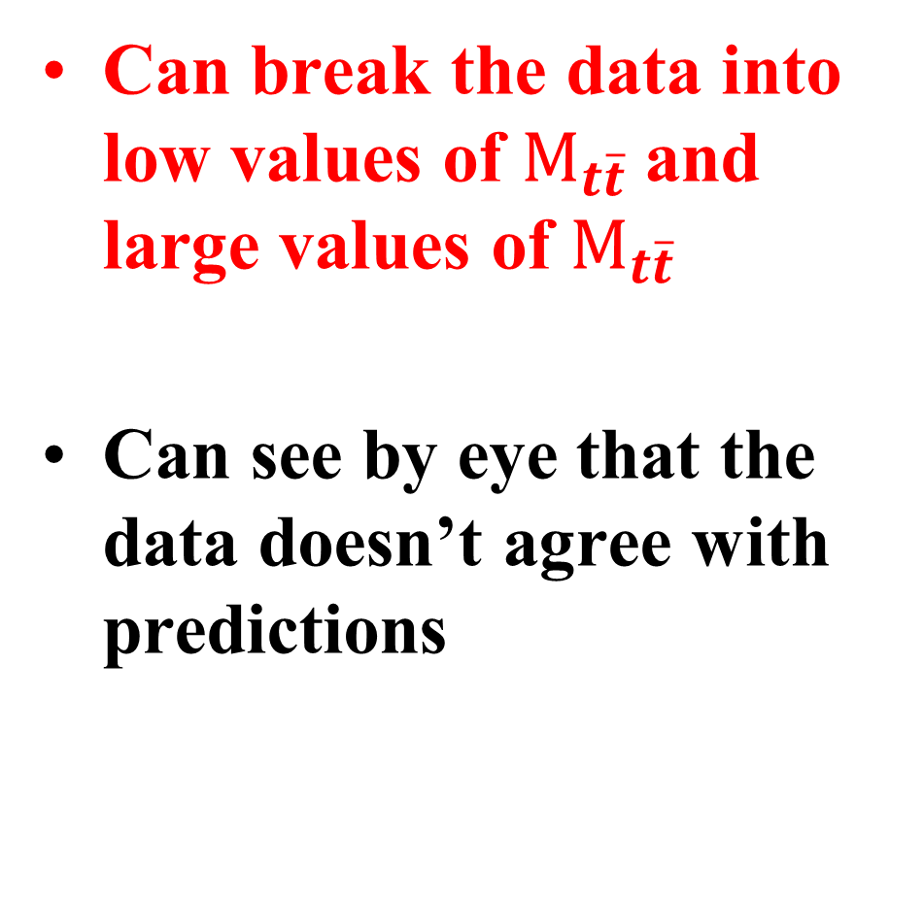

A_{FB} vs. $M_{t\overline{t}}$
Can break the data into low values of $M_{t\overline{t}}$and large values of $M_{t\overline{t}}$
Can see by eye that the data doesn’t agree with predictions

Slide 24
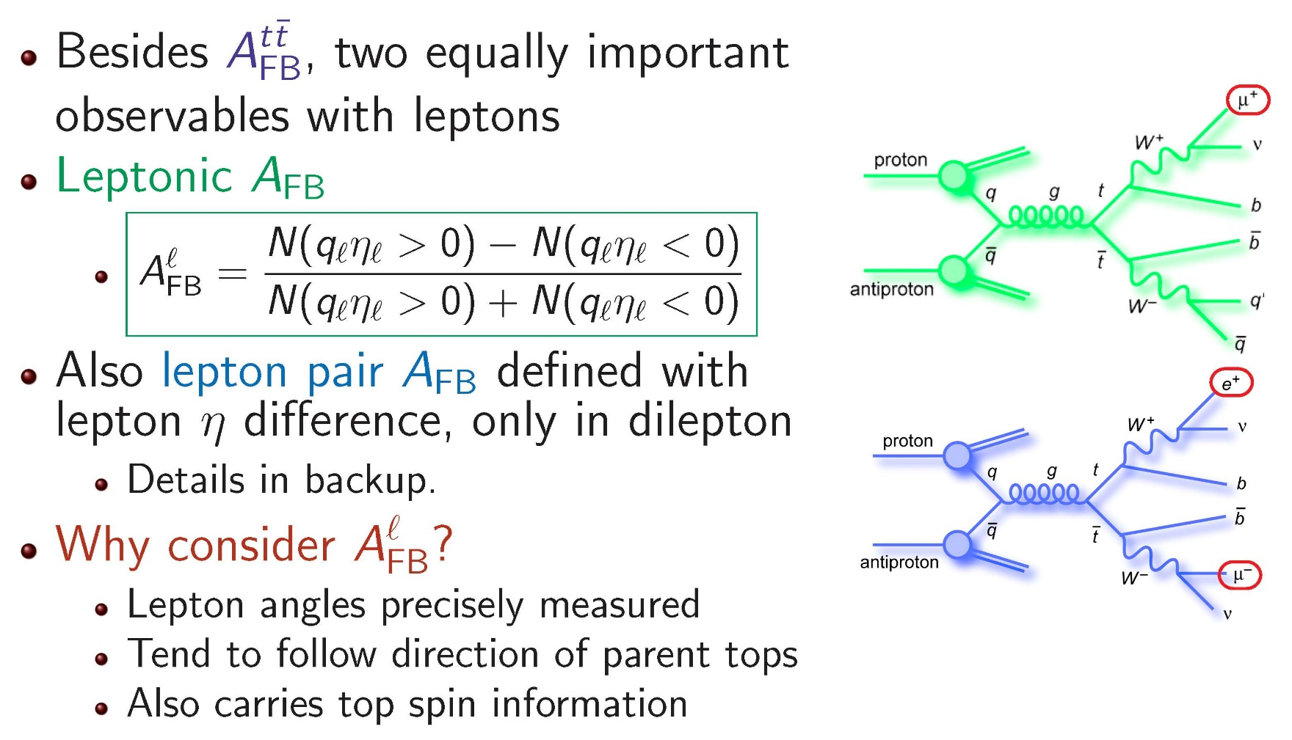
Leptonic A_{FB} Definition
SM: A_{FB} = 3.8%, specific ratio for Reconstructed/Leptonic
Various BSM Models: -5% < A_{FB} < 15%, ratio can vary significantly

Slide 25
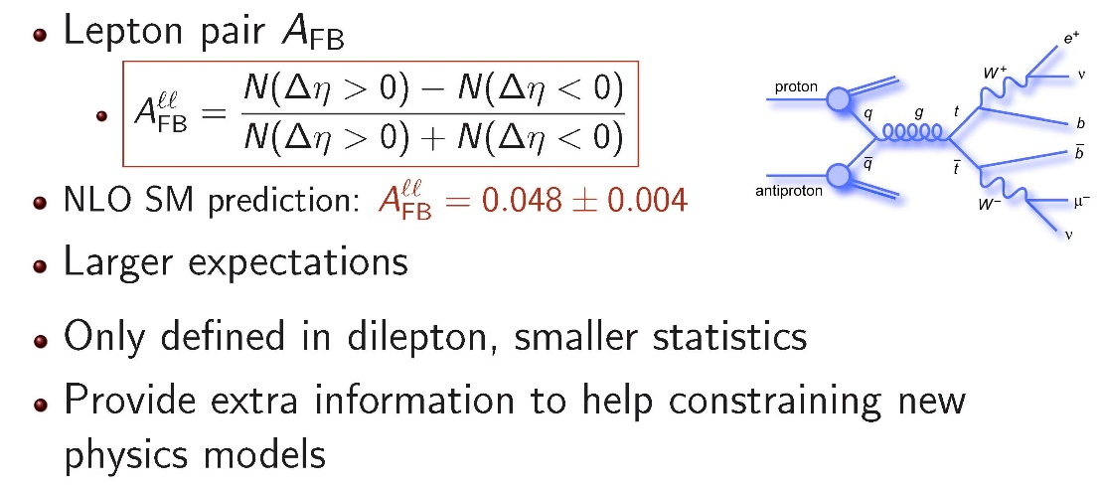
Dilepton-only Observable
Same BSM models: -9% < A_{FB} < 22%

Slide 26
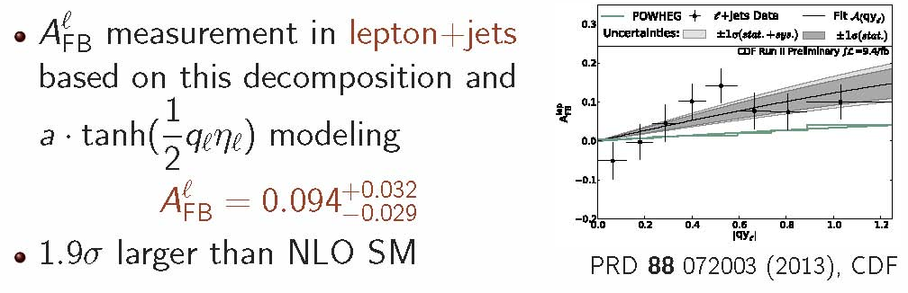
Leptonic A_{FB} from Lepton+Jets

Slide 27
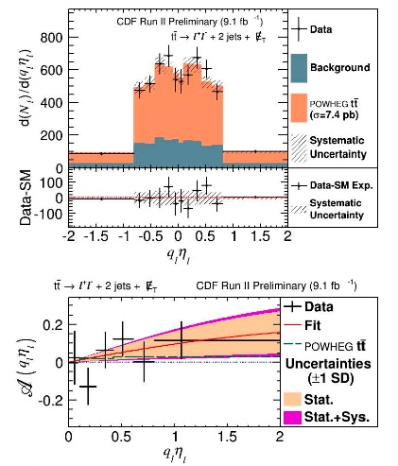
Leptonic A_{FB} from Dileptons
Measure A_{FB} with CDF full dataset in dilepton (9.1 fb⁻¹)
A_{FB} = 0.072±0.060
A_{FB}(SM,NLO) = 0.038 ±0.003
Combine CDF measurements →Result is 2σ larger than NLO SM prediction:
A_{FB} = 0.090 ± 0.028
Published as PRL 113, 042001 (2014) (CDF)

Slide 28
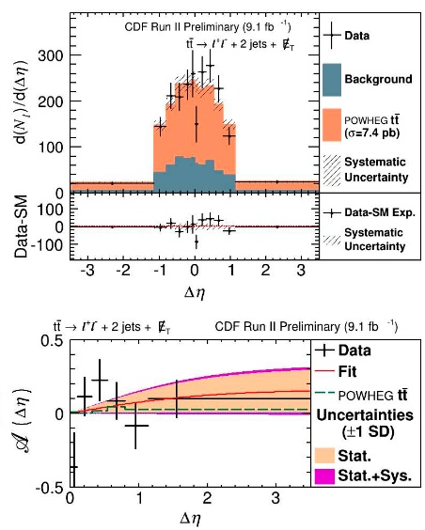
Leptonic Δη Results (Dileptons only)
Measurement techniques works equally well for A_{FB} in Δη
A_{FB} =0.076±0.072(st)±0.039(sys)
= 0.076± 0.081
Result consistent with SM
A_{FB}(SM,NLO) = 0.048 ±0.004
PRL 113, 042001 (2014)

Slide 29
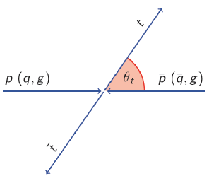
Definition of A_{FB}
In proton-antiproton collisions can measure the relative angle between the outgoing top and the proton direction
This is a forward event… If the top was going in the direction of the anti-proton →backward event
Forward-Backward Asymmetry:
A_{FB} = Fraction(Forward) – Fraction(Backward)

Slide 30
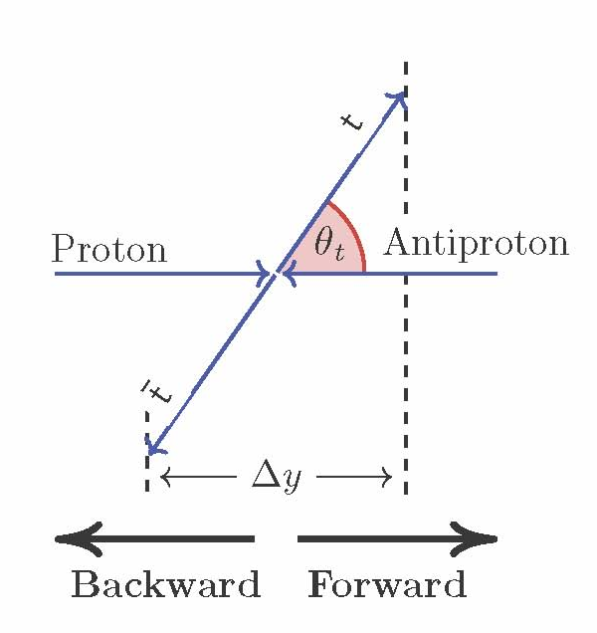
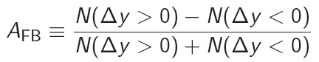
Quick Aside on Variable Choice Δy
Transform from Θ_{t} to rapidity (y)
Rapidity difference is a good proxy for production angle
Invariant under longitudinal boosts
Asymmetry in Δy is bigger than in Θ_{t,} easier to distinguish from 0
Note: y doesn’t have the usual geometric angle many of us are used to.
At hadron colliders we usually use pseudo-rapidity which assumes m=0
→ Here E and p not close to equal because of the top mass

Slide 31
Asymmetry Predictions
First SM predictions of A_{FB} after top discovery (~1995)
No A_{FB} at LO, all asymmetry comes from NLO diagrams. Took many years to get decent predictions
Interference among diagrams
Larger-than-expected EW correction and higher order QCD corrections complicate the calculation
Note: Process has been a harbinger of things to come: We have learned during the process that LO MC’s are simply not good enough to measure properties of the top quark

Slide 32
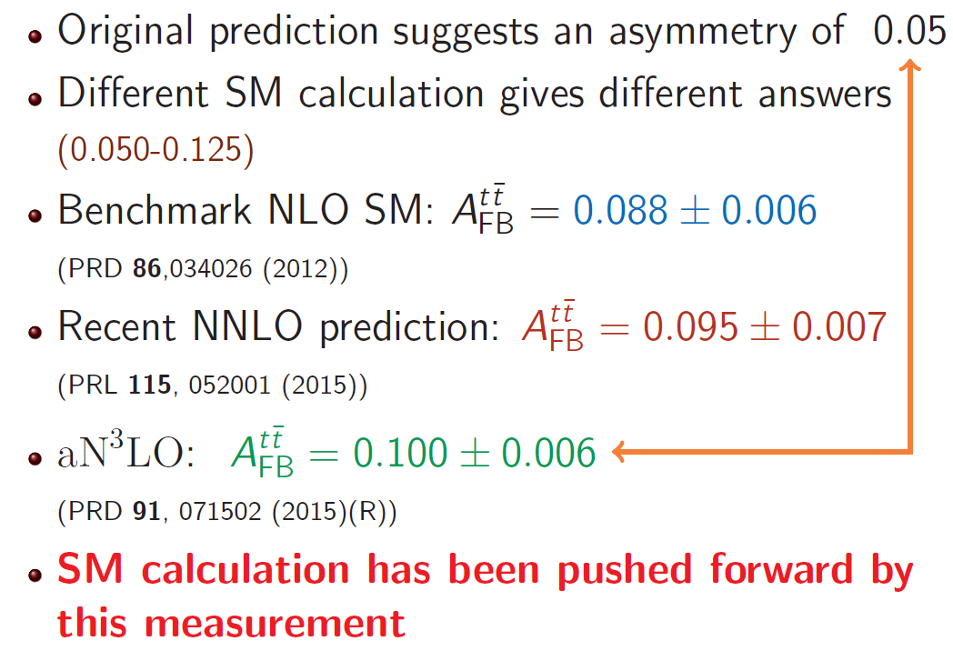
Lots of Predictions

Slide 33
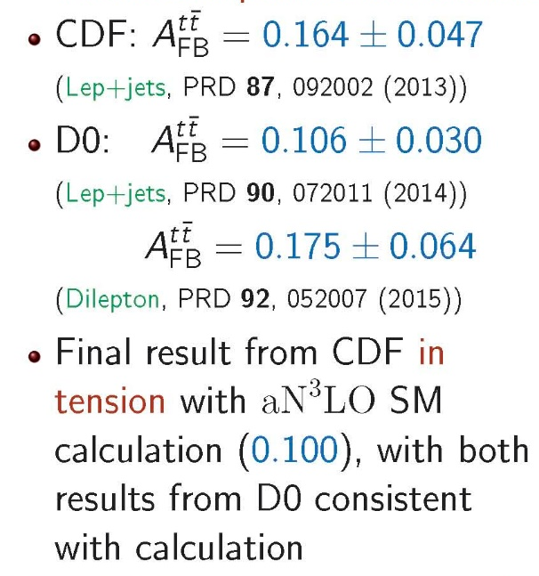
Inclusive A_{FB} Results
Prediction in plot is old so one can see where the excitement came from
Can already tell that the asymmetry is larger than expected for large |Δy|

Slide 34
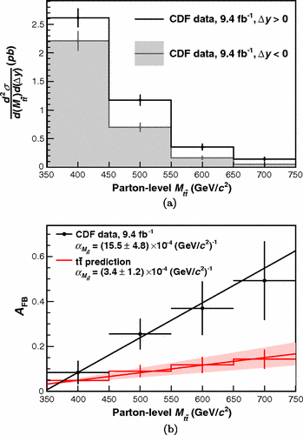

A_{FB} vs. $M_{t\overline{t}}$ Cont…
Quantify with a Slope:
(15.5±4.8)x10⁻⁴ Observed
(3.4±1.2)x10⁻⁴ NLO
Not a huge anomaly, but certainly we notice it and push forward…
Can the numerical values of these slopes be useful to model builders?

Slide 35
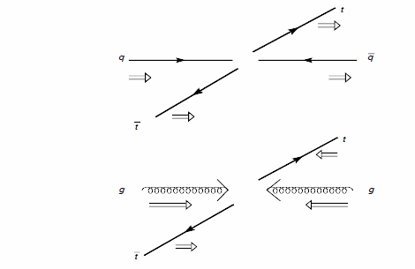
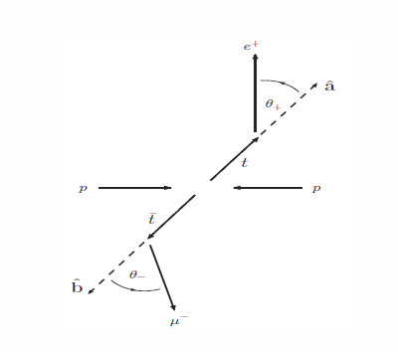
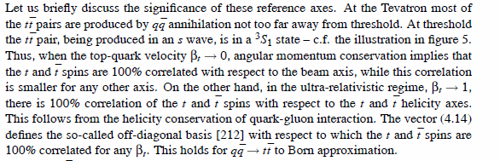
Big Picture 3: Bernreuther Notes 2

Slide 36
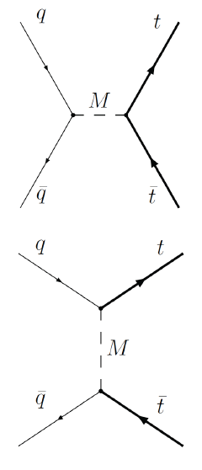
Examples of New Physics that could give a Large A_{FB}
Two main classes of models
S-channel mediator
e.g. axigluon
T-channel flavor changing mediator
e.g. W’ or Z’
Although many of these have strong constraints (and many are now excluded), they provide a good model for searches
For a review see:
M. Gresham, I.-W. Kim and K. Zurek,
Phys. Rev. D83 114027 (2011)

Slide 37
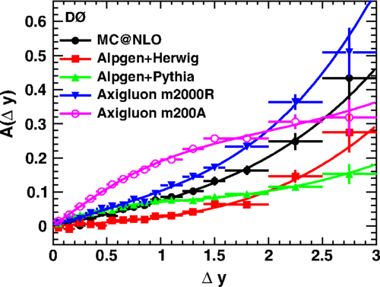
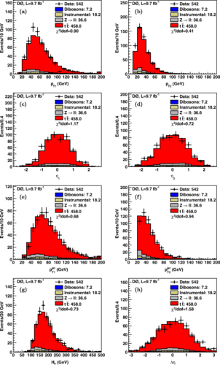
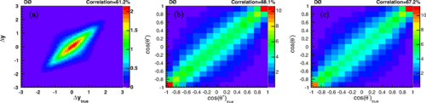
Spin Correlation

Slide 38
AFB+Top polarization from DZEro Part 1
Simultaneous measurement of forward-backward asymmetry and top polarization in dilepton final states from tt¯ production at the Tevatron
V. M. Abazov et al. (D0 Collaboration)

Slide 39
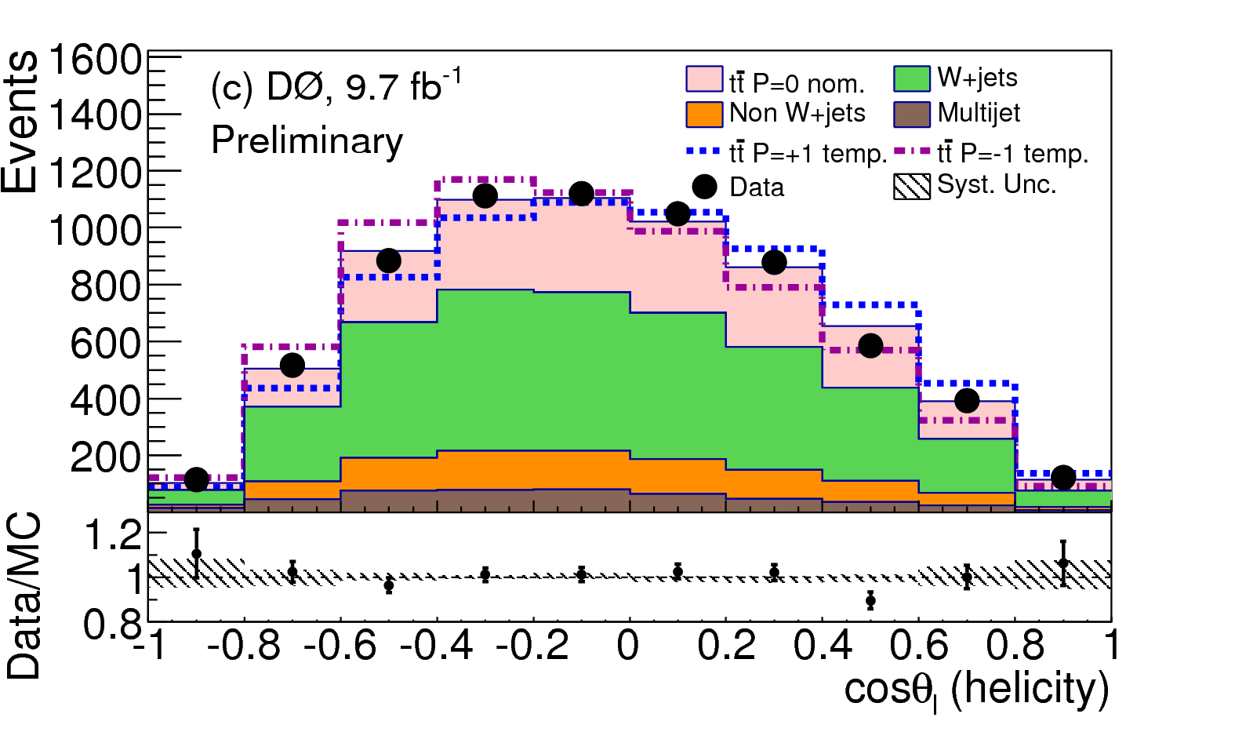
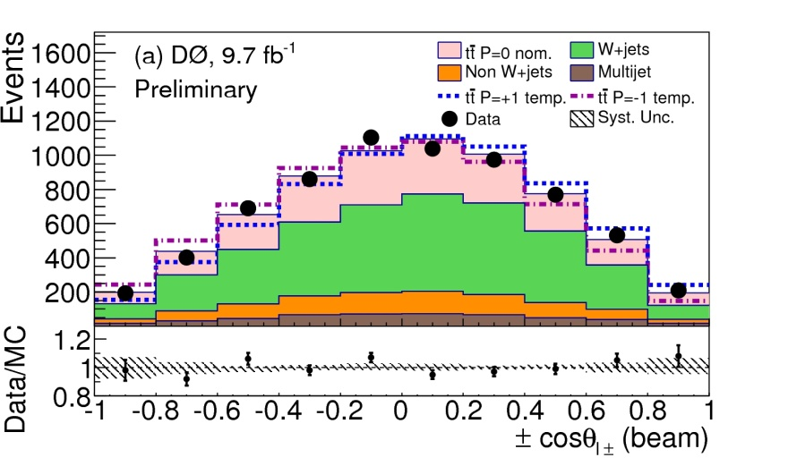
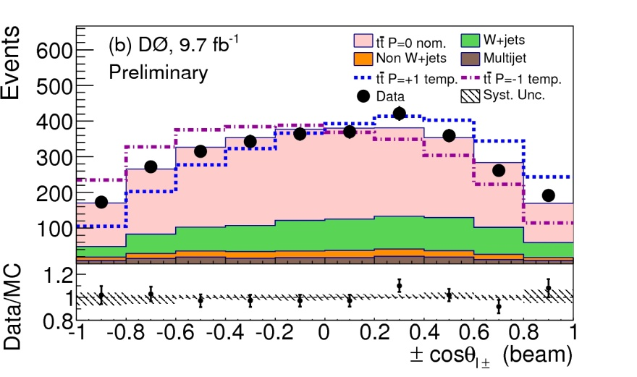
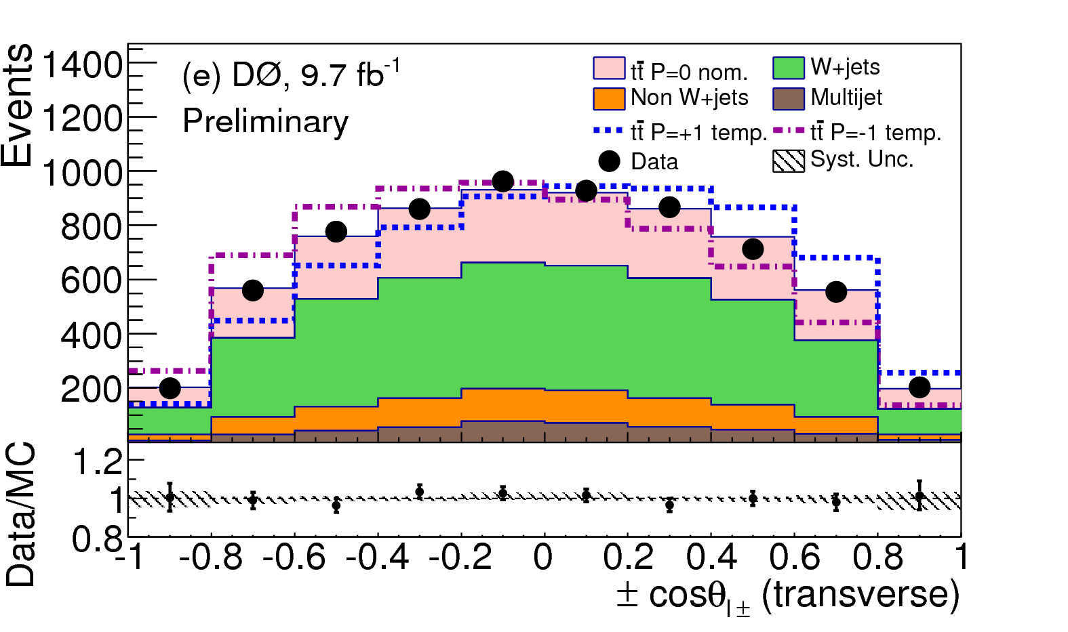
Polarization Backups

Slide 41
Dzero Spin Correlation 1: Want 3 pages
Measurement of spin correlation between top and antitop quarks produced in pp collisions at √s = 1.96 TeV
Within the SM, the longitudinal polarizations of the top quark and antiquark are due to parity violating electroweak contributions to the production process. The polarization is expected to be <0.5% for all choices of the spin quantization axis [4,5]
Dzero

Slide 42
Spin correlation stuff

Slide 44
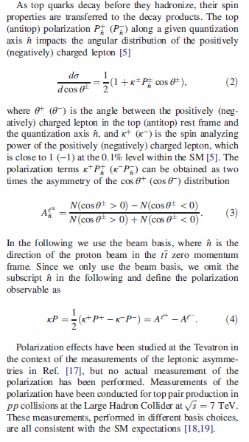
AFB+Top polarization from DZero

Slide 45



AFB+Top polarization from Dzero: Data
Dzero Phys. Rev. D 92, 052007 (2015)

Slide 46




AFB+Top polarization from DZEro Part 3

Slide 49


Slide 50


