Slide 1
Collider Physics: Supersymmetry at
Fermilab Tevatron and the Large Hadron Collider
Arnowitt Fest
David Toback
Texas A&M University
Mitchell Institute for
Fundamental Physics and Astronomy
September 2014

Slide 2
Overview
Overview of the Science: from Supersymmetry to minimal Supergravity
Overview of the A&M Collider Physics Group, the Tevatron and LHC, and our role in the search for SUSY
Golden search modes at the Tevatron and LHC
Second generation searches inspired by new particle physics and cosmological results
What we’ve learned and conclusions

Slide 3
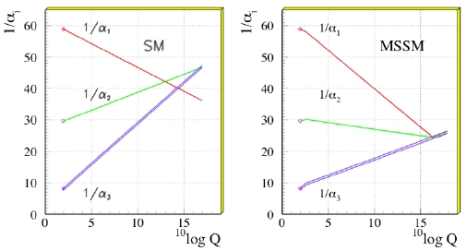
SUSY and mSUGRA
Supersymmetry is one of the most compelling theoretical ideas in the last 40 years
However, the most complete models have 128 free parameters
Dick played a major role in thinking about the methods for the unification of the forces, for example pushing gravity mediated SUSY and the simplification of the unification of the scalar and gaugino masses at the GUT scale, as well as ways to help experimentalists
The product, minimal SuperGravity or mSUGRA, had huge phenomenological and experimental advantages as it was narrowed down to 5 parameters that led to large swaths of parameter space being similar
Benchmark SUSY search strategy for well over a decade
m₀
m_{1/2}

Slide 4
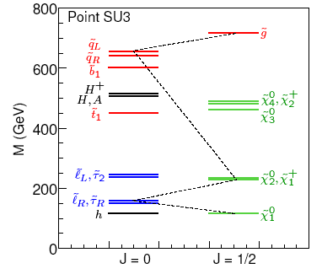
Sparticle Masses in mSUGRA
In a typical mSUGRA scenario
Squarks and gluinos are heavy
1st and 2nd generation squarks are mass degenerate
The lightest neutralino is the LSP
Dark Matter candidate
m_{1/2}
For large values of tanβ Stop, Sbottom and Stau can get much lighter
◊Can also have a significant effect on the branching ratios
Need complementary searches for low tanβ and high tanβ

Slide 5
Collider Physics Group at A&M
Peter McIntyre, Russ Huson and Bob Webb hired in 1980 to create the high energy experiment group
James White hired in 1987: D0 until 2003
Teruki Kamon Hired in 1991: CDF + Founding member of TAMU/CMS group in 2005
Dave Toback Hired in 2000: CDF + Founding member of TAMU/CMS group
Alexei Safonov Hired in 2006: CDF + CMS
Ricardo Eusebi Hired in 2009: CDF + CMS
Keith Ulmer Hired in 2014: CMS
1980: Formation of the CDF Collaboration. McIntyre and Webb are Founding members.
1984: Formation of D0 collaboration
1985: CDF starts taking data
1989: First CDF/SUSY paper (Run 0)
1994: Dzero first paper
2000: Run II begins
2005: The TAMU group joins CMS
2009: LHC first collisions 2009, 7 TeV in 2010, 8 TeV in 2012
2011: Tevatron Stops running
2011: First SUSY paper from LHC
2011 & 12: First hints of Higgs. Report of 1-in-550 at Tevatron July 2nd (2012) and 1-in-a million discovery at LHC on July 4th

Slide 6
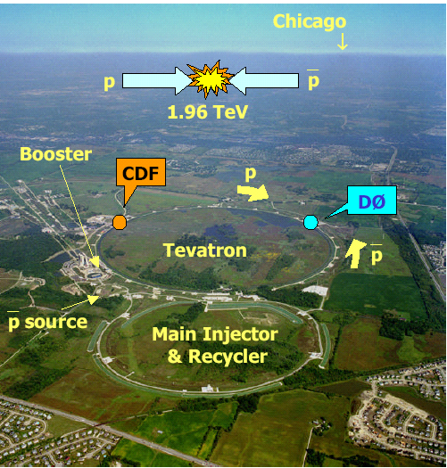
The Fermilab Tevatron the LHC at CERN
Protons anti-proton at 1.8 TeV → 1.96TeV
CDF and Dzero co-discovered the Top quark in 1996
Broad program of physics
World’s best Measurement of the top mass and W mass
Most powerful searches for new particles until the turn on of the LHC
Search program nearly complete
Review article arXiv:1409.4910 DT & Zivkovic
Reused LEP tunnel
Proton-Proton collisions at 7 TeV & 8 TeV → 10 & 14 TeV coming up
CMS and ATLAS discovered the Higgs in 2012
Currently the high energy frontier, and best place to look for SUSY

Slide 7
History of mSUGRA searches
Tevatron searches in the golden modes
Colored production: Squarks and Gluinos in Jets+Met
Dileptons
Trileptons (Dick co-proposed this)
High tanB direct searches in Sbottoms and Stops
B_{s}→μμ (Dick co-proposed this)
LEP & LEP II also did most of these
Takes over after Run I in gaugino pairs, but superseded by Run II
Not competitive in large masses because of their restrictive energy
LHC searches at the high energy frontier take over
Jets+Met are most sensitive
Electroweak pair production searches
Extensive heavy flavor set of searches
New emphasis on Top Squarks after the Higgs discovery
Discovery of B_{s} → μμ
Powerful ability to fill in all the crooks and crannies

Slide 8
TAMU and SUSY at CDF
Based on the evidence of unification with MSSM from LEP measurements, Dick and Dimitri worked on the “trileptron” golden mode, and Kamon took on the analysis at CDF (Published in 1996)
In the 90’s, experimental SUSY was being done only by the dedicated few
Toback and Kamon were early SUSY players in Run I
mSUGRA and GMSB were the only games in town
Cosmological connection was there mostly in a “it predicts dark matter” way, not quantitative
Both played lead roles in Run II
First search out of CDF for Run II was B_{S}→μμ (TK)
First direct search of CDF for Run II was GMSB→γγ+Met (DT)
Kamon was SUSY convener from 2005-2007
Toback was SUSY convener from 2007-2011
During the Run II data taking, new emphasis on large tanB
B_{S}→μμ (TK)
Tau final states: Big push with Safonov, searches in RPV SUSY
LHC pheno projects and CMS Searches (more soon, also see talk by Dutta)

Slide 9
Squark and Gluino Searches in Multijet + Met
Three main production diagrams
Final states are mass dependent
2 jets + MET
3 jets + MET
4 jets + MET
Jets+Met is a powerful model independent search strategy

Slide 10
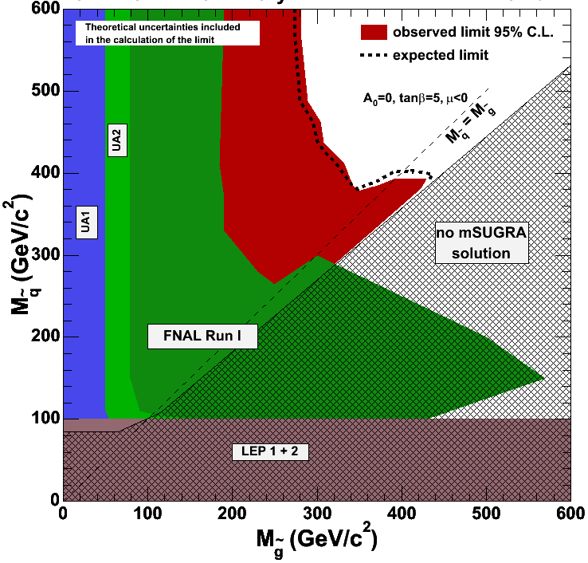
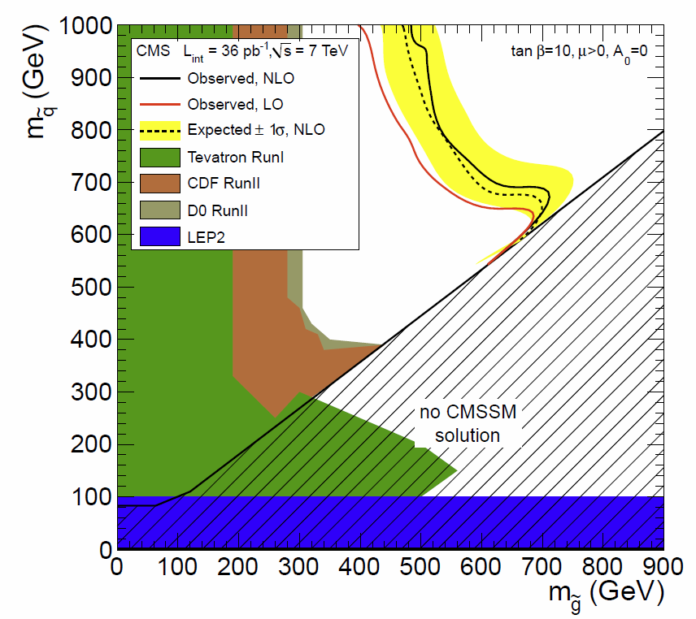
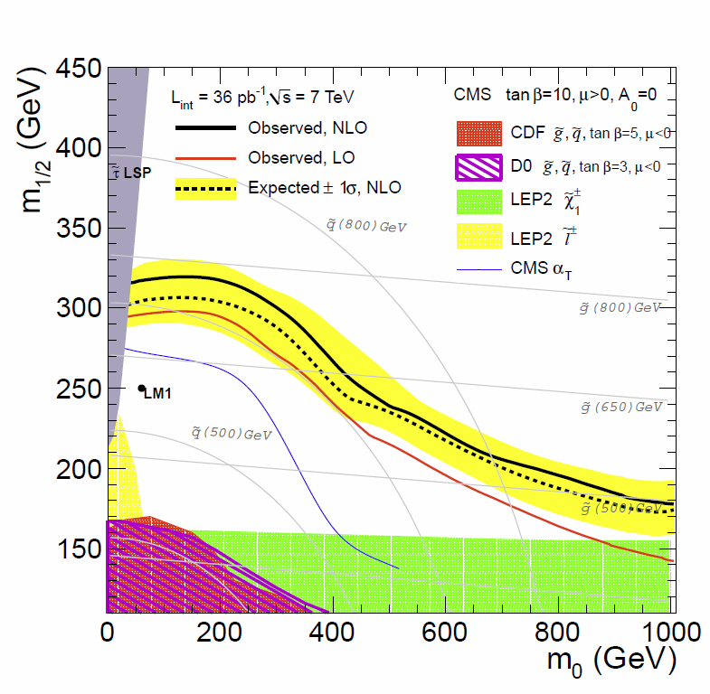
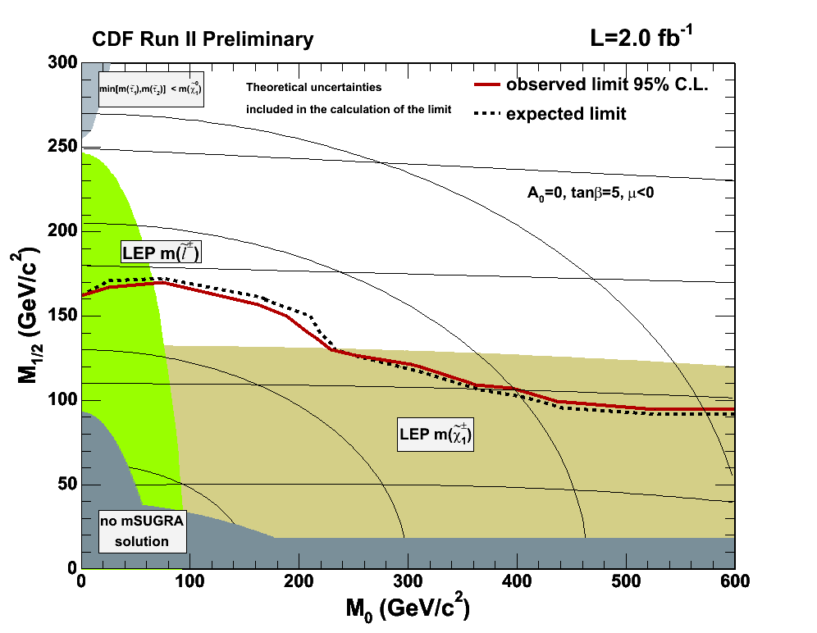
Limits: From CDF to CMS
Set limits as a function of the sparticle masses
Also in the m_{1/2} vs. m₀ plane (a la mSUGRA)
Highly disfavors mSUGRA

Slide 11
Gaugino Pair Production
Chargino-Neutralino gives three low energy leptons in the final state
eee
eeτ
eeμ
μμτ
eμμ
eμτ
μμμ
Lots of separate final states

Slide 12
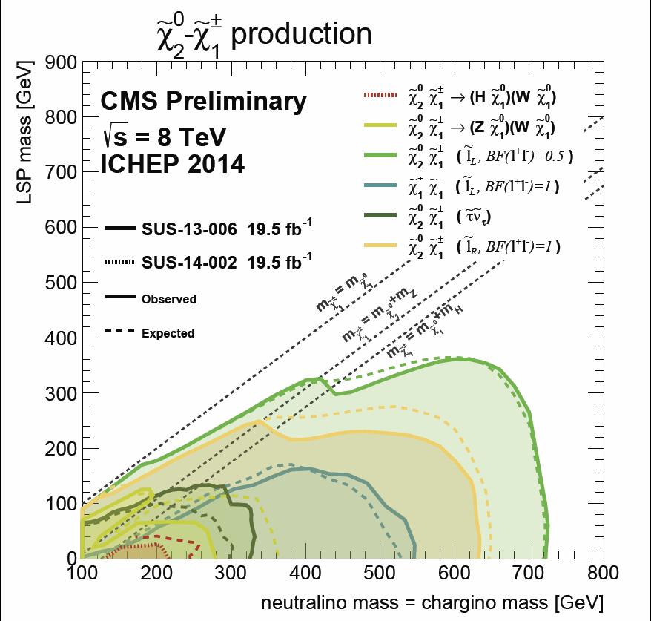
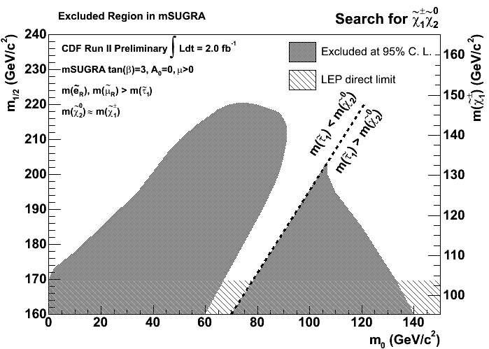
mSUGRA Limits from Trilepton Events
LEP direct limit

Slide 13
High Tanβ
As more data comes in during Run II, likelihood fits including Higgs mass limits, g-2, and other experimental data point to high tanβ
New emphasis on Stop and Sbottom searches as their masses can be much lighter
Gaugino branching fractions to τ’s can rise to 100% as the stau gets light…
Allanach, PLB 635, 123 (2006)

Slide 14
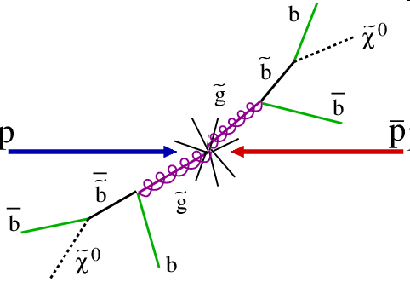
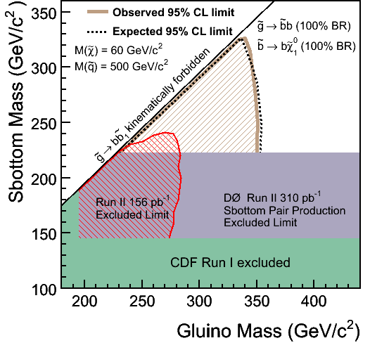
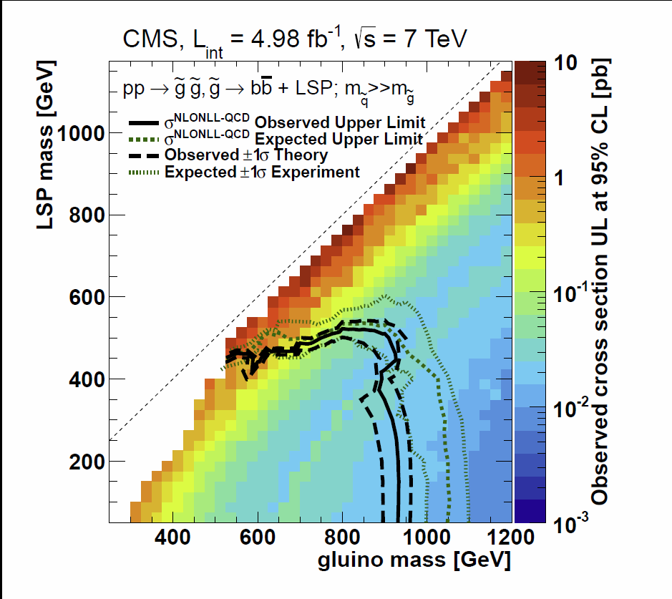
Limits on Sbottoms
Two primary Sbottom (basically the same as the Jet+Met Searches, but where we require b-quark tags)
Sbottoms from gluinos
Direct sbottom pair production

Slide 15
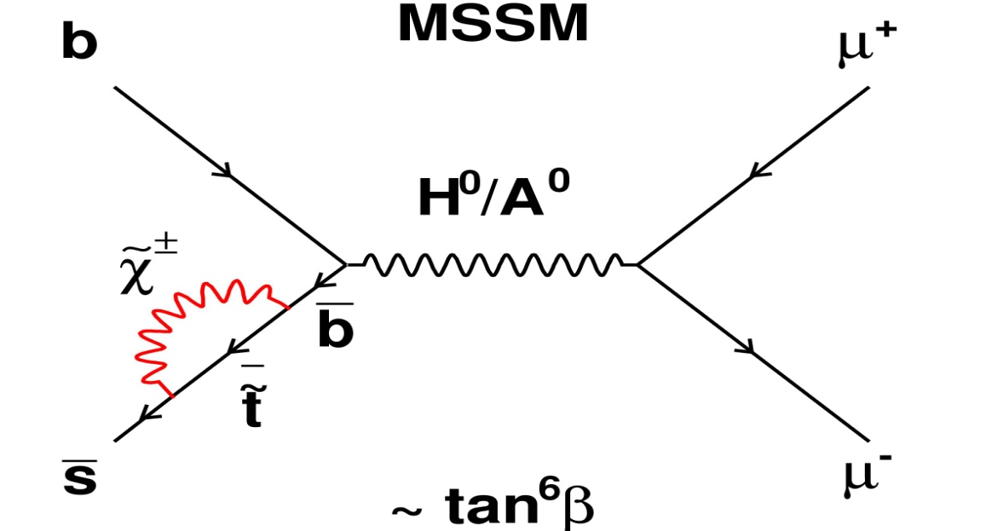
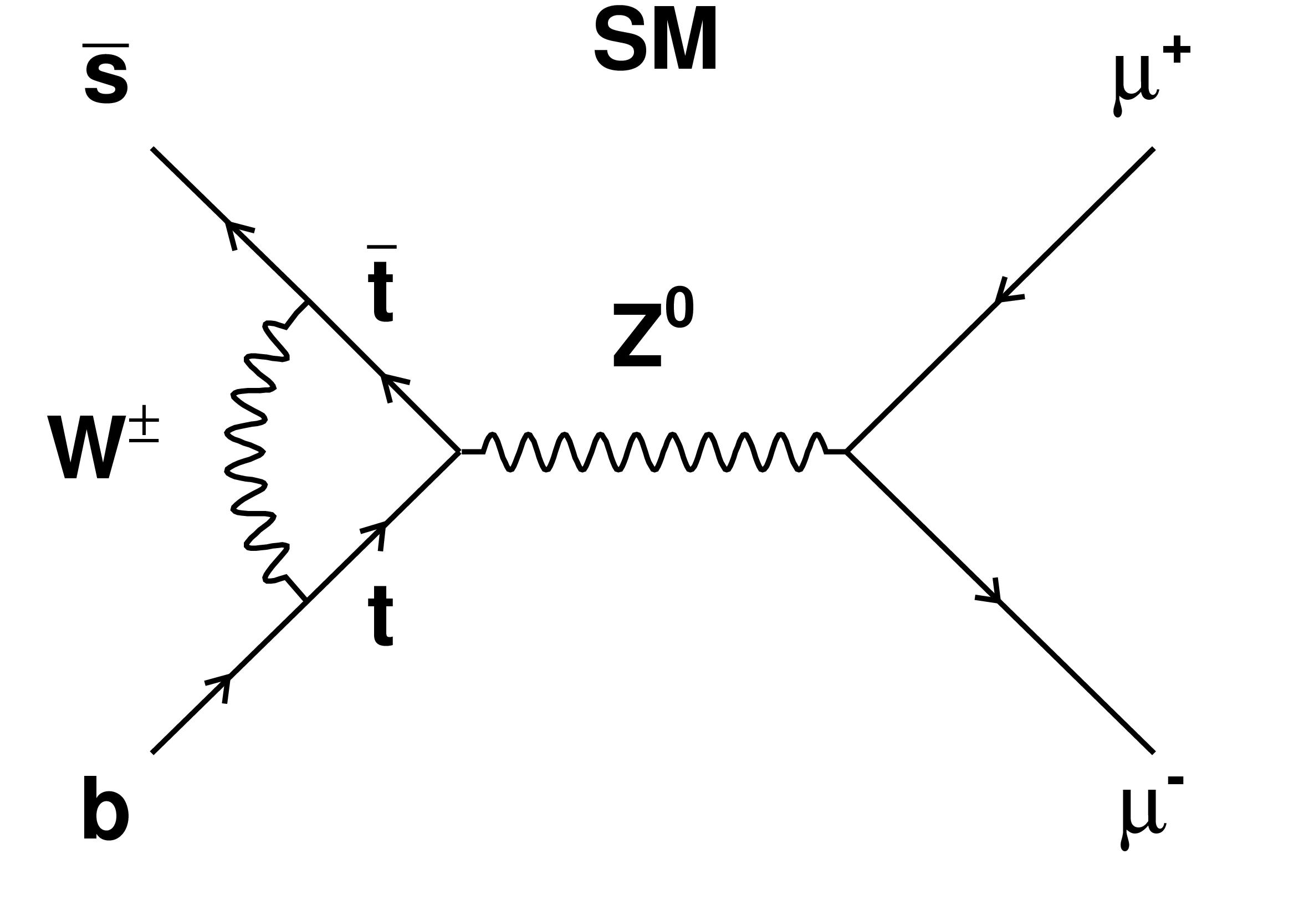
Indirect Search: B_{s} → μμ
Dick, Teruki, Bhaskar et al, argue that the search for B_{s} → μμ is perhaps the most sensitive to SUSY since sparticles show up in loops
Especially sensitive at high tanβ (Br ∝ tanβ⁶)
In the Standard Model, the FCNC decay of
B_{S} →μ⁺μ⁻ is heavily suppressed
(Buchalla & Buras, Misiak & Urban)

Slide 16
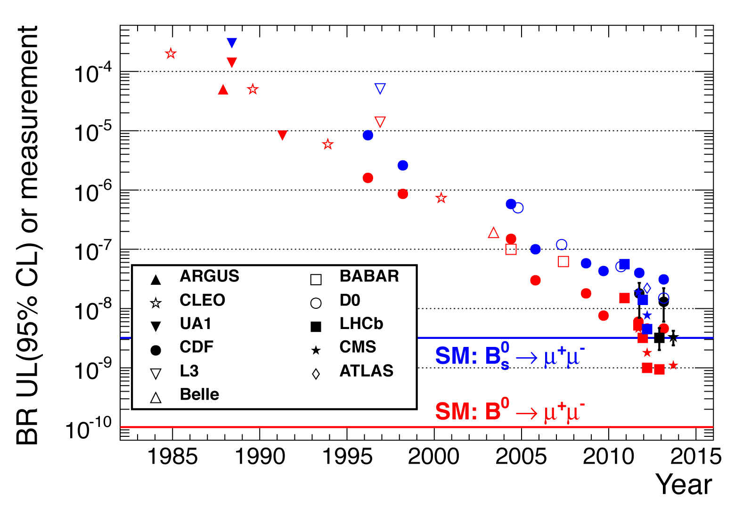
Text
Limits, Discovery and Implications
Multiple searches at the Tevatron (co-led by Kamon)
Best limits for many years at CDF
PhD for Krutelyov
Then ~2σ evidence
B_{S}→ μμ now observed at SM level
Disfavors high tanB of SUSY

Slide 17
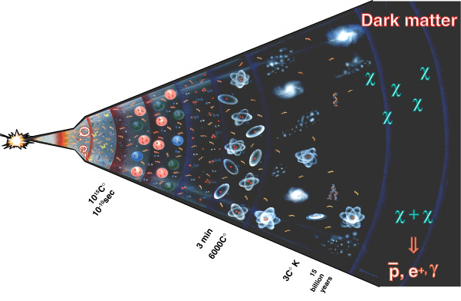
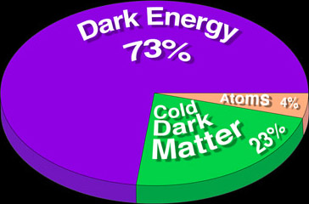
Cosmological Connection
WMAP and others provide cosmological measurements with a precision that allow us to take the next steps
Astronomy, Cosmology and Particle Physics: The Dark Matter in the Universe is made up of LOTS of Sparticles that we haven’t discovered yet!
Got created in the Early Universe like everything else and is still here today!
Move from simply providing a candidate, to predicting the Dark Matter relic density with a full SUSY calculation
Dick, Teruki, and Bhaskar with help from DT and others

Slide 18
Co-Annihilation in the Early Universe
If there is a second SUSY particle with small mass (similar to that of the LSP) it can have a large abundance in the early universe
The presence of large amounts of this second particle would allow large amounts of the LSP to annihilate away and reduce the Dark Matter relic density to the value observed today
Co-annihilation effect (Griest, Seckel:92)
Common in many models
SUSY with taus in the final state
Pheno was done with Dick, Teruki, Bhaskar, DT + Students

Slide 19
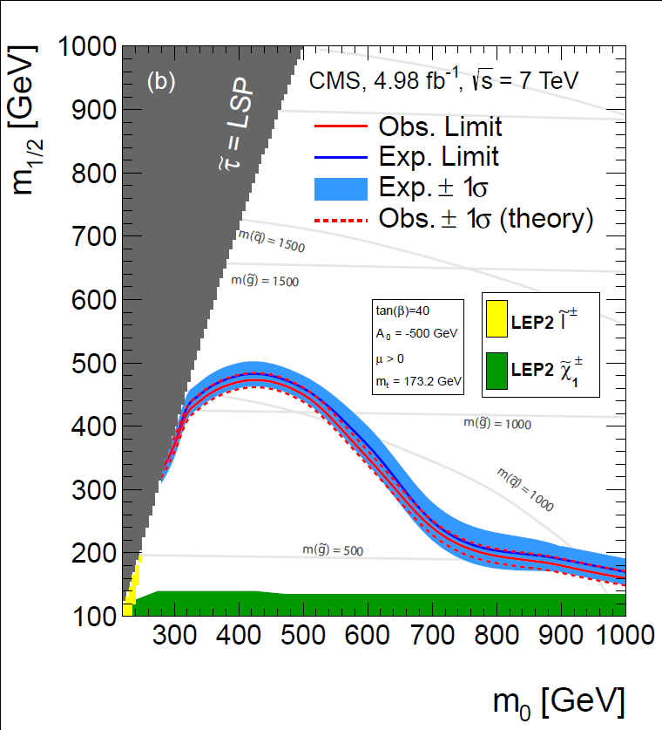
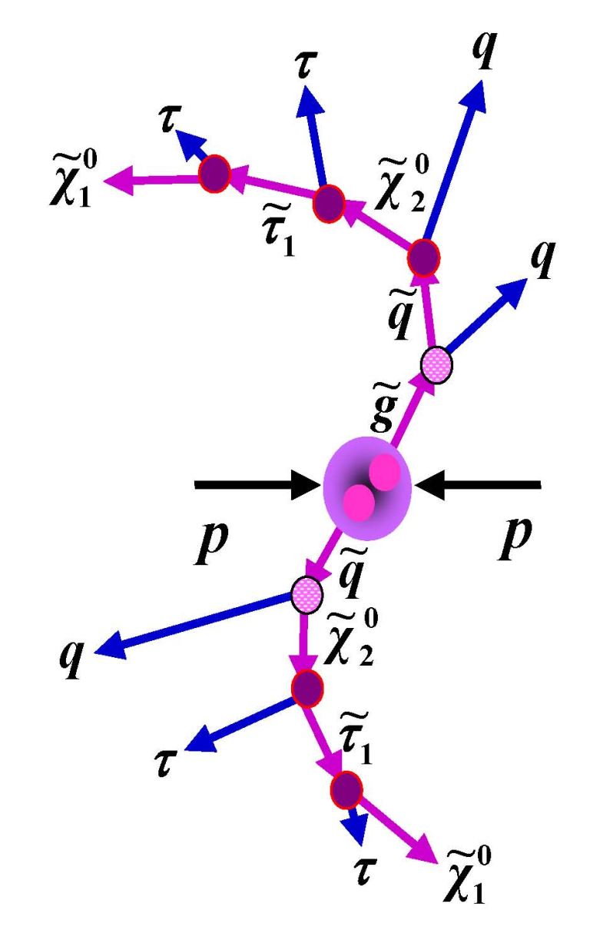
Searches for evidence of Co-annihilation region at CMS
A&M led search
Phd for Gurrola and Montalvo
Again, not good for mSUGRA

Slide 20
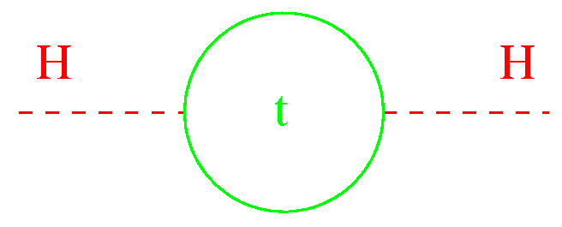
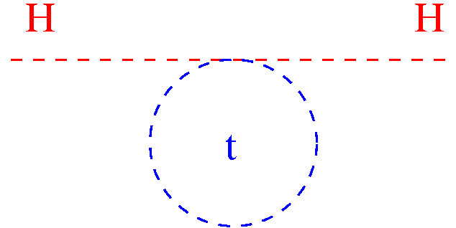
Discovery of the Higgs also changes the emphasis in searches
The Standard Model
Corrections to Higgs boson mass not only finite, but in fact divergent
Supersymmetry
Fermion and Boson contributions to the Higgs cancel nearly exactly in supersymmetry
The one loop divergences will cancel, provided that the SUSY particles have masses that are small enough… Maybe only Stop contributions matter?

Slide 21
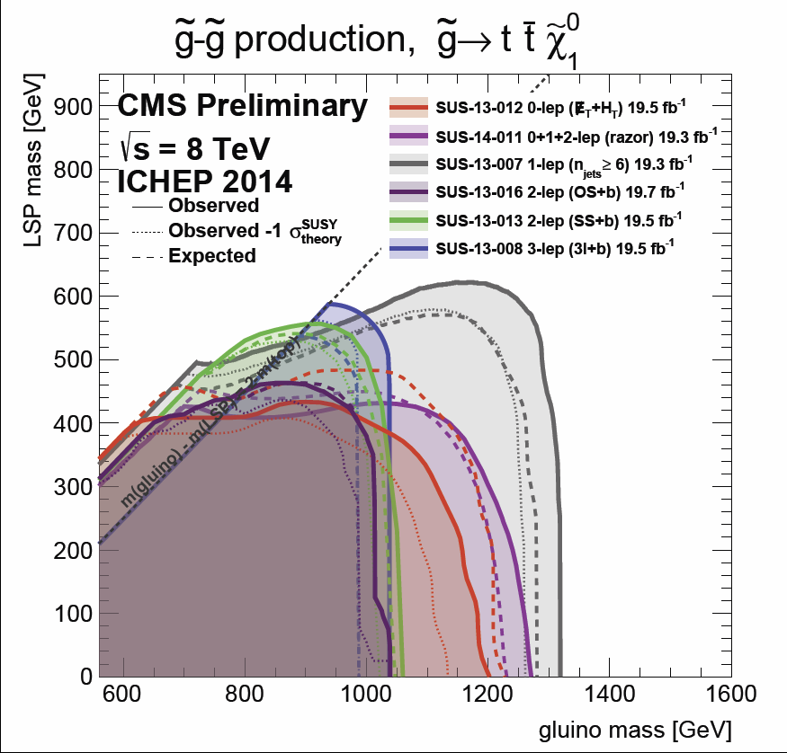
Lightest Squark = Stop?
Lots of
Analyses
Direct Counting
Experiments and Sophisticated Fitting Methods
No evidence, just limits

Slide 22
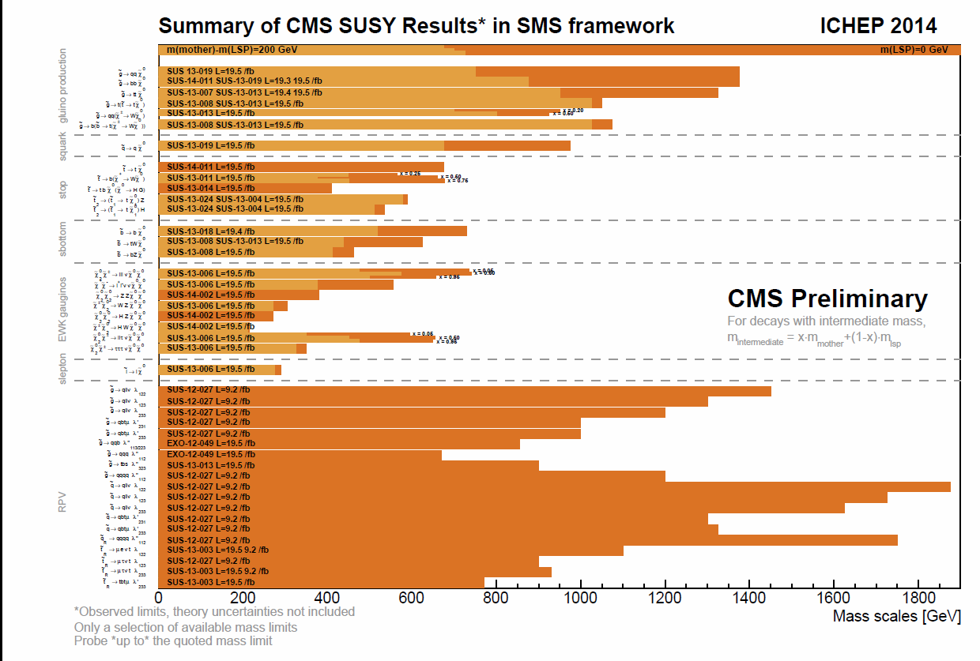
Summary/Conclusions
Dick’s legacy is still with us today, although new knowledge has changed our thinking
SUSY has a good chance to be correct, it may well explain the dark matter in the universe, and cosmological connections are likely to be central to future Pheno work
However, mSUGRA is basically considered ruled out and we need to think non-minimally or that nature isn’t as simple as the gravity unification with unified scalar and gaugino masses
That being said, the future is bright for SUSY and the legacy that Dick built
LHC is the best place at the moment to do the searches and his work has already laid the ground work for the next generation of SUSY searches (e.g. Vector Boson Fusion)
TAMU is now one of the most powerful groups on CMS
Muons, trigger, taus, big computing
Recent hire Ulmer continuing the grand tradition of the SUSY convener being at A&M
With LHC Run II at the with higher energy and more data being right around the corner Dick would be more excited than all of us, and we will miss him dearly

Slide 23
End of Lecture

Slide 24
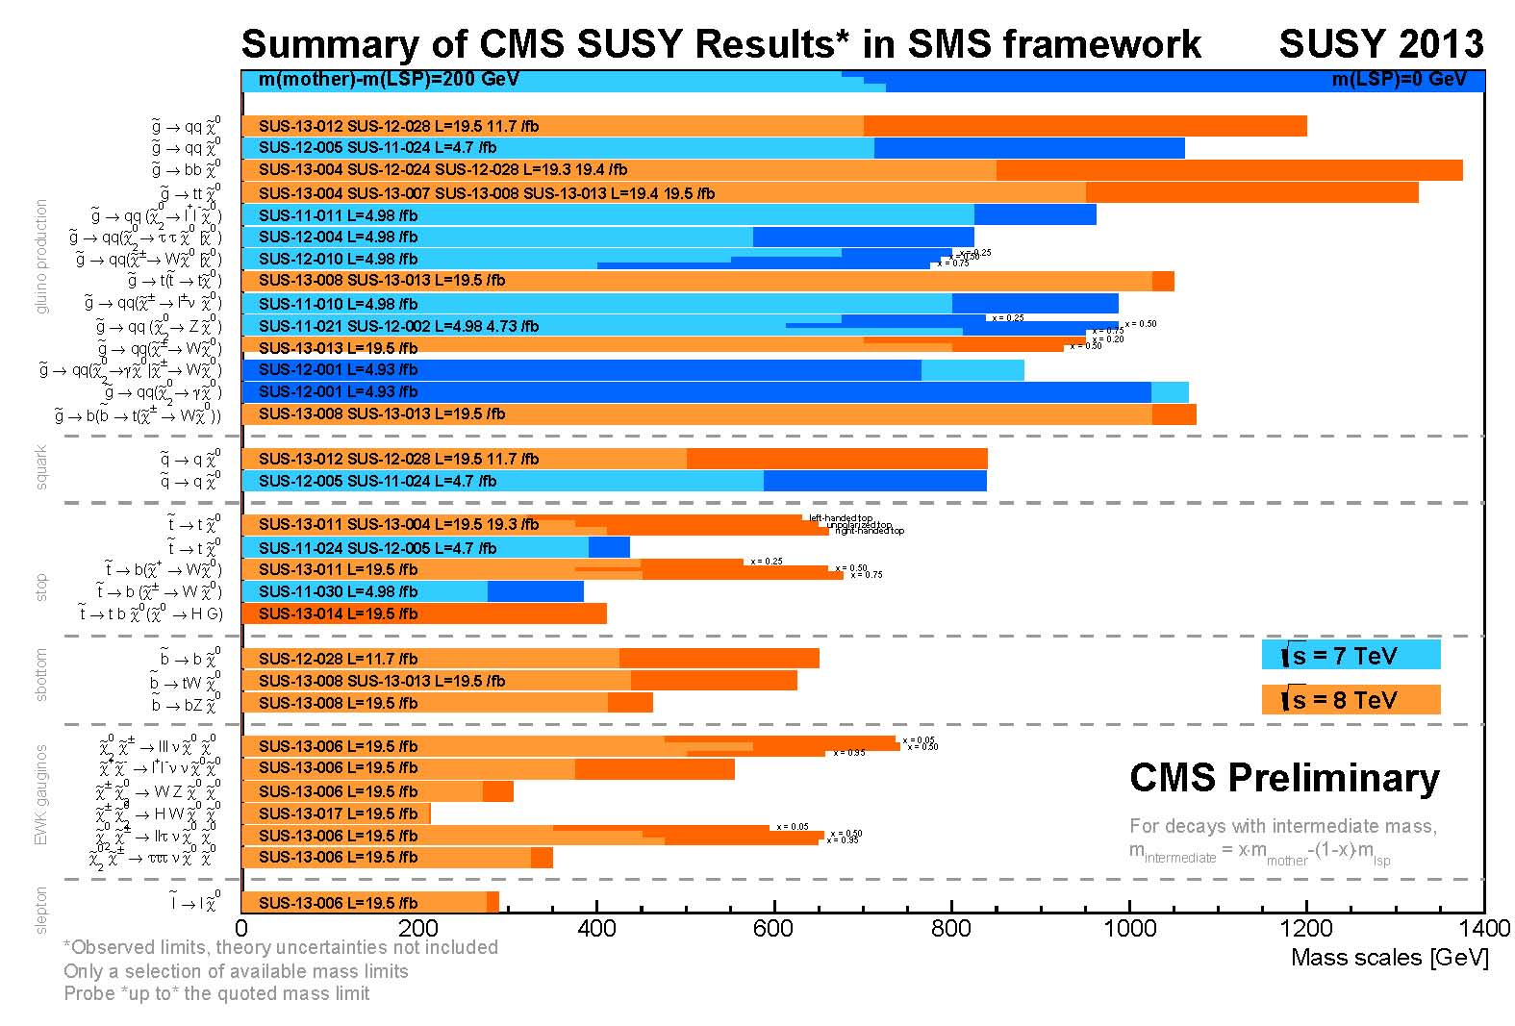
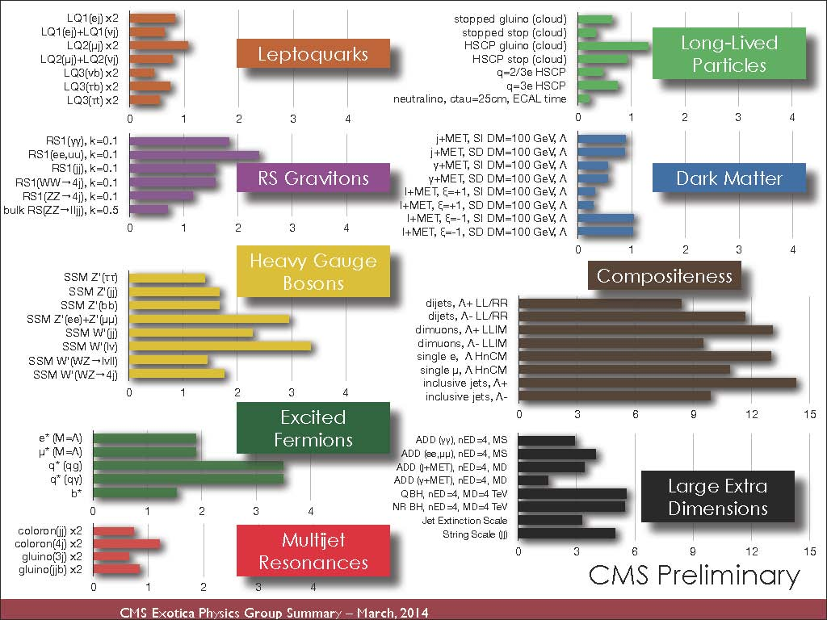
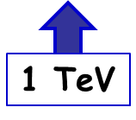
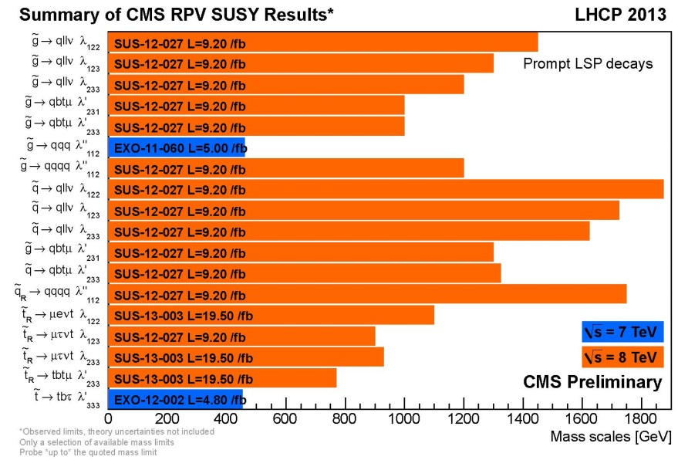
CMS “New Physics Searches” Charts
program
mass
Probing a TeV scale at LHC8 ☺
No hints of NP (yet) in very diverse search programs ☹
[Note] −1 sigma exclusion limits rather than the nominal value are also available in CMS papers.
RPV
24

Slide 25
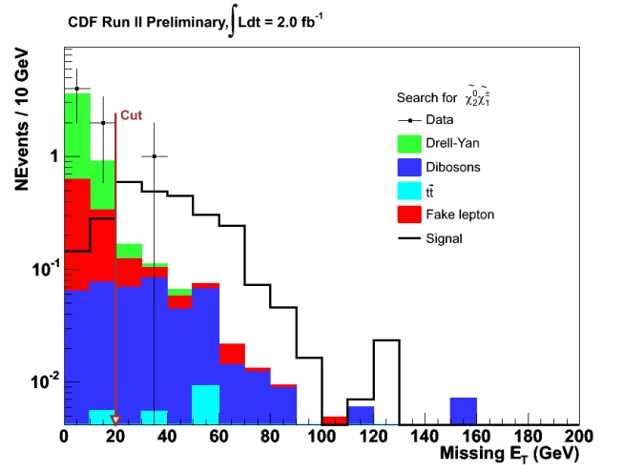
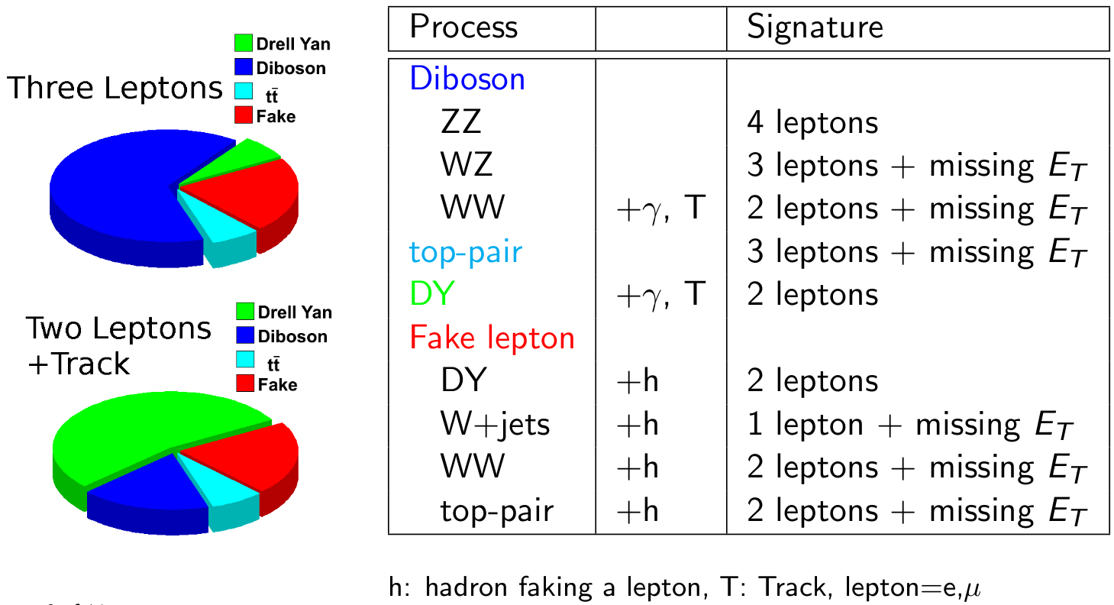
SUSY in Trilepton Events?
No evidence for SUSY or Dark Matter so set limits…
3 leptons

Slide 26
Trileptons in mSUGRA
The details of the full decay chains of the gauginos affects the final state kinematics
Look at the lines of constant M₀
Decay dominantly
via on-shell sleptons
Gauginos Decay dominantly
via on-shell sleptons
Gauginos Decay
dominantly
via off-shell W/Z
Decay dominantly
via off-shell W/Z
LEP direct limit

Slide 27
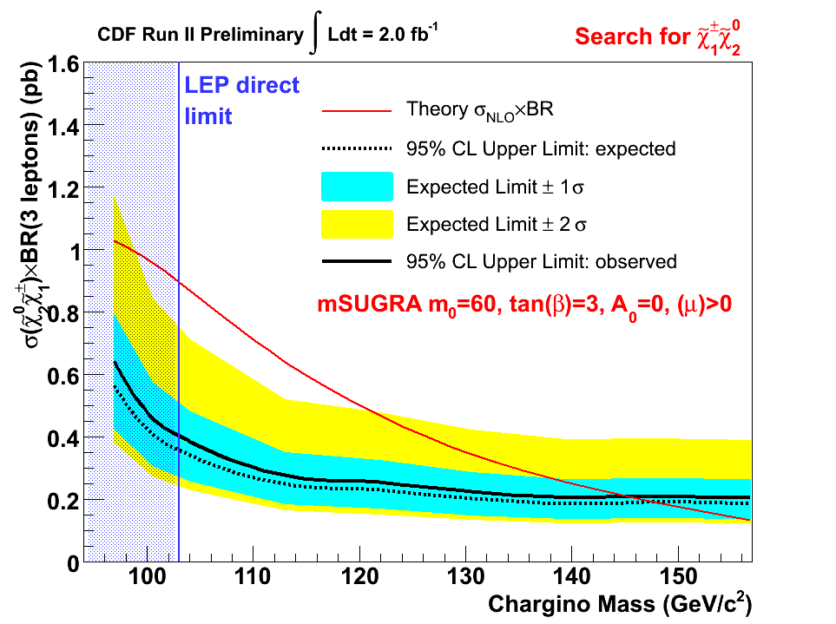
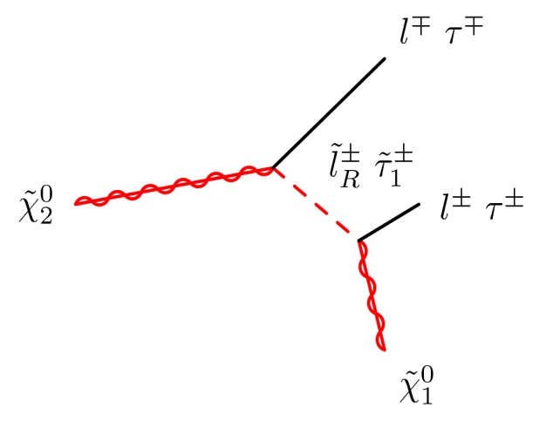
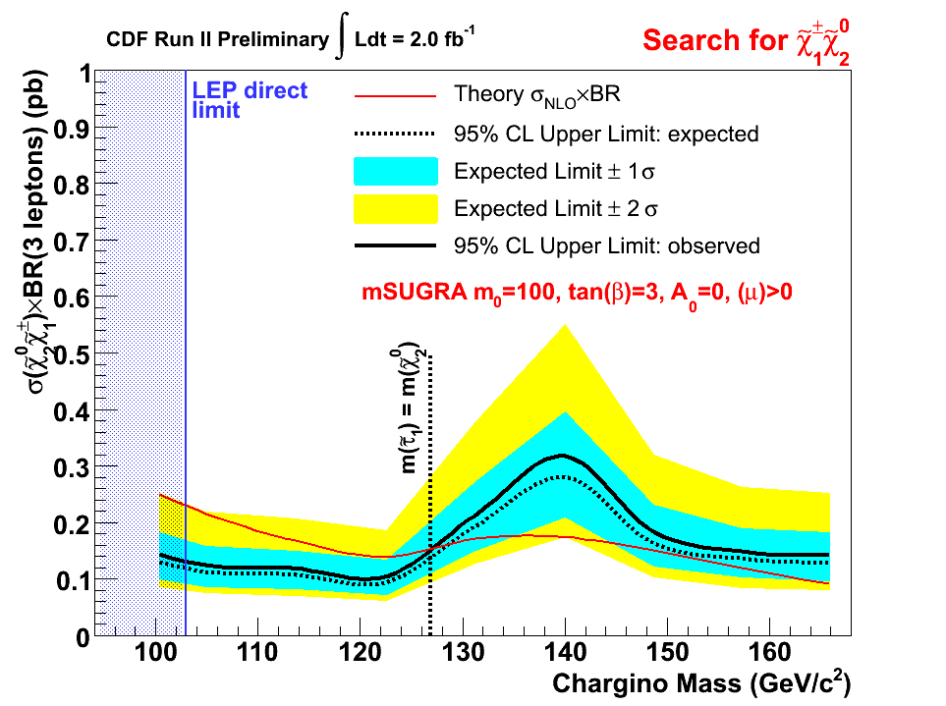
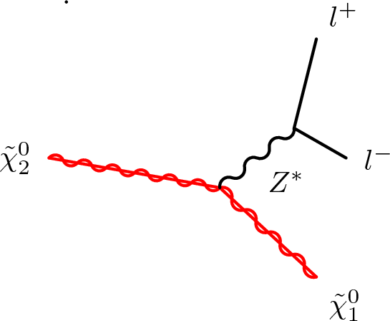
Cross Section limits vs. Chargino Mass
M₀ = 60 GeV
Exclude chargino masses
below ~145 GeV/c²
Gauginos Decay dominantly
via on-shell sleptons
Small gaugino-slepton mass difference reduces the branching fraction
M₀ = 100 GeV
Gauginos Decay
dominantly
via off-shell W/Z

Slide 28
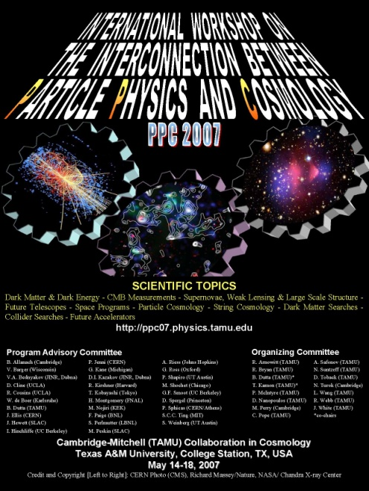
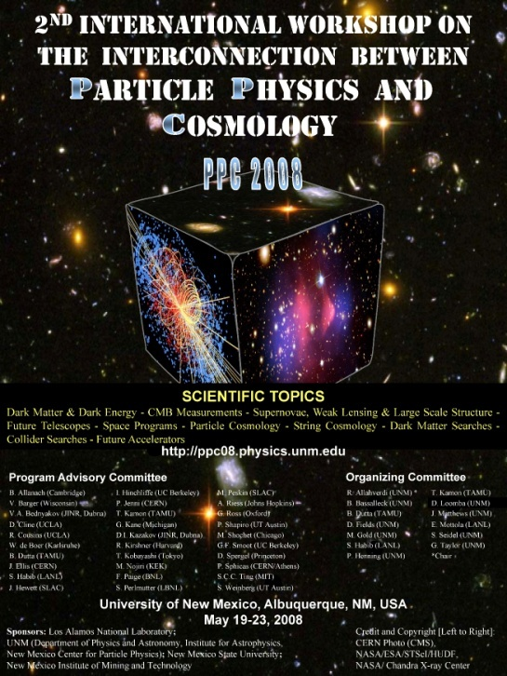
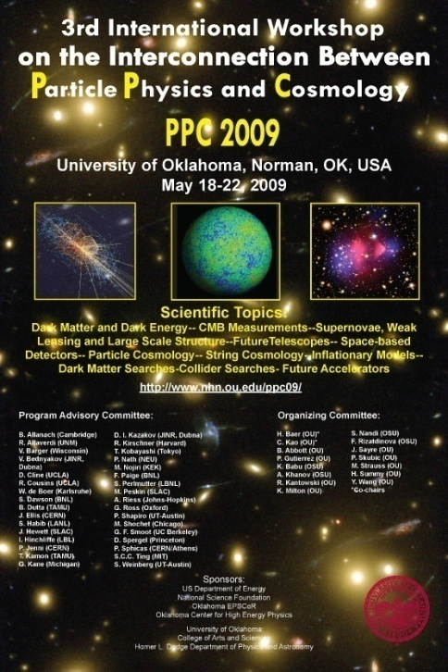
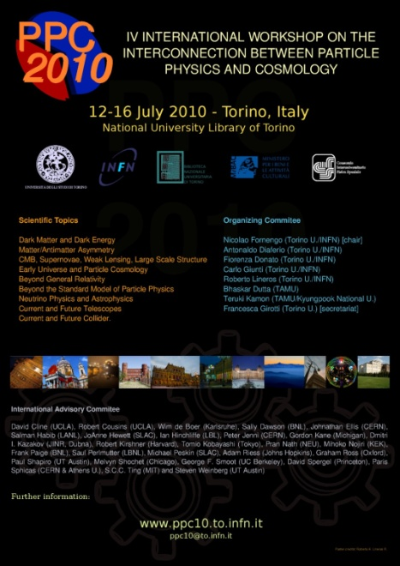

“PPC”
Interconnection between Particle Physics and Cosmology
PPC Cube
PPC 2011 at CERN, June 14-18
PPC 2012 at KIAS, Korea, Nov. 5-9
PPC 2013 at CETUP*, SD, USA, July 8-13
PPC 2014 at Univ. de Guanajuato, Mexico, June 23-27
PPC 2015 at ???
28

Slide 29
1991
As soon as an evidence of unification with MSSM from LEP measurements, Dick and Dimitri gave me their papers on “trileptron” signal.
I started the trilepton analyses. The first CDF paper was in 1996 (http://inspirehep.net/search?p=find+irn+3301664).
in 1995-96: There was a working group for physics at the Tevatron for 2000 and beyond. Chap 6 was written in 95-96. Dick was my mentor of writing this chapter.
http://people.physics.tamu.edu/kamon/research/TEVpheno/TeV2000/Fermilab-Pub-96_082_tev2000_susy.pdf
DiTevatron (1996) and Triper (2001) for SUSY and Higgs …. I think Peter will cover this.
DiTevatron … http://arxiv.org/abs/hep-ph/9406248 (with James)
Tripler … http://inspirehep.net/search?p=find+eprint+hep-ph/0011253 (with Dick)
1998-2000
There was Run II SUSY/Higgs Workshops in 1998.The SUGRA chapter was published in 2000 --- http://arxiv.org/abs/hep-ph/0003154
I was the CDF contact on mSUGRA chapter. nd of course, Dick was there, too. At this time, Bhaskar, too.
2002 – 2012
As soon as WMAP results came, I started the Bs àmumu analysis in 2002, Dick and Bhaskar were behind … (http://www.sciencedirect.com/science/article/pii/S037026930201972X)
The last CDF paper in 2012 … so 10 years to see ~2sigma..
Link: http://people.physics.tamu.edu/kamon/research/TEVpheno/Tevatron_Bs2mumu/, Slava earned on Ph.D with Bsàmumu.
`2006 – present
The first paper of the LHC PHENO Projects in 2006. Link: http://people.physics.tamu.edu/kamon/research/LHCpheno/
We have 3 students (Alfredo Gurrola, Roy Montalvo, Will Flanagan) in this line.
2007 – present … PPC
The first PPC workshop in 2007 at TAMU was from a lunch time discussion with Dick in fall 2006 “DM Searches” are what we inherited from Dick. Reference: http://people.physics.tamu.edu/kamon/TEMP/140626_DM_at_CMS_Kamon_v3c.pptx

Slide 30
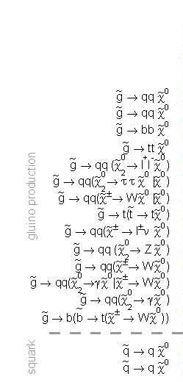
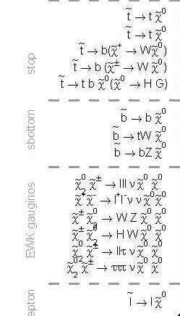
Closer Look at CMS SUSY Searches
stop
gluino production
sbottom
EWK gaugino
squark
slepton
30

Slide 31
Final Tevatron Stuff?
Toback moves stays the course on CDF because there appears to be an excess in the data
→CDF SUSY, VEP, TopBSM (+higgs), Now finally A&M has a spokesperson
There at the beginning and the end
Legacy measurements…
Total of 575 students got their PhD on CDF
8 with 2 more expected soon
3 from CMS, with 3 more soon

Slide 32
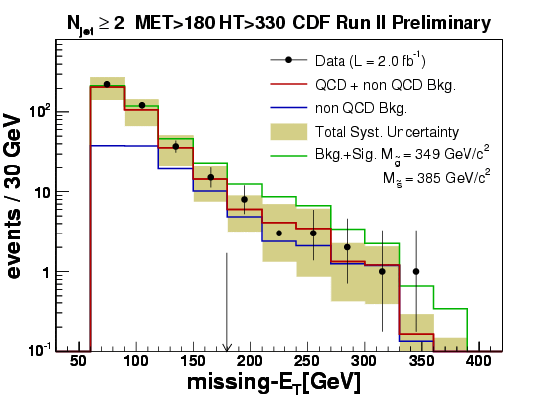
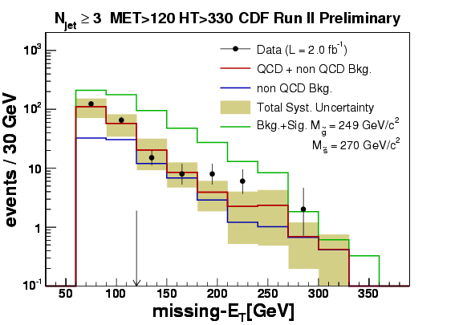
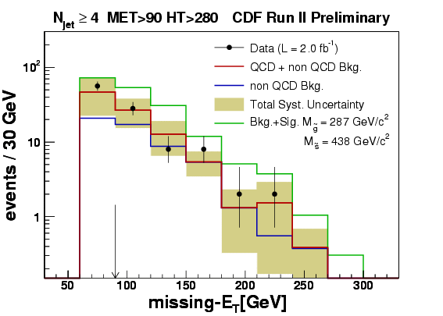
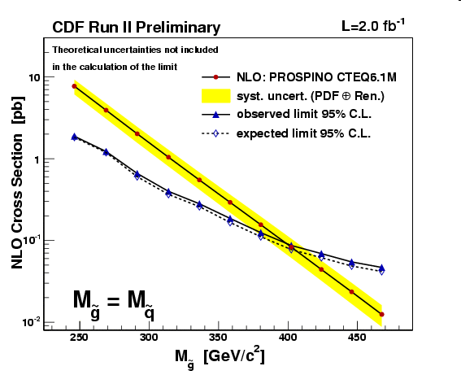
Unified Squark/Gluino Search
2 jets + MET
3 jets + MET
4 jets + MET
SUSY Interpreter
Set Cross Section Limits
No evidence for new physics
As with most CDF results, there are comparable DØ results which I won’t touch on

Slide 33
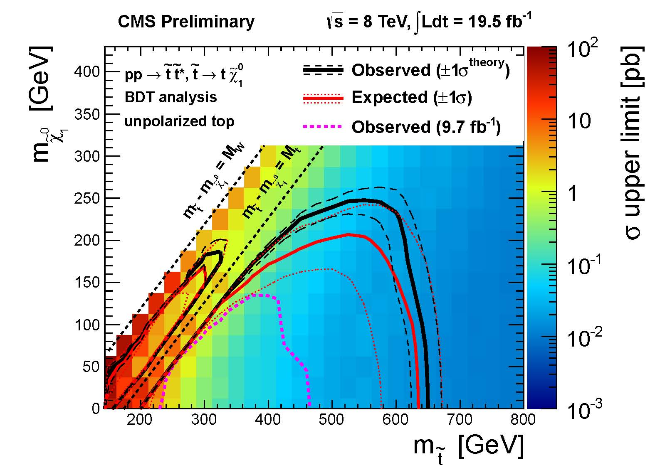
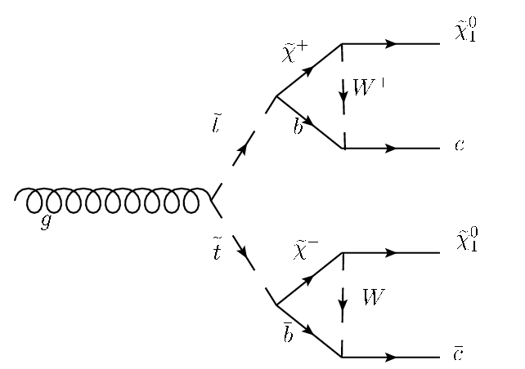
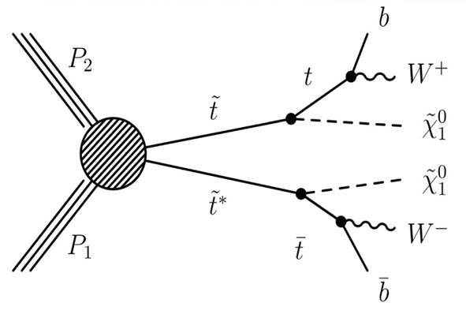
EPJC 73 (2013) 2677: Fig.10(a)
(400, 220)
(250, 240)
ΔM = 7
ΔM = 37
(300, 135)
(250, 85)
(200, 35)
CMS-13-011-PAS
33

